Slide 1
A Sustainable Future:
Social Science and the Struggle to Avert an Environmental and Societal Collapse
Prof Thomas Reuter
University of Melbourne
Introductory presentation @ Academia Europaea
Barcelona, 25 October 2019

Slide 2

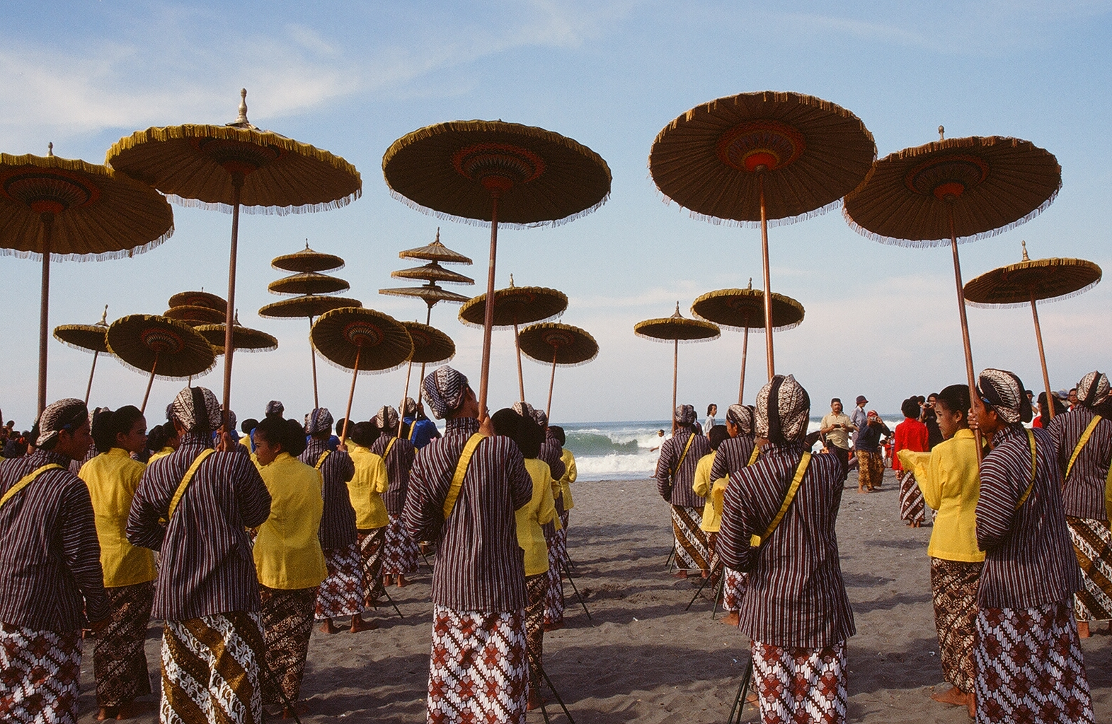
Key areas of past research
  EXPLORING THE LIFEWORLDS OF INDIGENOUS PEOPLE (through extended ethnographic research)

Slide 3
Key areas of past research
  2. Understanding Social Change
  (by exploring cultural revitalisation, religious fundamentalist and anti-globalisation movements)
Notes:
Abstract
Deteriorating environmental growing conditions, increasing demand and increasing inequality together produce mounting food security risks in many countries. Indonesia is among the 30 countries most at risk. Small farmers grow most of Indonesia’s food but struggle to make a living from farming, partly because state interventions depress prices or disrupt local economies. For disadvantaged consumers, in turn, increasing food price volatility is an existential threat. The mainstream recommendation, promoted by agro-science, corporations, many international development agencies and the (Indonesian) state, is to enhance capital investment, technology and market access, which favours the growth of corporate land holdings and profit oriented production. The alternative approach, shared by small-farmers organisations, NGOs and ethnographic researchers, tends toward solutions grounded in local knowledge, sustainable farming, and local systems of distribution and consumption. The radical disjuncture between these two approaches leads their proponents to talk past each other. This paper explores state-led and farmer-led initiatives working across this gap of understanding.

Slide 4
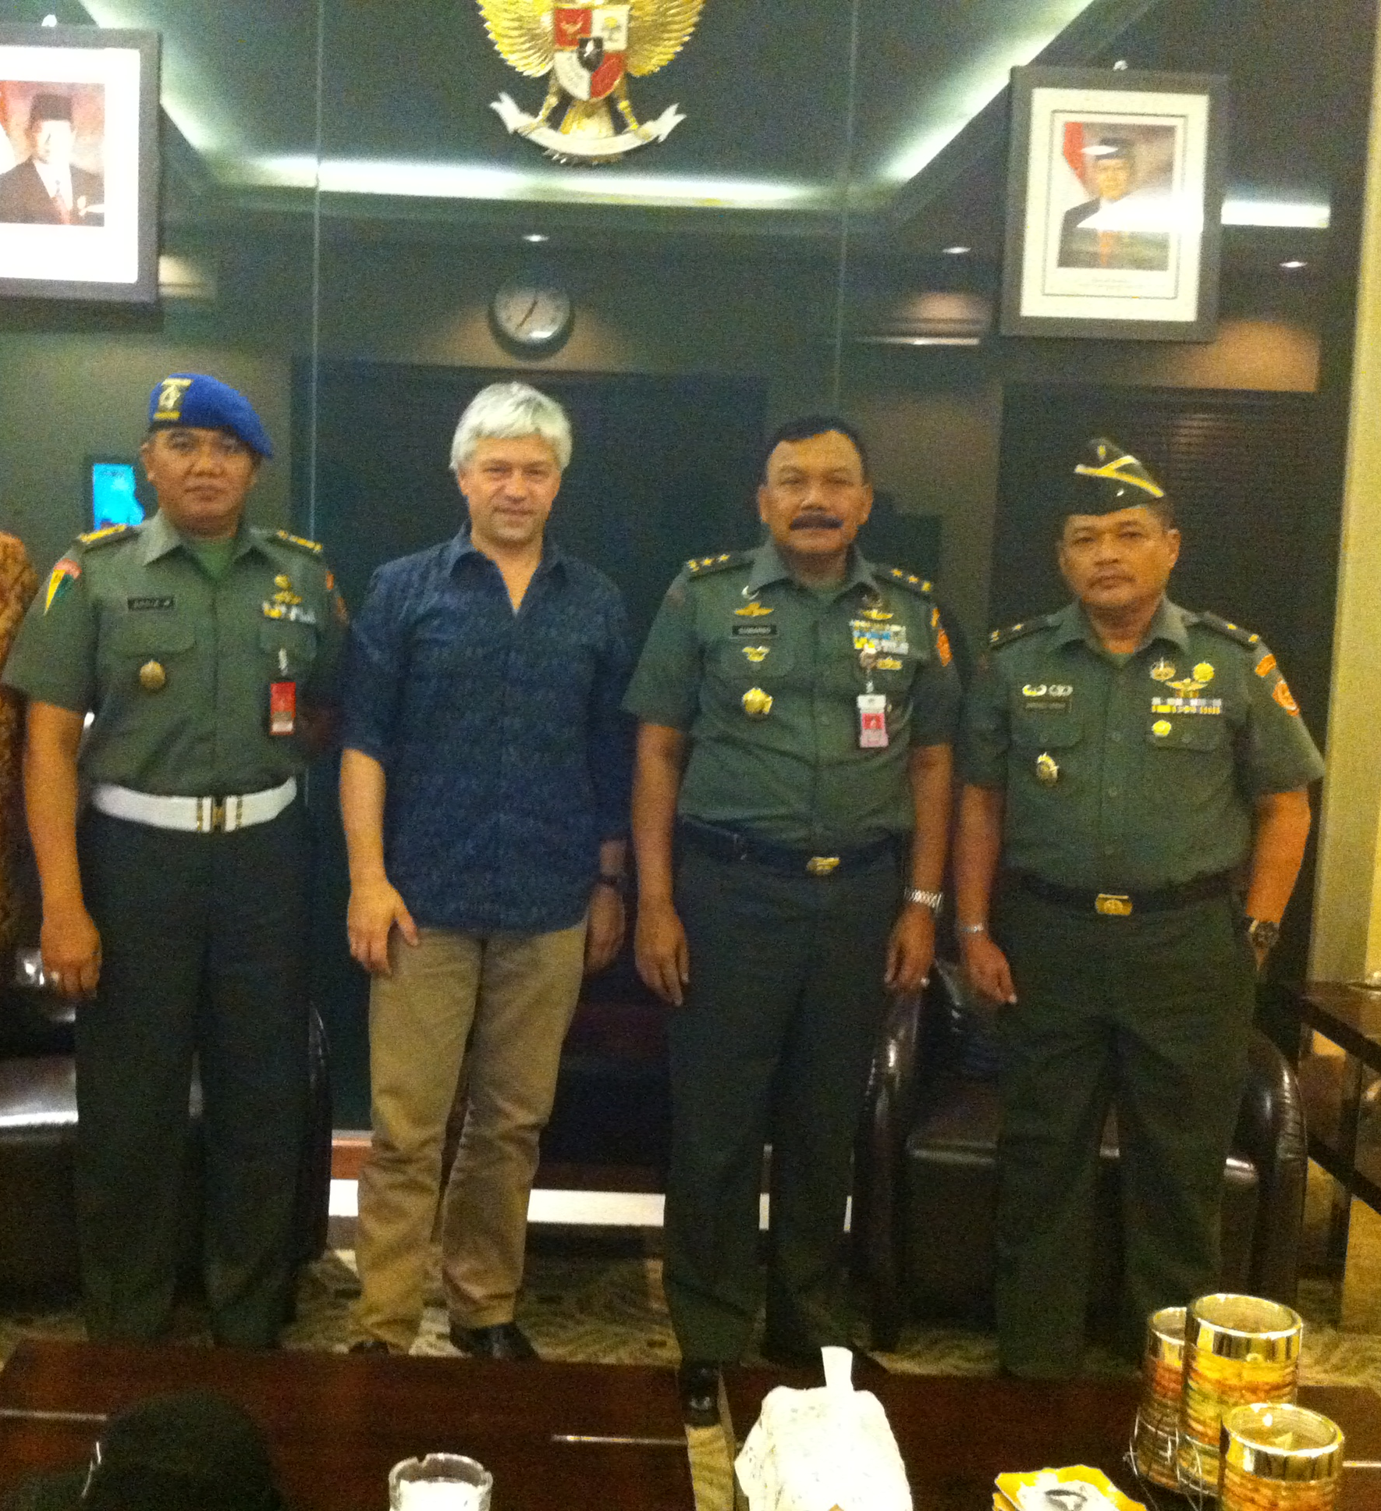
Key areas of past research
  3. UNDERSTANDING
  THE POWER AND LIMITATIONS OF
  ELITES
  (through immersion research with national elites in Indonesia and beyond)
Notes:
Abstract
Deteriorating environmental growing conditions, increasing demand and increasing inequality together produce mounting food security risks in many countries. Indonesia is among the 30 countries most at risk. Small farmers grow most of Indonesia’s food but struggle to make a living from farming, partly because state interventions depress prices or disrupt local economies. For disadvantaged consumers, in turn, increasing food price volatility is an existential threat. The mainstream recommendation, promoted by agro-science, corporations, many international development agencies and the (Indonesian) state, is to enhance capital investment, technology and market access, which favours the growth of corporate land holdings and profit oriented production. The alternative approach, shared by small-farmers organisations, NGOs and ethnographic researchers, tends toward solutions grounded in local knowledge, sustainable farming, and local systems of distribution and consumption. The radical disjuncture between these two approaches leads their proponents to talk past each other. This paper explores state-led and farmer-led initiatives working across this gap of understanding.

Slide 5
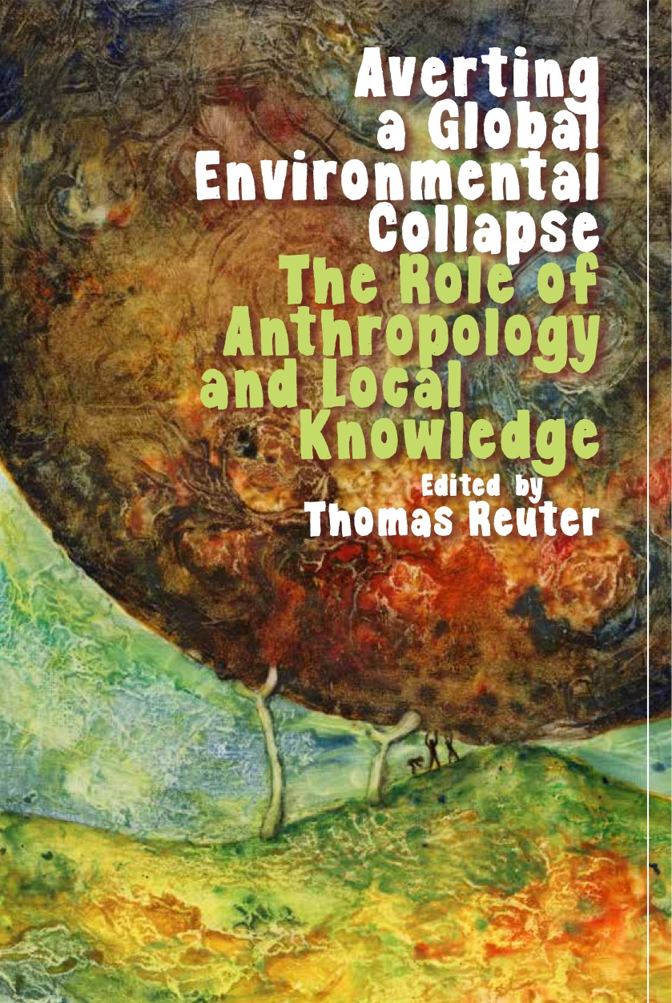
Key areas of past research
  4. USING SOCIAL SCIENCE TO HELP AVERT A GLOBAL ENVIRONMENTAL COLLAPSE
  (by studying the impact of climate change, potentials for adaptation and the scope of local sustainability action)
Notes:
Abstract
Deteriorating environmental growing conditions, increasing demand and increasing inequality together produce mounting food security risks in many countries. Indonesia is among the 30 countries most at risk. Small farmers grow most of Indonesia’s food but struggle to make a living from farming, partly because state interventions depress prices or disrupt local economies. For disadvantaged consumers, in turn, increasing food price volatility is an existential threat. The mainstream recommendation, promoted by agro-science, corporations, many international development agencies and the (Indonesian) state, is to enhance capital investment, technology and market access, which favours the growth of corporate land holdings and profit oriented production. The alternative approach, shared by small-farmers organisations, NGOs and ethnographic researchers, tends toward solutions grounded in local knowledge, sustainable farming, and local systems of distribution and consumption. The radical disjuncture between these two approaches leads their proponents to talk past each other. This paper explores state-led and farmer-led initiatives working across this gap of understanding.

Slide 6
CURRENT INDIVIDUAL RESEARCH: SDG2 - FOOD
Types of Food Security Risks:
  Demand Risks: Population growth + per capita consumption growth
  Supply Risks: Global & Local Limits to Growth
  Ecological Risks: Environmental Change and Associated Disaster Impacts
  Distribution Risks: Market-based Food Systems (moral economy deficit)
Notes:
Abstract
Deteriorating environmental growing conditions, increasing demand and increasing inequality together produce mounting food security risks in many countries. Indonesia is among the 30 countries most at risk. Small farmers grow most of Indonesia’s food but struggle to make a living from farming, partly because state interventions depress prices or disrupt local economies. For disadvantaged consumers, in turn, increasing food price volatility is an existential threat. The mainstream recommendation, promoted by agro-science, corporations, many international development agencies and the (Indonesian) state, is to enhance capital investment, technology and market access, which favours the growth of corporate land holdings and profit oriented production. The alternative approach, shared by small-farmers organisations, NGOs and ethnographic researchers, tends toward solutions grounded in local knowledge, sustainable farming, and local systems of distribution and consumption. The radical disjuncture between these two approaches leads their proponents to talk past each other. This paper explores state-led and farmer-led initiatives working across this gap of understanding.

Slide 7
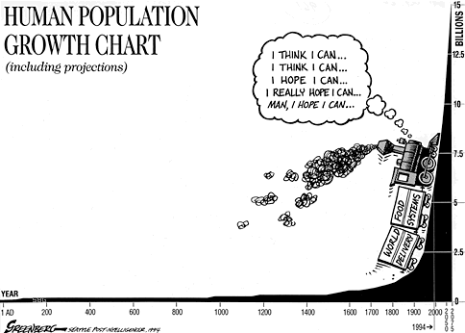
1. Demand Growth– cf. population increase
Notes:
World population is predicted to increase by about 50% by the end of this century. Most of the increase will be in Sub-Saharan Africa. But Indonesia is also affected.
Source: subdude-site.com

Slide 8
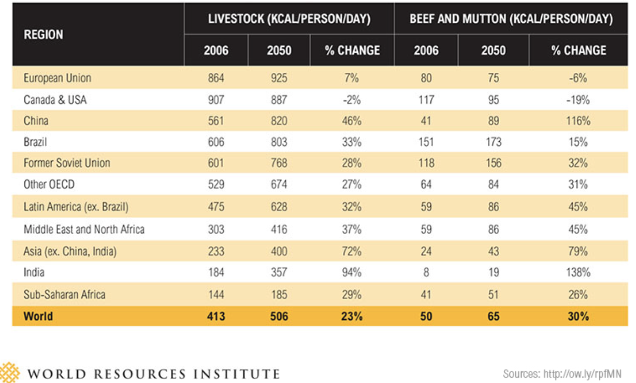
1. Demand Growth – cf. higher per capita consumption and dietary composition change
Notes:
Consumption per capita is increasing as the middle class expands in developing countries, notably China and India. This is exacerbated by dietary shifts toward more animal based foods that are costly in terms of land use and environmental impact.

Slide 9
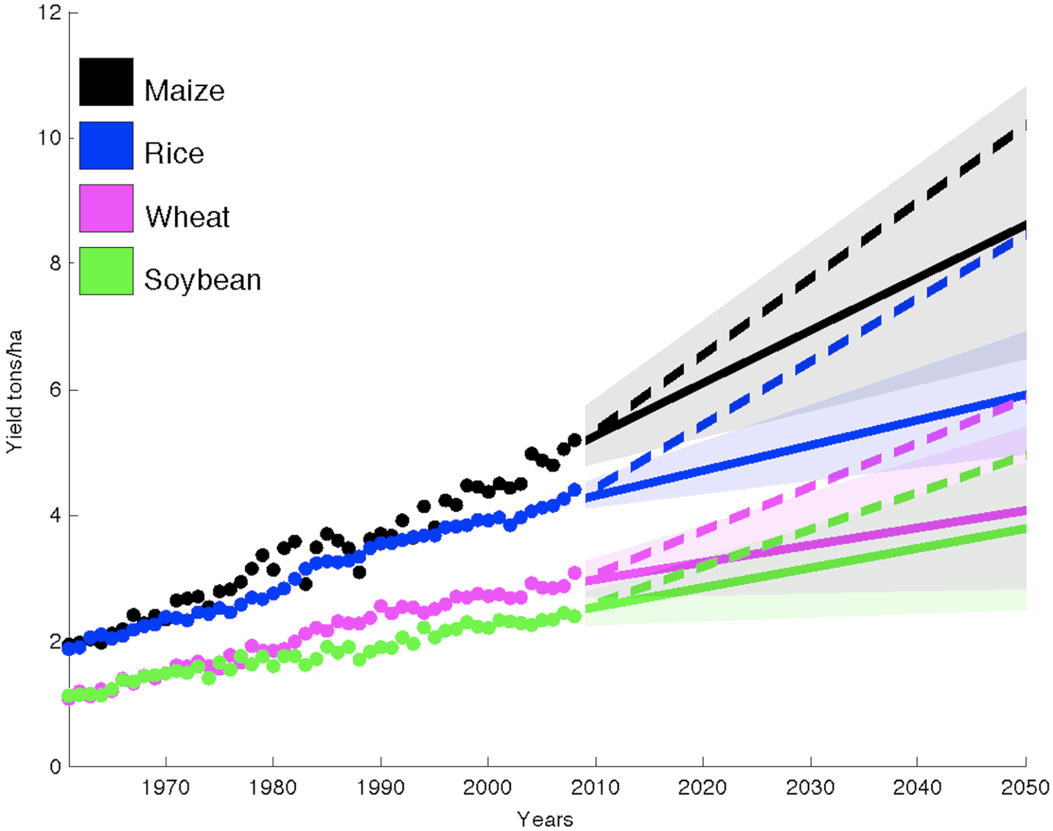
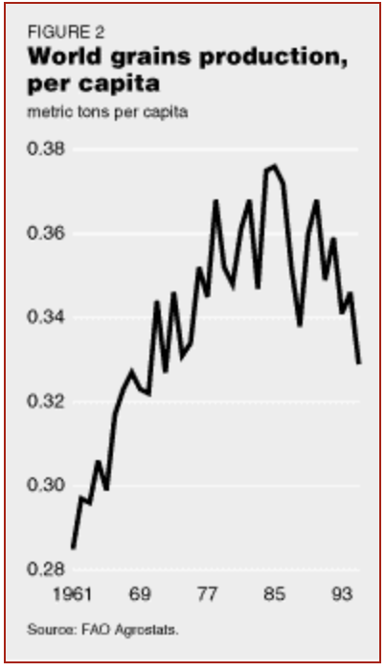
2. Supply Risks: The GR in its present form has reached its limits
Notes:
Yield per hectare increases are not keeping up: Solid line: actual projections; dotted line: what we need…
Source: http://journals.plos.org/plosone/article?id=10.1371/journal.pone.0066428
D.K Ray, N.D. Miller, P.C. West and J.A. Foley 2013. Yield trends are insufficient to double crop production by 2050.

Slide 10
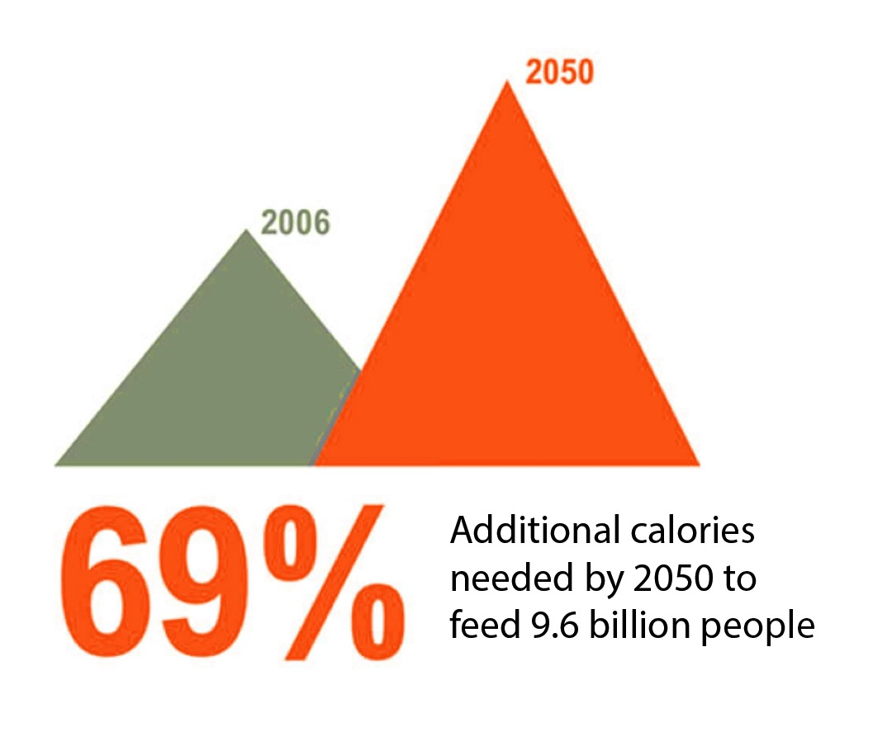
Overall effect = the growing FOOD GAP
Notes:
Note there is also a quality gap. Increasing production often goes hand in hand with increasing reliance on processed foods of poor nutritional value.
The FOOD GAP
Source: World Resources Institute

Slide 11
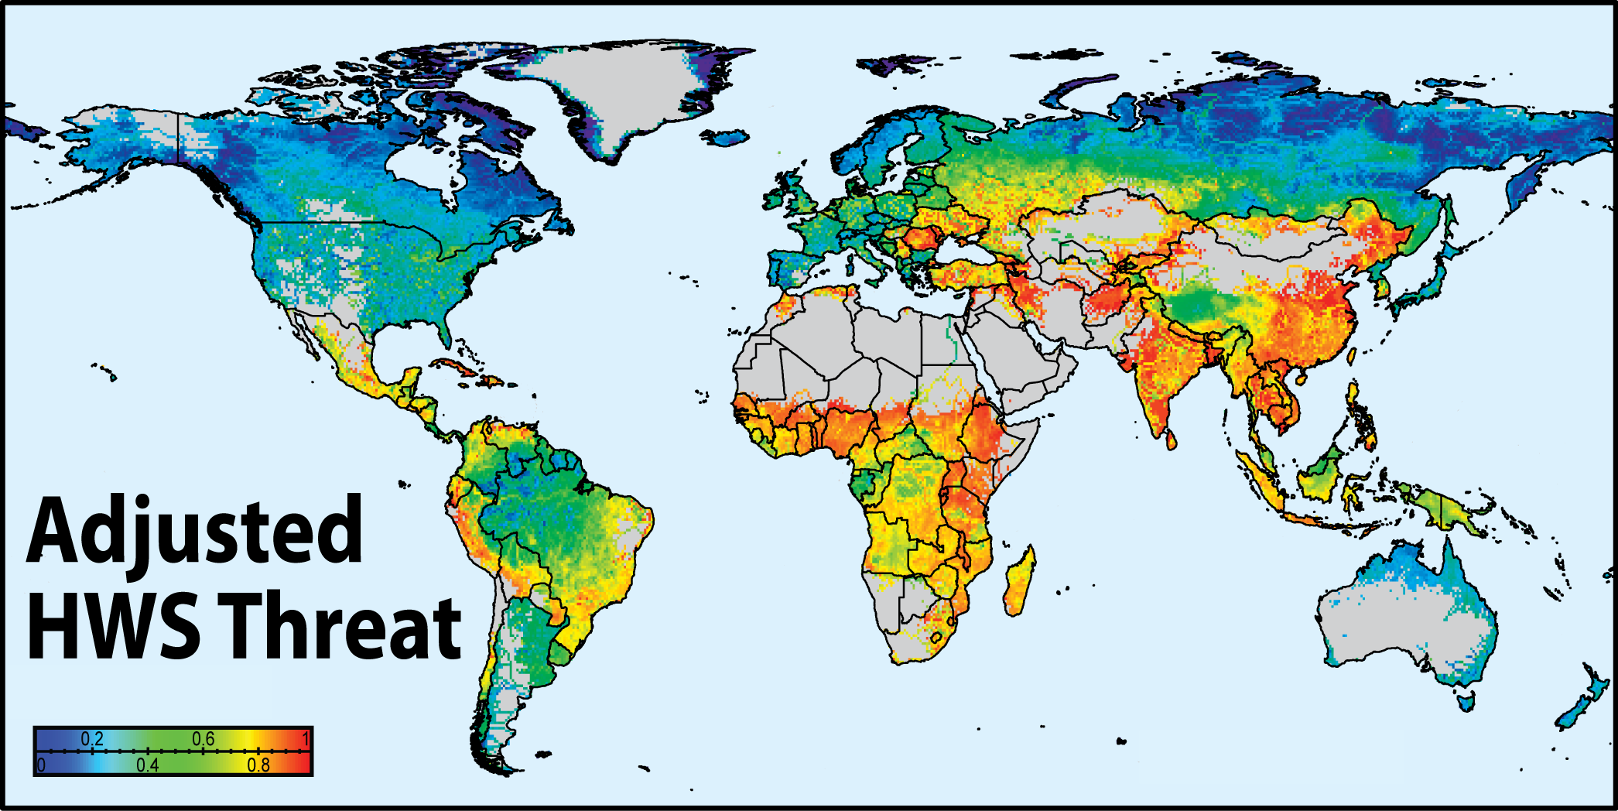
3. Ecological Change: Risks for Food Production
Example: World Water Security Crisis
Notes:
Note: This is water security NOW. Likely to deteriorate rapidly in future
According to the laws of thermodynamics, a warming world will be subject to higher wind energy and greater weather extremes in general. Increased evaporation rates and declining reserves in aquifers, as well as the loss of freshwater stores in glaciers, pose a major threat for our large rivers and for the large irrigated agricultural production and population centres that depend on them.

Slide 12
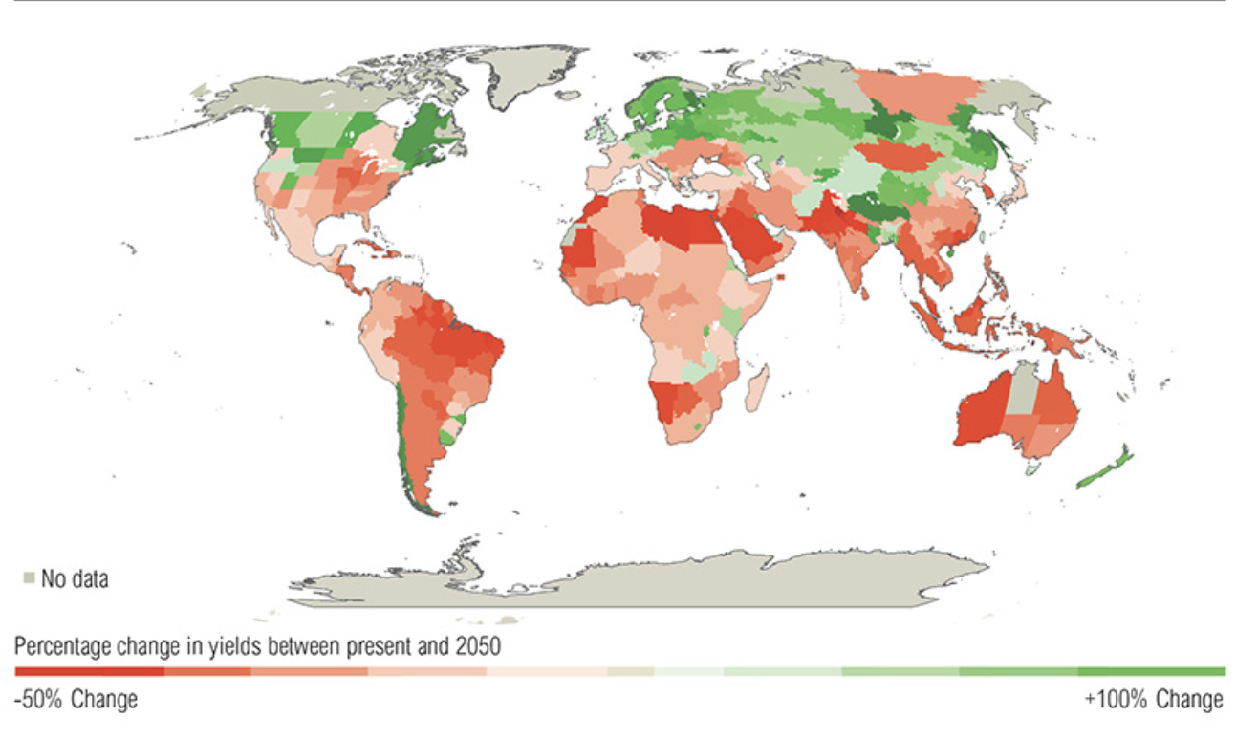
Example: 3 degrees of warming - effect on yields
Notes:
Source: World Resources Institute

Slide 13
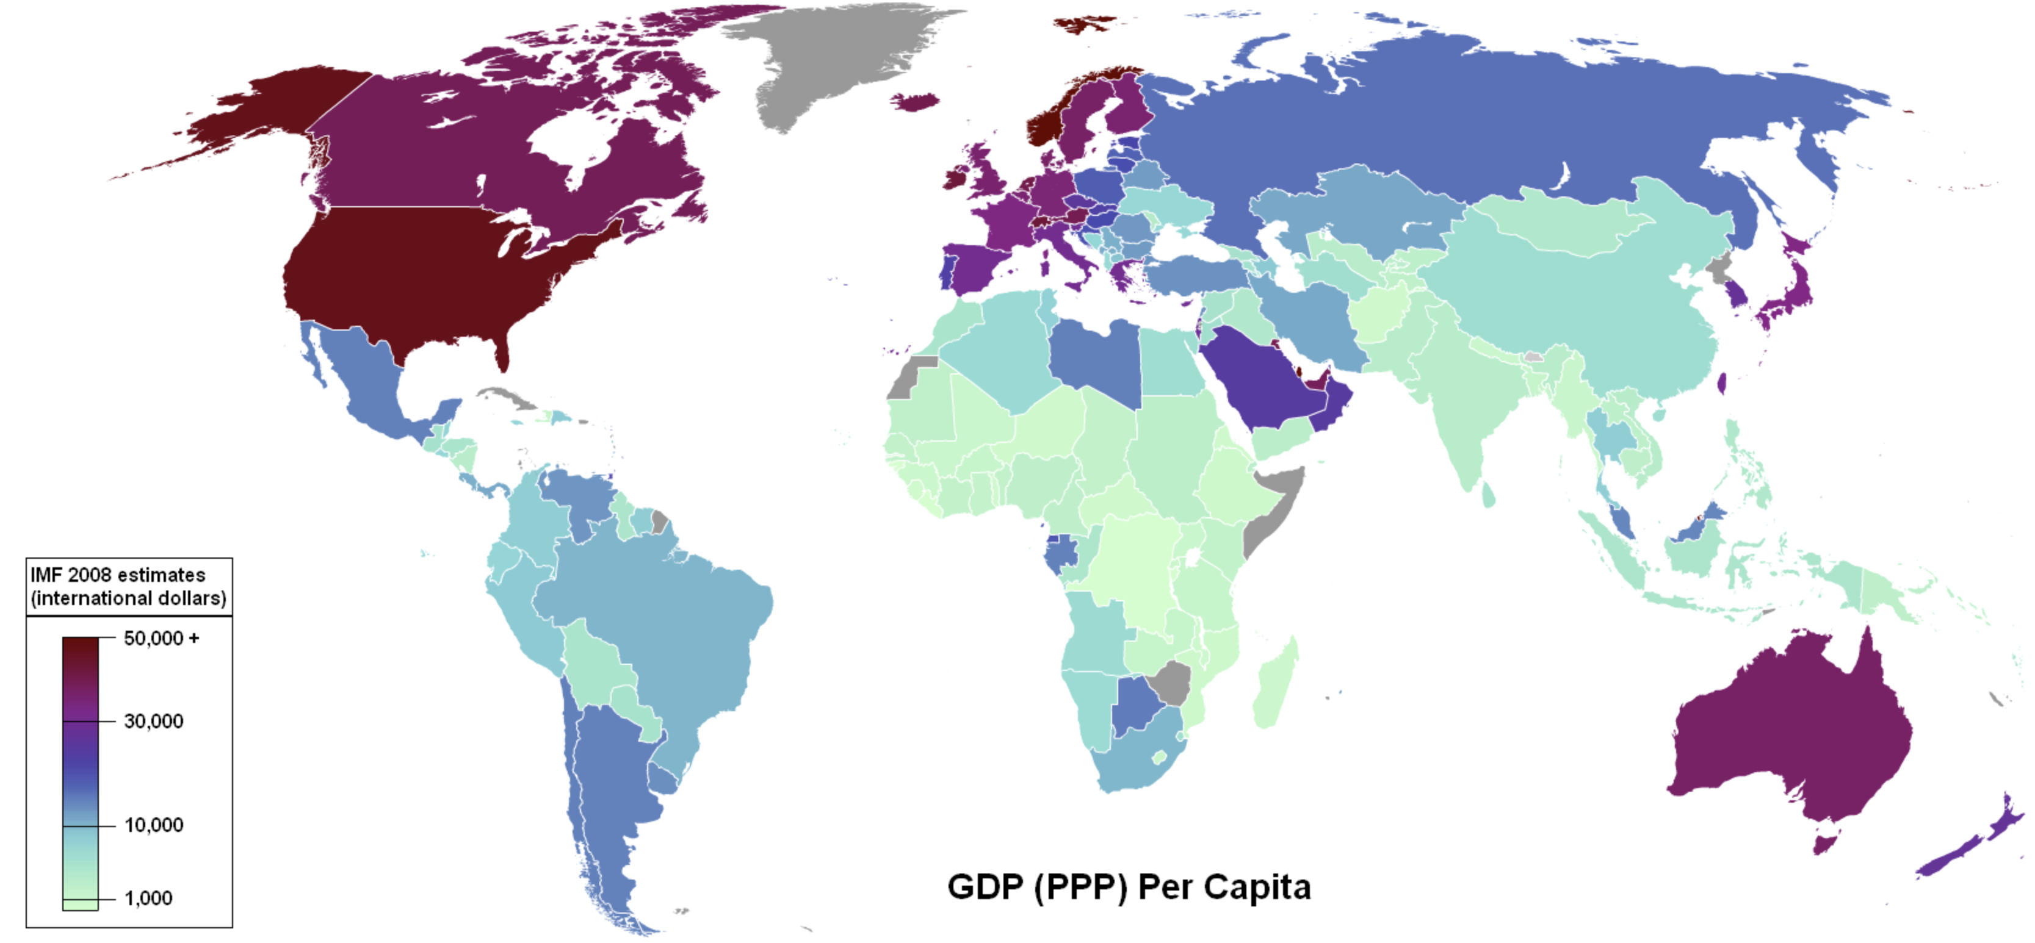
4. Distribution Risks: Inequality & Ability to Pay
The poorest countries are the first victims, but downwardly mobile working and middle classes in rich countries are also at risk, certainly in the event of a crisis
Food affordability is already decreasing in many countries
Market dependence (as sovereign local food systems are dismantled)
Source: Geocurrents
Notes:
High prices cannot be paid by those who are already most food insecure. MARKET FAILURE.
A World Food Treaty is needed.
Source: http://www.geocurrents.info/economic-geography/global-inequality-where-is-it-found

Slide 14
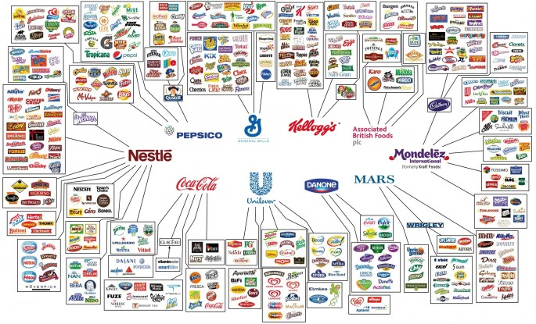
3. Distribution Risks:
Food Market Cartels and Financial Speculation
Market Capture (cartel formation) and
Market Manipulation (speculators amplify and profit from volatility)
Source: Braodsheet
Notes:
Cargill and Continental control 50% of the world’s grain.
MARKET FAILURE.
A World Food Treaty is needed.
Image Source: http://www.broadsheet.ie/2014/07/14/the-food-cartel/

Slide 15
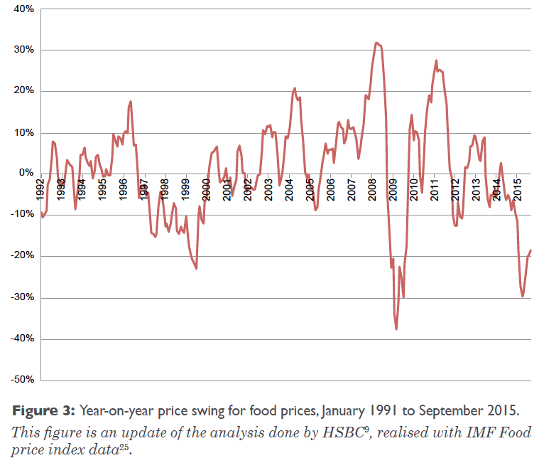
3. Distribution Risks: Rising Food Price Volatility
Average food price index volatility from year to year was ~7% in 1991 -2006, but rose to 14% in 2007 and 2015 !
Monthly price level changes >4 standard deviations from the annual average rose from 8 out of 187 between 1991 and 2007 to 48 out of 99 since then
Source: UNEP ERISK Report Stage 2
Notes:
High prices cannot be paid by those who are already the most food insecure. MARKET FAILURE.
A World Food Treaty is needed.

Slide 16
What is the Solution?
NO CLEAR ANSWER:
Trust Big Agro: Further Industrialisation of Agriculture
(A view supported by most agro-scientists)
vs.
Trust in Family and Community Farming: Small is beautiful
(A view supported by many social scientists)
Who is right?
Source: UNEP ERISK Report Stage 2

Slide 17
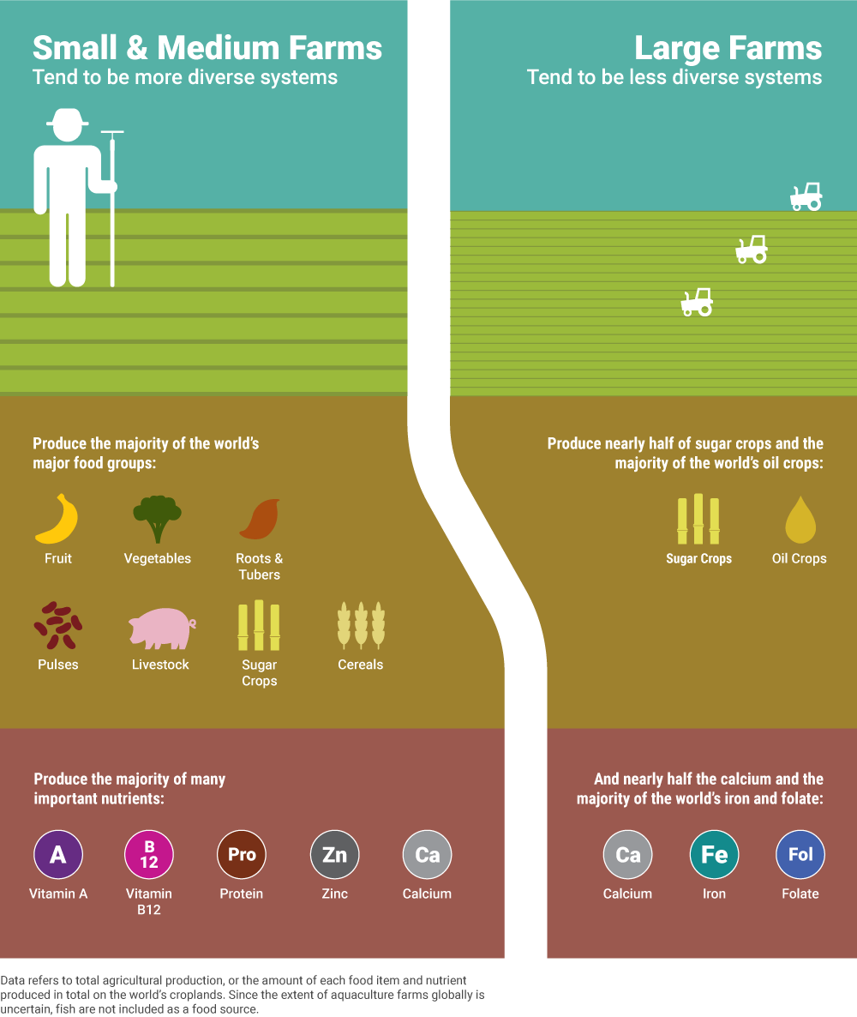
FAO now says: “Small is
Beautiful”
Small farmers feed 2/3 of the world with healthy food on less that a quarter of arable land;
corporate farming specialises on producing sugar and fat (biofuels)
Source: http://www.environmentreports.com/small-farms-stewards-global-nutrition/
Notes:
Quote refers to the title of a book by E.F. Schumacher, a visionary 1970s economist.
The FAO says it is viable to sustain the world population with small scale organic farming.
More likely to satisfy the new SDGs and agenda 2030, to which 193 governments pledged their support in 2015.

Slide 18
Small is
Beautiful
Fisheries
A similar pattern as
small vs. large scale farming
Source: National Geographic 2008 / UBC
Notes:
Commercial fisheries: huge carbon footprint, more waste and eco-damage

Slide 19
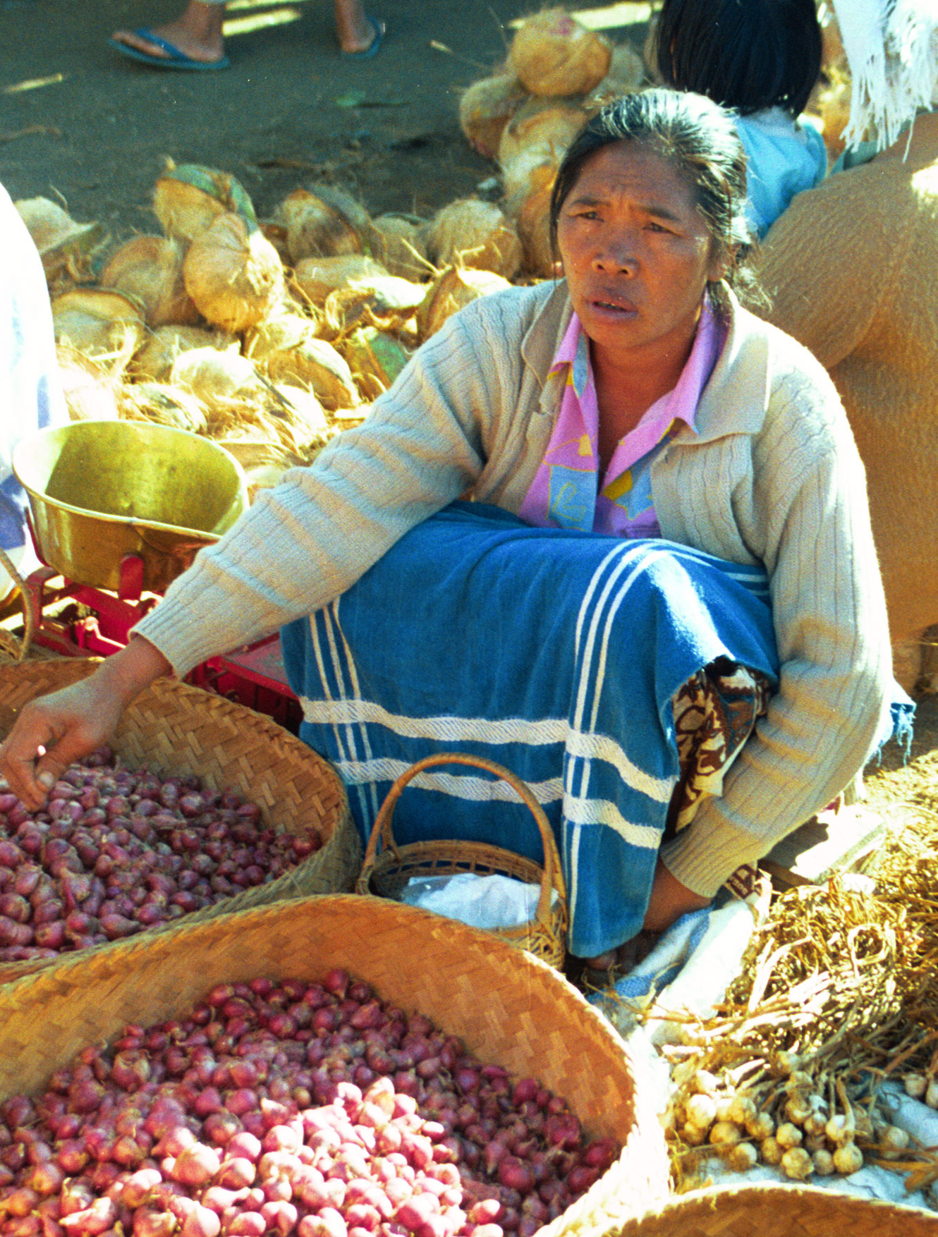
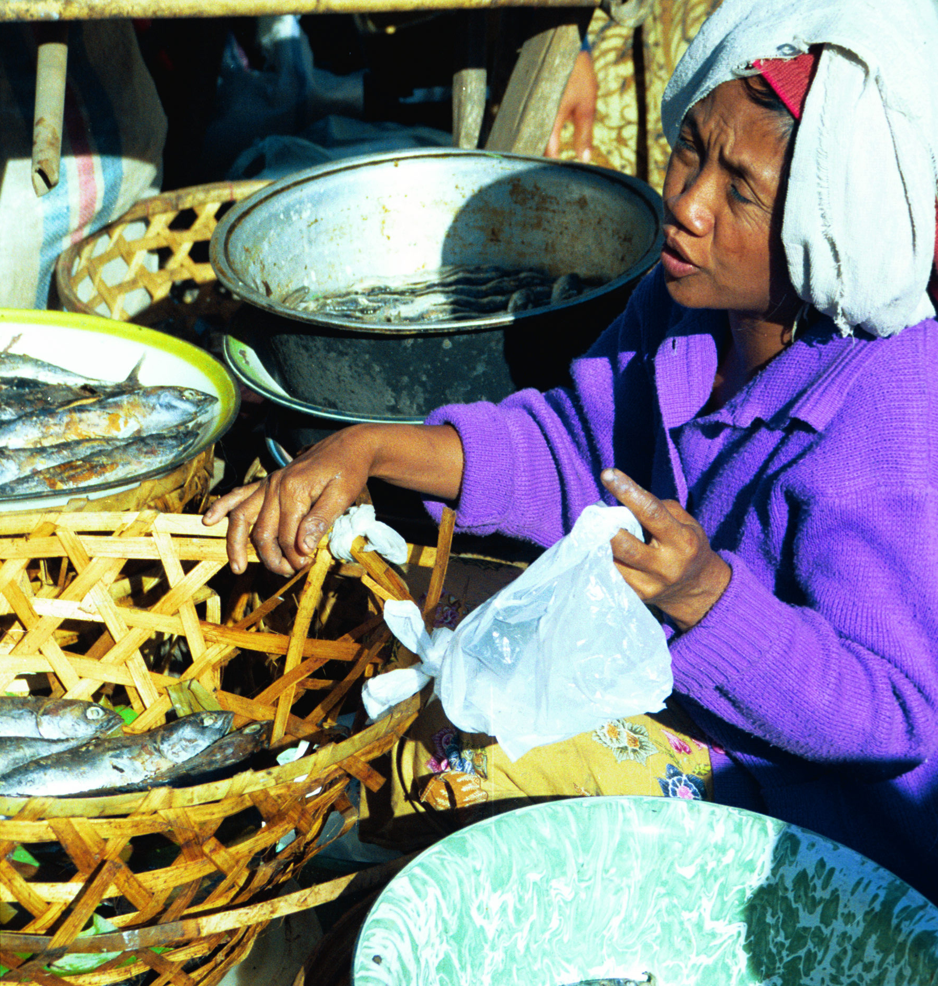
Indonesia
Small eco-famers & fishers - vital but have no state support

Slide 20
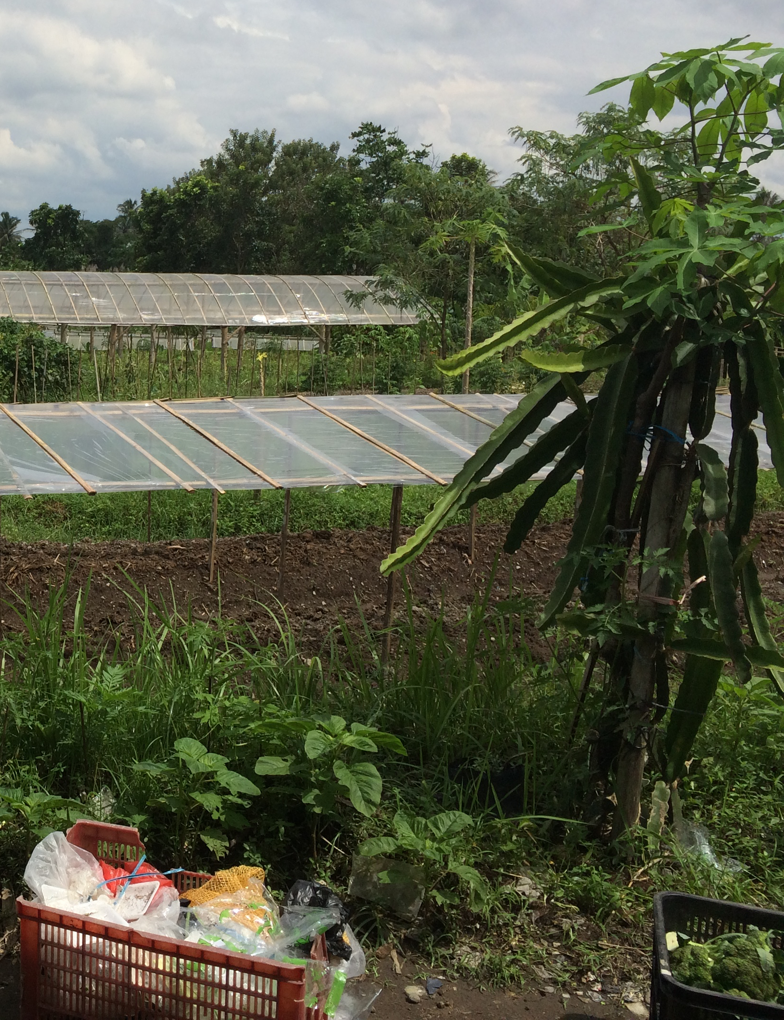
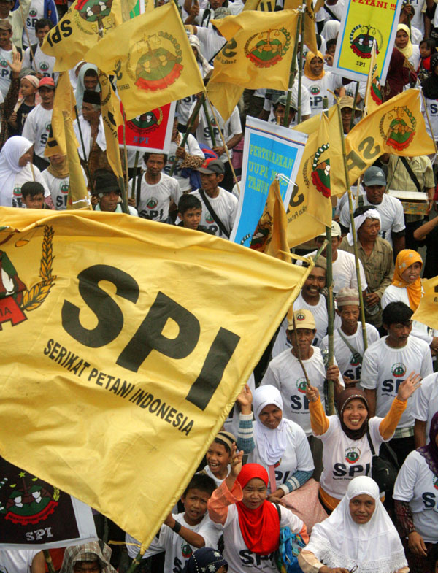
Local Responses:
Sustainable farming movement in Indonesia:
Revitalization of Tradition + Innovation

Slide 21
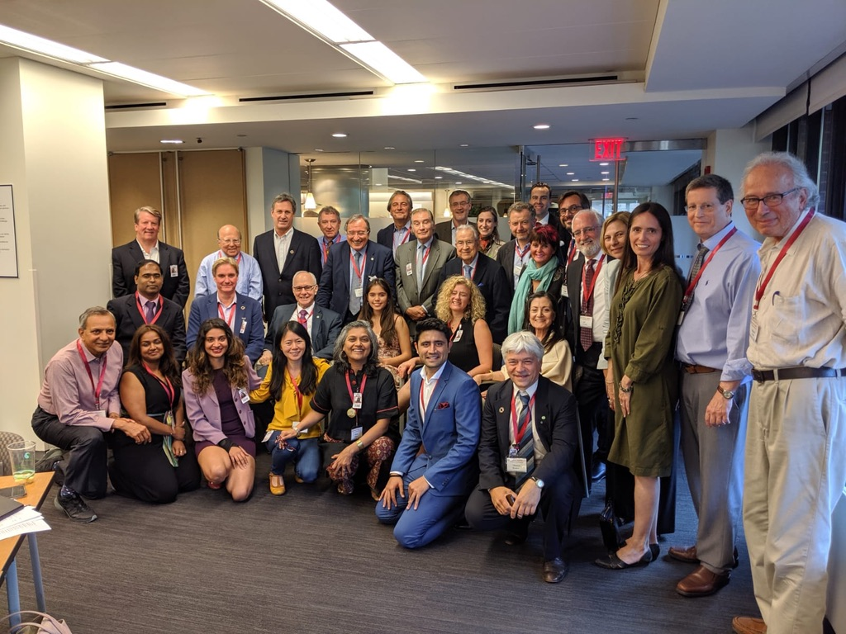
ENGAGEMENT: Science Policy Interface
FUTURE FINANCE INITIATIVE >
with UN (New York) and World Bank
Leading roles in:
WAAS
ISC
WCAA
IUAES
Advisory roles in:
IPCC
IPBES
UNESCO
Nat’l Govts

Slide 22
THANK YOU
FOR YOUR ATTENTION
Contact:
Prof Thomas Reuter
Asia Institute
University of Melbourne
Email: thor2525@gmail.com

