Slide 1
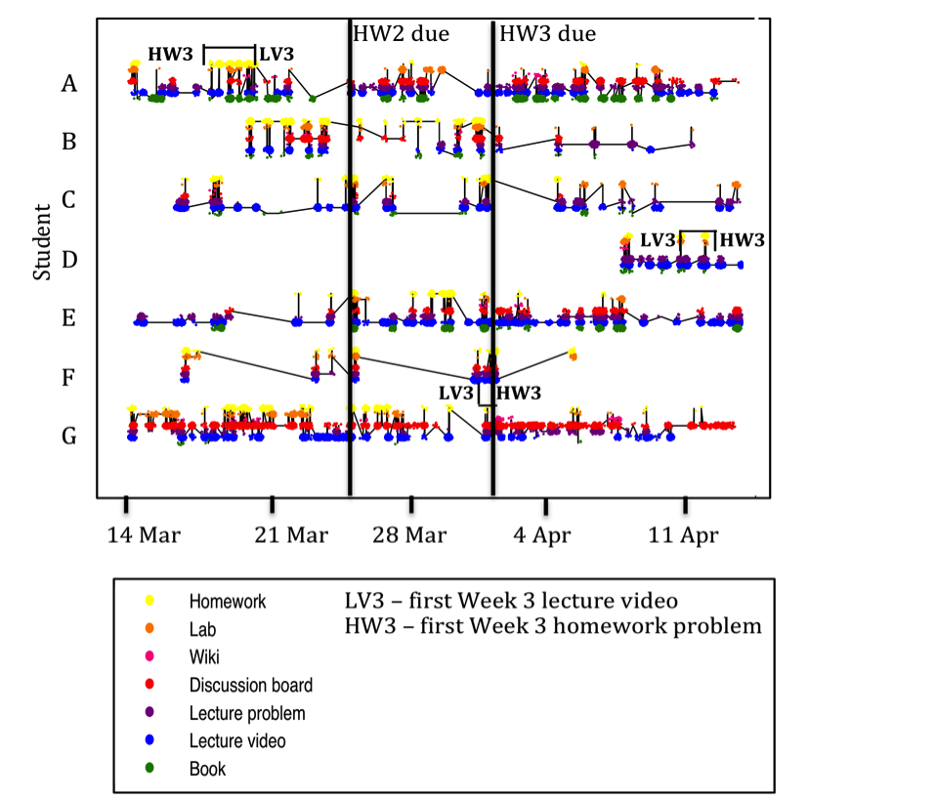
MOOC Research
What we know and what we would like to find out
A presentation for the International Symposium
Emerging Models of Learning and Teaching in Higher Education:
From Books to MOOCs?
Dr. Lori Breslow
MIT Teaching and Learning Laboratory
Graph courtesy of Professor Jennifer DeBoer, Purdue University

Slide 2
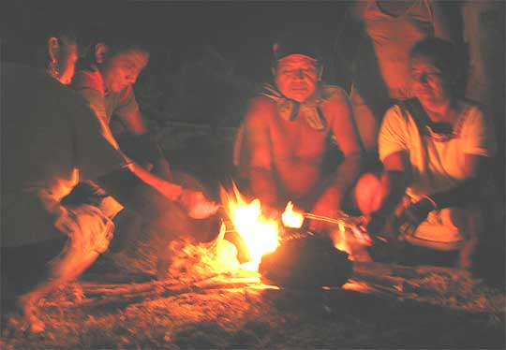


The book changed . . .
Emerging Models of Learning and Teaching in Higher Education
May 2015
Notes:
Previous work in history of communication technologies . . . know changes are more subtle and usually not what people prophesize

Slide 3



The computer changed . . .
Emerging Models of Learning and Teaching in Higher Education
May 2015

Slide 4
More information, coming faster, from a more diverse group of people
+
= ?
Emerging Models of Learning and Teaching in Higher Education May 2015

Slide 5
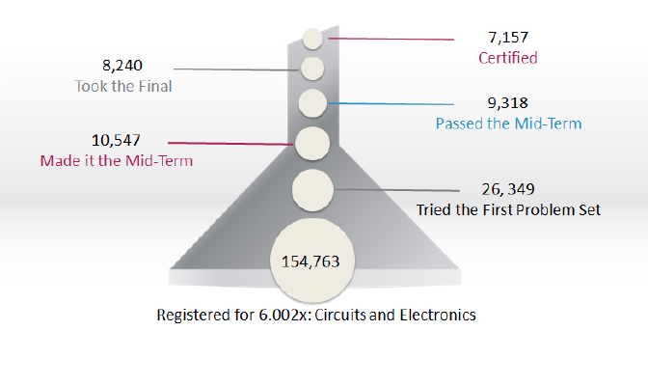
From 154,000+ registrants to 7,000+ certificate earners in 6.002x (spring ’12)
Source: edX
Emerging Models of Learning and Teaching in Higher Education May 2015
Notes:
We want to know about the certificate earners, but also about other groups. What about the students who tried the first problem set? Who passed the midterm but didn’t take the final? What about students who joined halfway but earned a certificate?

Slide 6
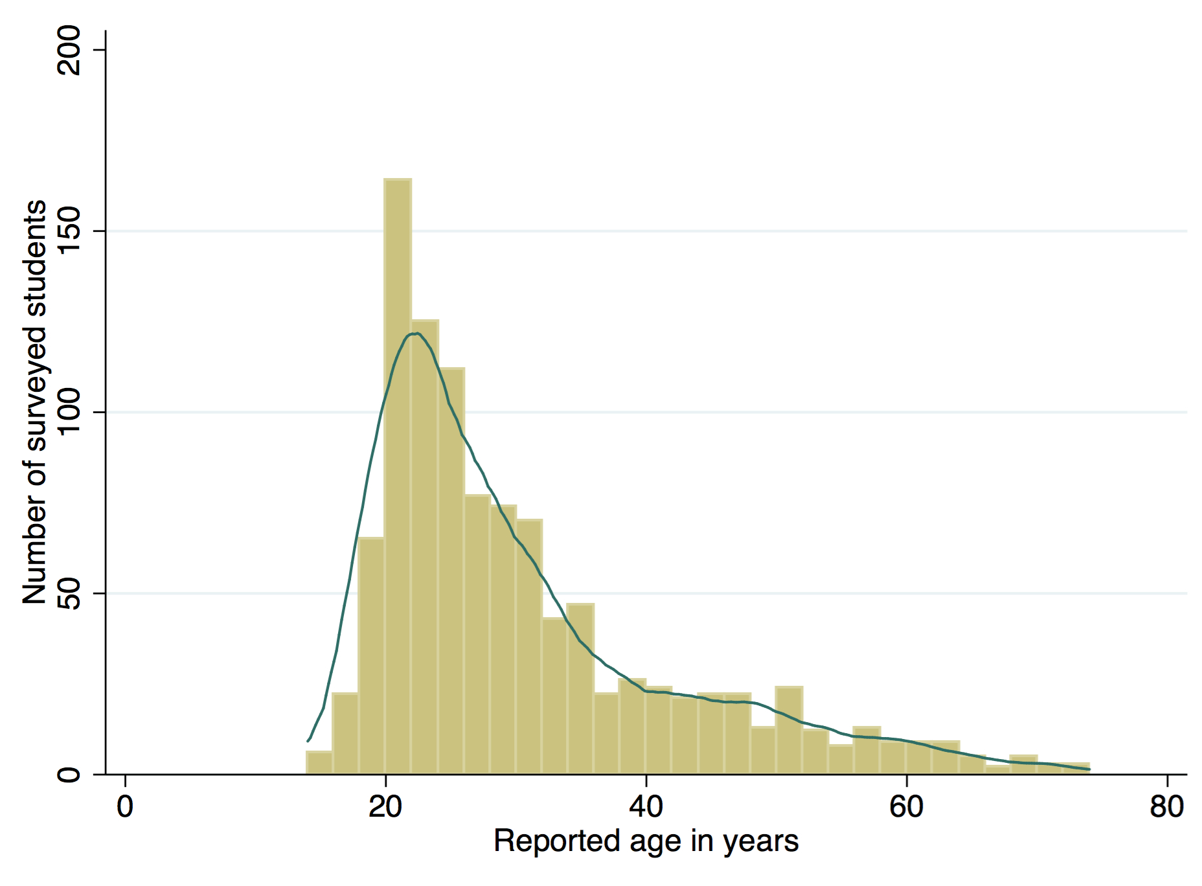
Most survey respondents reported being in their 20s or 30s
88% were male
88% were male
N = 1,116 [matrix sample]
Analysis by Dr. Jennifer DeBoer
Breslow, L., Pritchard, D. E., DeBoer, J., Stump, G. S., Ho, A. D., & Seaton, D. T. (2013). Studying learning in the worldwide classroom. Journal of Research and Practice in Assessment, http://www.rpajournal.com

Slide 7
Primary reason for enrolling
N = 1,173 [matrix sample]
Percent of students
Analysis by Dr. Jennifer DeBoer
Notes:
N will vary by question because of matrix sampling

Slide 8
Relations between background and achievement in full-points model
None
None
None
None
Marginal
Positive
Positive
− Reason for enrolling
− Age
− Gender
− Parental/home background
− Degree level
− Level of calculus
* Work off line with someone else
Analysis by Dr. Jennifer DeBoer
Emerging Models of Learning and Teaching in Higher Education May 2015
Notes:
Online course count may matter…

Slide 9
An outpouring of research
300+ in 2015
150-200 on MOOC Literature Browser in 2013
20 papers
on ERIC
before 2013
Learning@Scale, 2014 & 2015
http://learningatscale.acm.org
Emerging Models of Learning and Teaching in Higher Education May 2015

Slide 10
MRI Classification
Student engagement & learning success
MOOC design & curriculum
Self-regulated learning & social learning
Social network analysis & networked learning
Motivation, attitude & success criteria
Gašević, G. Kovanović, V., Joksimović, S., & Siemens, G. (2014). Where is research on Massive Open Online Courses Headed? A Data Analysis of the MOOC Research Initiative. The International Review of Research in Open and Distributed Learning 5(15), http:http://www.irrodl.org/index.php/irrodl/article/viewFile/1954/3111.

Slide 11
Breslow & DeBoer Classification
Persistence
Pedagogy
Discussion forums
Analytics/methodologies
The MOOC phenomena itself
DeBoer, J. & Breslow, L. (2015). Understanding the general utility of online resources for achievement in a MOOC, forthcoming.

Slide 12
Persistence
Persistence • Pedagogy • Discussion Forums • MOOC Phenomenon • Analytics/Methodology
By a conventional understanding . . .
Miserable
− But what’s the
denominator?
− Isn’t 7,157 still
pretty impressive?
Source: edX spring 2013
See DeBoer, J., Ho, A. D., Stump, G. S., & Breslow, L. (2014). Changing “course”: Reconceptualizing educational variables for massive open online courses. Educational Researcher, 43(2), 74-84; and Koller, D., Ng, A., Do, C., & Chen, Z. (2013). Retention and intention in massive open online courses: In depth. Educause Review, 48(3), 62-63.

Slide 13
Pedagogy
Persistence • Pedagogy • Discussion Forums • MOOC Phenomenon • Analytics/Methodology
Most studies have been in the service of persistence:
Assign students to small groups based on correct answers (Hearst, et al.)
Intervene when students disappear (Krumm, et al.)
Crowd source coding assignments (O’Reilly, et al.)
Form co-located study groups (Li & Dillenbourg)
Send messages to increase “stickiness” (Kotturi, et al.)
Emerging Models of Learning and Teaching in Higher Education May 2015

Slide 14
Discussion Forums
Persistence • Pedagogy • Discussion Forums • MOOC Phenomenon • Analytics/Methodology
What’s on them? (Cui & Wise)
Who uses them? (Enyon, et al.)
To what effect? (Huang, et al.; Shillair & Walsh)
How can they be used to their best advantage? (Stump, et al.; Ertmer, et al.)
Emerging Models of Learning and Teaching in Higher Education May 2015

Slide 15
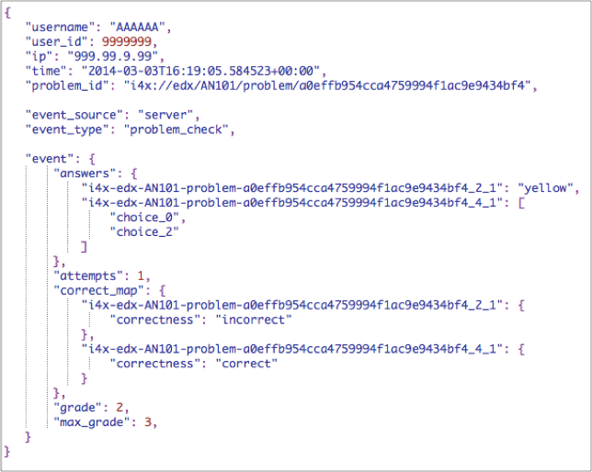
Analytics
Persistence • Pedagogy • Discussion Forums • MOOC Phenomenon • Analytics/Methodology
Tracking log courtesy of Xin Chen
Emerging Models of Learning and Teaching in Higher Education May 2015

Slide 16
Analytics/Methodology
Persistence • Pedagogy • Discussion Forums • MOOC Phenomenon • Analytics/Methodology
Predicting student success from
Demographics (Brooks, et al.)
Wheel-spinning (Gong & Beck)
Navigation/activity patterns (Guo)
Discussion forums (Yang, et al.)
Methods include
Structural Topic Model (Reich)
Latent Dirichlet Allocation (Coleman, et al.)
A/B testing (Tomkin & Charlevoix)
Text & graphic clustering (Yang & Rose)

Slide 17

Persistence • Pedagogy • Discussion Forums • MOOC Phenomenon • Analytics/Methodology
The MOOC Phenomenon

Slide 18
What should we know?
Will MOOCs, as originally conceived, be viable in the future?
Emerging Models of Learning and Teaching in Higher Education May 2015

Slide 19
What should we know?
If yes
How do we increase persistence?
How do we know what/if students are learning?
How can we make better use of technological affordances?
If no, data can still tell us about
What are common misconceptions (in specific fields) & ways of addressing them?
How can we link concepts in different contexts?
What rhetorical moves can instructors & students make to improve social learning?
Emerging Models of Learning and Teaching in Higher Education May 2015

Slide 20
References
Breslow, L., Pritchard, D. E., DeBoer, J., Stump, G. S., Ho, A. D., & Seaton, D. T. (2013). Studying learning in the worldwide classroom. Journal of Research and Practice in Assessment, http://www.rpajournal.com.
Brooks, C., Stalburg, C., Dillanunt, T., & Robert, L. (2015, March). Learn with friends: The effects of student face-to-face collaborations on Massive Open Online Course activities. Learning at Scale (work-in-progress), Vancouver, British Columbia, Canada.
Coleman, C. A., Seaton, D. T., Chuang, I. (2015, March). Probabilistic use cases: Discovering behavioral patterns for predicting certification. Learning at Scale, Vancouver, British Columbia, Canada.
Cui, Y. & Wise, A. F. (2015, March). Identifying content-related threads in MOOC discussion forums. Learning at Scale (work-in-progress), Vancouver, British Columbia, Canada.
DeBoer, J., Ho, A. D., Stump, G. S., & Breslow, L. (2014). Changing “course”: Reconceptualizing educational variables for massive open online courses. Educational Researcher, 43(2), 74-84.
Ertmer, P. A., Sadaf, A., & Ertmer, D. J. (2011). Student-content interactions in online courses: The role of question prompts in facilitating higher-level engagement with course content. Journal of Computing in Higher Education, 3, 157–186.
Gašević, G., Kovanović, V., Joksimović, S., & Siemens, G. (2014). Where is research on Massive Open Online Courses headed? A data analysis of the MOOC Research Initiative. The International Review of Research in Open and Distributed Learning 5(15), http://www.irrodl.org/index.php/irrodl/article/viewFile/1954/3111.
Gong, Y. & Beck J. E., (2015, March). Towards detecting wheel-spinning: Future failure in mastery learning. Learning at Scale, Vancouver, British Columbia, Canada.
Guo, P. J. & Reinecke, K. (2014, March). Demographic differences in how students navigate through MOOCs. Learning at Scale, Atlanta, GA.

Slide 21
References
Gillani, N. & Enyon, R. (2014). Communication patterns in massively open online courses. Internet and Higher Education, 23, 18–26.
Hearst, M., Coetzee, D., Fox, A., & Hartmann, B. (2015, March). All it takes is one: Evidence for a strategy for seeding large-scale peer interactions. Learning at Scale (work-in-progress), Vancouver, British Columbia, Canada.
Hollands, F. M. & Tirthali, D. (2014). MOOCs: Expectations and reality. Center for Benefit-Cost Studies of Education Teachers College, Columbia University. Retrieved from http://www.academicpartnerships.com/sites/default/files/MOOCs_Expectations_and_Reality.pdf, 6/14/15.
Huang, J., Dasgupta, A., Ghosh, A., Manning, J., & Sanders, M. (2014, March). Superposter behavior in MOOC forums. Learning at Scale, Atlanta, GA.
Koller, D., Ng, A., Do, C., & Chen, Z. (2013). Retention and intention in massive open online courses: In depth. Educause Review, 48(3), 62-63.
Kotturi, Y., Kulkarni, C., Bernstein, M., & Klemmer, S. (2015, March). Structuring and messaging techniques for online peer learning systems that increase stickiness. Learning at Scale, Vancouver, British Columbia, Canada.
Krumm, A. E., D’Angelo, C., Podkul, T. E., Fung, M., Yamada, H., et. al. (2015, March). Practical measures of learning behaviors. Learning at Scale (work-in-progress), Vancouver, British Columbia, Canada.
Li, N., Himanshu, V., Skevi, A., Zufferey, G., Blom, J., & Dillenbourg, P. (2014). Watching MOOCs together: Investigating co-located MOOC study groups. Distance Education, 35(2), 217–233.
Reich, J., Tingley, D., Leder-Luis, J., Roberts, M. E., Stuart, B. M. (2014). Computer-assisted reading and discovery for student-generated text in Massive Open Online Courses. HarvardX Working Paper Series Number 6. Retrieved from http://ssrn.com /abstract=2499725, 4/15/15.

Slide 22
References
Shillair, R. & Walsh, R. (2015, March). Are you listening? Social roles and perceived value statements in online learning communities. Learning at Scale (work-in-progress), Vancouver, British Columbia, Canada.
Stump, G. S., DeBoer, J., Whittinghill, J., & Breslow, L. (2013). Development of a framework to classify MOOC discussion forum posts: Methodology and challenges. EducationXPress, Retrieved from
http://educationxpress.mit.edu/journal/development-of-framework-to-classify-mooc-discussion-forum-posts-methodology-and-challenges, 4/15/15.
Tomkin, J. H. & Charlevoix, D. (2014, March). Do professors matter? Using an A/B test to evaluate the impact of instructor involvement on MOOC student outcomes. Learning at Scale, Atlanta, GA.
Veeramachaneni, K., O’Reilly, U.-M., & Adl, K. (2015, March). Feature factory: Crowd-sourced feature discovery. Learning at Scale (work-in-progress), Vancouver, British Columbia, Canada.
Yang, D., Wen, M., Kumar, A., Xing, E., P., Rose, C. P. (2014, November). Towards an integration of text and graph clustering methods as a lens for studying social interaction in MOOCs. The International Review of Research in Open and Distributed Learning, 15(5).
Yang, D., Wen, M., Howley, I., Kraut, R., & Rose, C. (March, 2015). Exploring the effect of confusion in discussion forums of Massive Open Online Courses. Learning at Scale, Vancouver, British Columbia, Canada.

