Slide 1
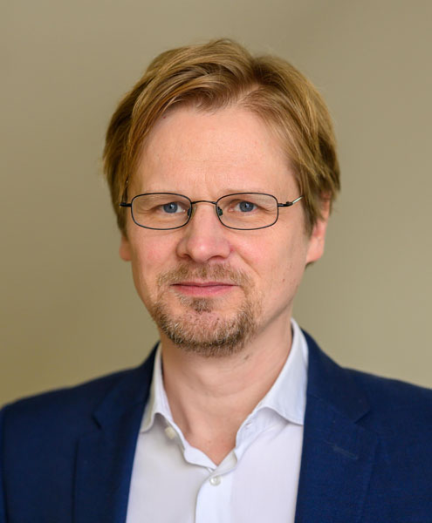
2023 Class A1 – Humanities Section – History & Archaeology
Stefan Bauer King’s College London United Kingdom | Early Modern history Humanism Reformation Historiography Fakes and forgeries Church history Renaissance Censorship

Slide 2
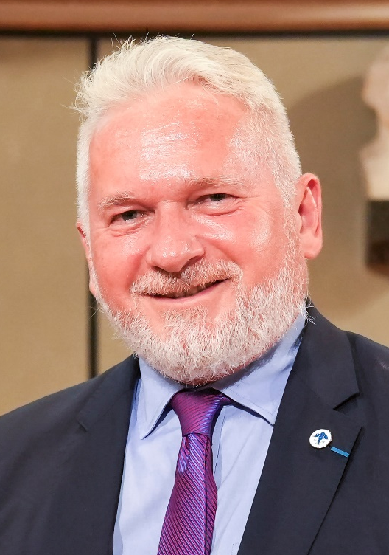
2023 Class A1 – Humanities Section – History & Archaeology
László Rezső Borhy ELTE Eötvös Loránd University Hungary | Roman art Roman wall-painting Roman glypthics Latin epigraphy Roman military history Roman military architecture History and archaeology of the provinces of the Roman Empire Excavation of the Roman site of Brigetio Weapons of the Roman army History and archaeology of Roman Pannonia

Slide 3

2023 Class A1 – Humanities Section – History & Archaeology
Susanna Burghartz University of Basel Switzerland | Early globalisation Urban societies from15th to early 19th centuries Women’s history and gender history Digital history Early capitalism (18th, early 19th c.) Late medieval and early modern history of Switzerland Material culture

Slide 4
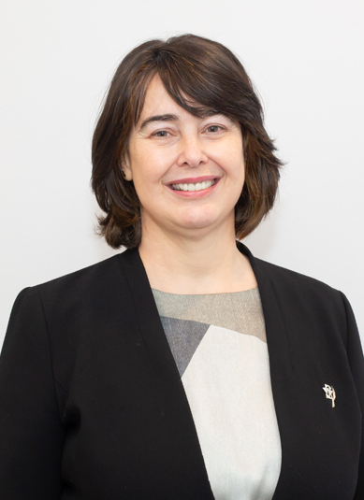
2023 Class A1 – Humanities Section – History & Archaeology
Ana Echevarria Arsuaga UNED, Madrid Spain | Mudejars Moriscos Medieval Iberian peninsula Religious minorities in the Middle Ages Medieval mining in the Iberian peninsula Mozarabs Interreligious polemics Mediterranean Convivencia Queenship

Slide 5
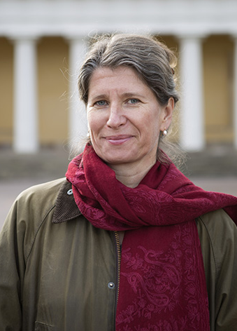
2023 Class A1 – Humanities Section – History & Archaeology
Gunnel Ekroth Uppsala University Sweden | Anthropology of food Ancient Greek religion Greek sanctuaries Greek landscape Animal sacrifice Classical archaeology Hero cults

Slide 6
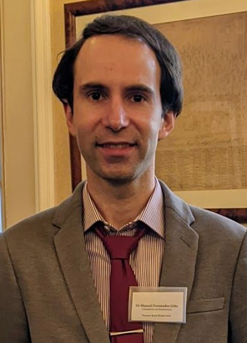
2023 Class A1 – Humanities Section – History & Archaeology
Manuel Fernández-Götz University of Edinburgh United Kingdom | Archaeology of identities Early urbanism in Europe and beyond Iron Age and Roman archaeology Conflict archaeology Migrations in prehistoric Europe

Slide 7

2023 Class A1 – Humanities Section – History & Archaeology
Lisa Hellman Lund University Sweden | Asian history Gender Early modern era Global history Maritime studies

Slide 8
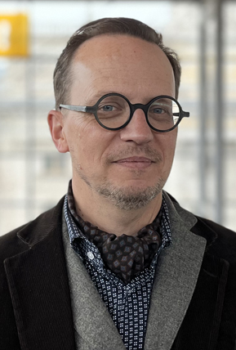
2023 Class A1 – Humanities Section – History & Archaeology
Axel Körner Universität Leipzig Germany | History of political thought Intellectual and cultural history Transnational history History of music European history

Slide 9
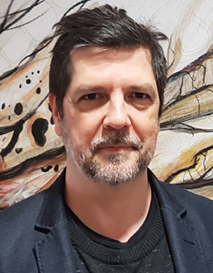
2023 Class A1 – Humanities Section – History & Archaeology
Javier Moscoso CSIC Madrid Spain | History and Philosophy of science Theory of history History of the emotions History of the body Cultural history

Slide 10

2023 Class A1 – Humanities Section – History & Archaeology
Luiz Oosterbeek Polytechnic Institute of Tomar Portugal | Cultural heritage management Prehistoric art Heritage law Landscape archaeology Humanities and society Landscape management Prehistoric early farming

Slide 11
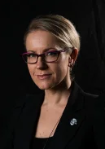
2023 Class A1 – Humanities Section – History & Archaeology
Ronika Power Macquarie University Australia | Archaeological science: Stable isotope analyses, palaeoproteomics, materials analyses Textual analyses Biological anthropology Material culture, mortuary behaviour Art: Representation, production Philosophy, historiography, ethics

Slide 12

2023 Class A1 – Humanities Section – History & Archaeology
Claudia Rapp University of Vienna Austria | Byzantine social and religious history, mobility and migration Byzantine cultural history Manuscript culture Late Antiquity

Slide 13
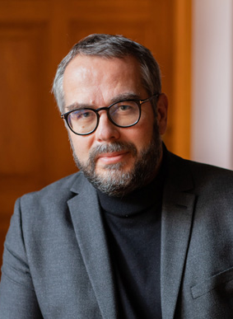
2023 Class A1 – Humanities Section – History & Archaeology
Marek Tamm Tallinn University Estonia | Cultural history Cultural memory studies Semiotics of culture Medieval studies Theory of history

Slide 14

2023 Class A1 – Humanities Section – History & Archaeology
Dorothea Weltecke Humboldt-Universität zu Berlin Germany | History of christianities, esp. Latin Church and the churches of the Syrian tradition Art history History of religions, esp. Jews, Christians, Muslims History of religious deviance Medieval studies

Slide 15
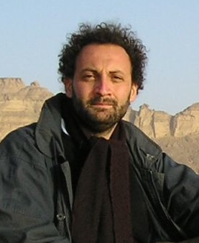
2023 Class A1 – Humanities Section – Classics & Oriental Studies
Giovan Battista D'Alessio Università degli Studi di Napoli 'Federico II' Italy | Papyrology Lyric Poetry Classical Philology Greek Literature Hellenistic Poetry

Slide 16

2023 Class A1 – Humanities Section – Classics & Oriental Studies
Simon Goldhill University of Cambridge United Kingdom | Literary theory Greek culture Reception Cities 19th century literature and culture Later Greek literature Greek tragedy

Slide 17

2023 Class A1 – Humanities Section – Classics & Oriental Studies
Elisabetta Ragagnin Ca' Foscari University of Venice Italy | Turkic and Mongolian folklore Ethnolinguistics Contact linguistics Turkic and Mongolian material and spiritual culture Marco Polo studies Turkic and Mongolian oral literatures Mongolic linguistics Documentation of endangered languages in Mongolia and Iran Turkic linguistics

Slide 18

2023 Class A1 – Humanities Section – Classics & Oriental Studies
Danuta Shanzer University of Vienna Austria | Reception of classical literature in the Middle Ages Later Roman and Early Medieval history Classical and medieval philology Latin literature of the Late Roman and the Early Medieval periods Christian Latin literature Textual criticism and editorial technique Religion and social changes in the Late Roman period

Slide 19

2023 Class A1 – Humanities Section – Classics & Oriental Studies
Petra Sijpesteijn Leiden University The Netherlands | Arabic philology Papyrology Empire studies Late Antique and early Islamic writing cultures Early and medieval Islamic history Oriental manuscript and book studies

Slide 20
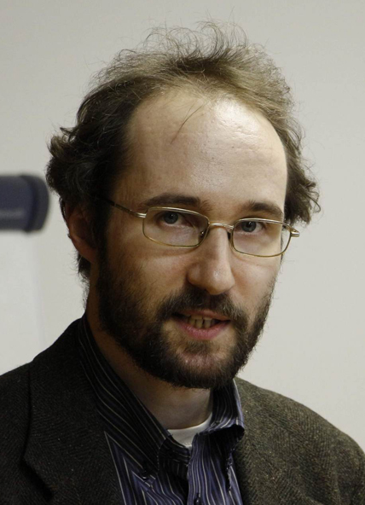
2023 Class A1 – Humanities Section – Linguistic Studies
Peter Arkadiev Johannes-Gutenberg-University Mainz Germany | Northwest Caucasian languages Tense and aspect systems Polysynthesis Case, agreement and grammatical relations Baltic languages Slavic languages Areal linguistics and language contact Morphology Linguistic typology

Slide 21

2023 Class A1 – Humanities Section – Linguistic Studies
Cedric Boeckx Catalan Institute for Research and Advanced Studies (ICREA) Barcelona Spain | Syntactic theory Cognitive biology Cognitive science Evolutionary biology Linguistics Philosophy of language Neurogenomics Philosophy of mind

Slide 22
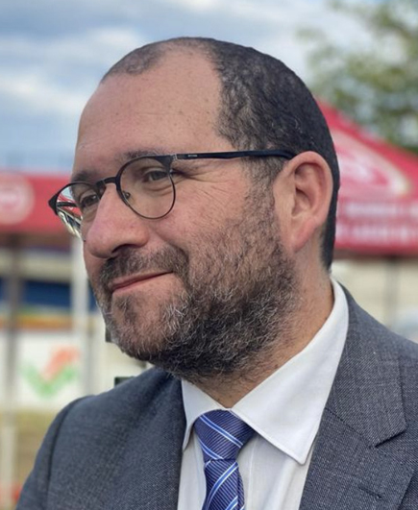
2023 Class A1 – Humanities Section – Linguistic Studies
João Costa FCSH - Universidade Nova de Lisboa Portugal | Educational Linguistics Language Acquisition Syntax

Slide 23
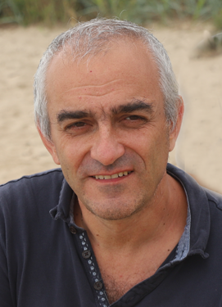
2023 Class A1 – Humanities Section – Linguistic Studies
Mikhail Daniel Unviersité de Lyon/CNRS France | Linguistic typology Language contact Corpus linguistics East Caucasian languages Russian Language variation Language documentation

Slide 24
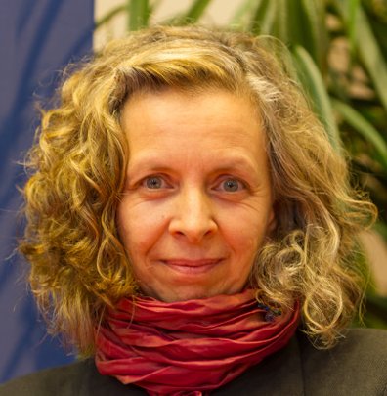
2023 Class A1 – Humanities Section – Linguistic Studies
Hamida Demirdache Nantes University/CNRS France | Syntax of Logical-Form (LF Syntax) Limits of linguistic diversity Semitic Syntax - Semantics - Acquisition Interfaces Experimental methodology for probing linguistic knowledge at the syntax semantics interface Under-represented languages Temporal and nominal anaphora Salish A'-dependencies (questions, relatives, resumption)

Slide 25

2023 Class A1 – Humanities Section – Linguistic Studies
Violeta Demonte Universidad Autónoma de Madrid Spain | Foundations and methodology of linguistic theory Spanish grammar Lexical theory and the lexicon/syntax interface Formal grammar Theoretical linguistics Syntax/semantics/pragmatics interface

Slide 26

2023 Class A1 – Humanities Section – Linguistic Studies
Nina Dobrushina University of Tübingen Germany | Linguistic typology Non-indicative moods Small-scale multilingualism Language contact Grammar of Russian Corpus linguistics Linguistic variation East Caucasian languages

Slide 27

2023 Class A1 – Humanities Section – Linguistic Studies
Maria Teresa Espinal Farré Universitat Autònoma de Barcelona Spain | Syntax/semantics interface Romance languages (Catalan, Spanish) Semantics/pragmatics interface Syntax Semantics Linguistic theory

Slide 28

2023 Class A1 – Humanities Section – Linguistic Studies
Martin Hilpert Université de Neuchâtel Switzerland | Corpus linguistics Grammaticalization Usage-based linguistics Construction grammar Cognitive linguistics

Slide 29

2023 Class A1 – Humanities Section – Linguistic Studies
Mark Janse University of Cambridge United Kingdom | Ancient Greek language and linguistics Biblical Greek language and linguistics Cappadocian Greek language and linguistics Medieval Greek language and linguistics Modern Greek language and linguistics Pontic Greek language and linguistics Biblical Hebrew and Aramaic language and linguistics Latin language and linguistics Historical linguistics

Slide 30

2023 Class A1 – Humanities Section – Linguistic Studies
Johanna Nichols University of California, Berkeley United States | Slavic linguistics Eurasian linguistics Historical linguistics Linguistic typology

Slide 31
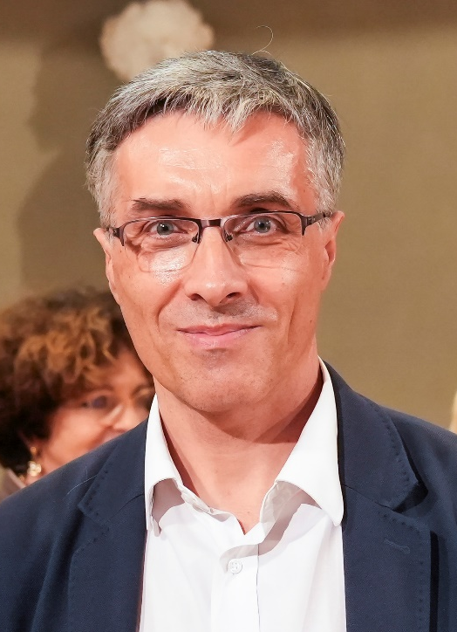
2023 Class A1 – Humanities Section – Linguistic Studies
Daniel Petit École Normale Supérieure Paris France | Latvian linguistics and philology Lithuanian linguistics and philology History of comparative linguistics Historical syntax Comparative grammar of the Indo-European languages Baltic linguistics and philology Old Prussian linguistics and philology Ancient Greek linguistics and philology

Slide 32
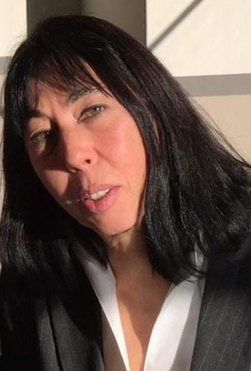
2023 Class A1 – Humanities Section – Linguistic Studies
Cecilia Poletto Goethe Universität Frankfurt am Main Germany | Germanic morphosyntax and dialectology Formal syntax Microvariation Dialectology Romance diachronic morphosyntax

Slide 33
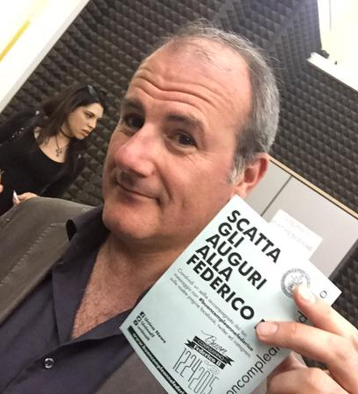
2023 Class A1 – Humanities Section – Literary & Theatrical Studies
Giancarlo Alfano Università di Napoli Federico II Naples Italy | Italian literature Comparative literature Theory of literature Cultural history

Slide 34

2023 Class A1 – Humanities Section – Literary & Theatrical Studies
Michèle Bokobza Kahan Tel Aviv University Israel | Religious testimonies, and theoretical approaches of fiction and testimonial writings Testimonial discourses from the 18th century to the 21th century Emigration and hospitality in novels written by female authors Discourse analysis in fiction literature Ethos and authorship in literature Marginal authors and underground literature in the eighteenth century 18th century France, literature and cultural studies

Slide 35
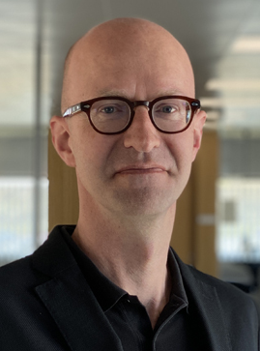
2023 Class A1 – Humanities Section – Literary & Theatrical Studies
Anders Engberg-Pedersen University of Southern Denmark Denmark | Intellectual history Cartography 18th - 21th-century literature (German, French, Russian, Scandinavian) War studies History and poetics of knowledge

Slide 36
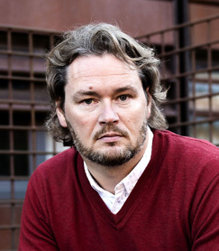
2023 Class A1 – Humanities Section – Literary & Theatrical Studies
Søren Frank University of Southern Denmark Denmark | Migration literature Theories of place and space History of football Border literature Blue humanities Maritime literature and culture History of comparative literature

Slide 37
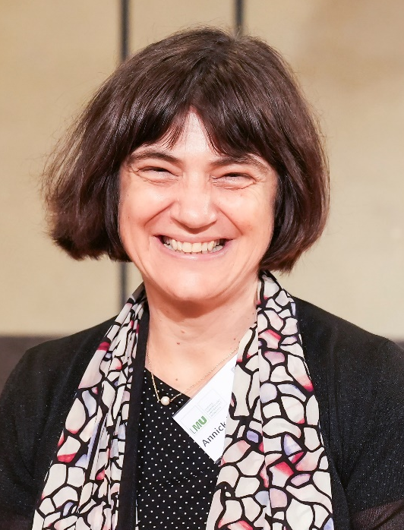
2023 Class A1 – Humanities Section – Literary & Theatrical Studies
Annick Louis University of Franche-Comté Bensaçon France | Archeological narratives XIXth - XXIst century Comparative literature Travel narratives Literary theory Epistemology Bibliography and sociology of texts Literature and social sciences Writing and meaning Literature

Slide 38
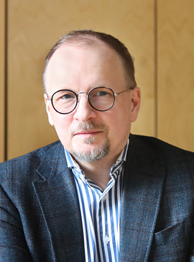
2023 Class A1 – Humanities Section – Literary & Theatrical Studies
Kai Mikkonen University of Helsinki Finland | French literature (19th century, early 20th century) Terrorism in literature Theory of fiction Literature studies and comparative literature Travel literature British literature (19th century, early 20th century) Graphic narratives and comics Stylistics Terrorism and literature Narratology, narrative theory Interpretation and reading Picture books

Slide 39
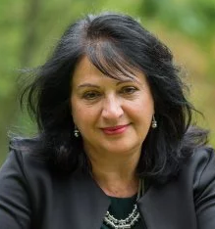
2023 Class A1 – Humanities Section – Literary & Theatrical Studies
Patricia Pulham University of Surrey United Kingdom | Nineteenth-century literature and visual culture Decadence, Aestheticism, and Neo-Victorianism in contemporary literature and culture Fin-de-siècle literature and the arts

Slide 40
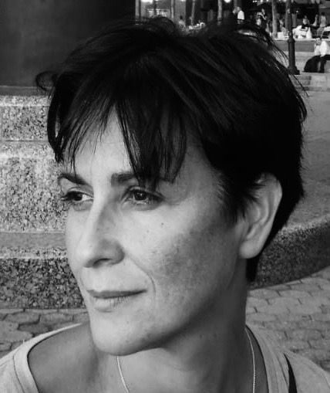
2023 Class A1 – Humanities Section – Musicology & Art History
Bianca de Divitiis University of Naples Federico II Italy | British art and architecture between 18th and 19th century Art, architecture and patronage in Renaissance Antiquarian culture in Europe

Slide 41
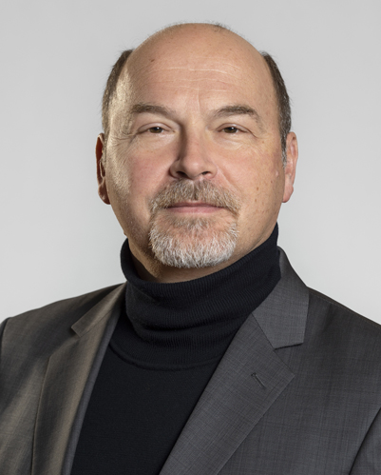
2023 Class A1 – Humanities Section – Musicology & Art History
Christoph Flamm University of Heidelberg Germany | Contemporary music Russian, Eastern European and Soviet music Music in political contexts Relations and interactions of music and other arts Recent Italian and French music Critical edition of musical works Instrumental music from the 18th century onwards

Slide 42
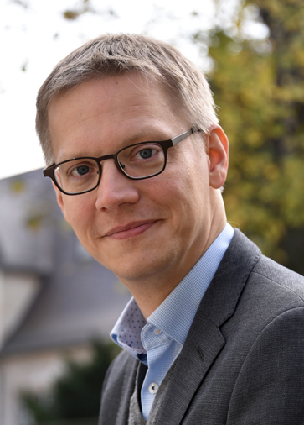
2023 Class A1 – Humanities Section – Musicology & Art History
Johannes Grave Friedrich Schiller University Jena Germany | Italian painting of the early Renaissance Art, art theory and art history around 1800 Practices of comparison Temporality of picture perception French painting from the 17th to the 19th century Social Imagining Picture theory and historical concepts of pictures European Romanticism(s)

Slide 43
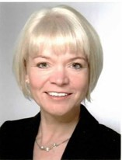
2023 Class A1 – Humanities Section – Musicology & Art History
Panja Mücke Staatliche Hochschule für Musik und Darstellende Kunst Mannheim Germany | Music history and performance practice in the 20th century Theatre music, music theatre and film music in the 20th century Music history of the 18th century Music culture at European courts in the 17th and 18th centuries

Slide 44
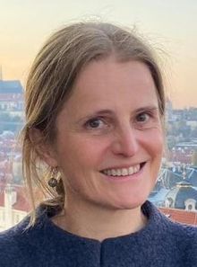
2023 Class A1 – Humanities Section – Musicology & Art History
Anne Piéjus CNRS, IREMUS, Paris France | Music and early modern press Music and theater, music and education, music non stage Early modern music criticism Music and letters Early modern European music Sung poetry (France, Italy, 1550-1750) Music and religion Musical iconography Digital humanities, databases, music editions, digital vocabularies, crowdsourcing, connecting digital resources Music and politics Music and fine arts

Slide 45
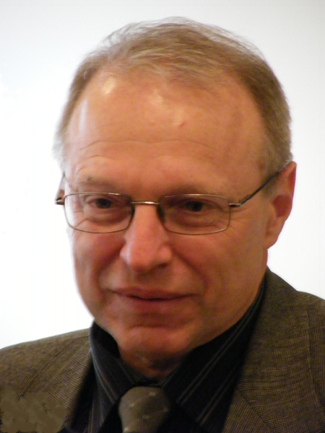
2023 Class A1 – Humanities Section – Musicology & Art History
Sergiy Shyp South Ukrainian State Pedagogical University Odessa Ukraine | Music teacher training Theory of musical language, form, style, and genre Semiotics and hermeneutics of music Electronic music

Slide 46
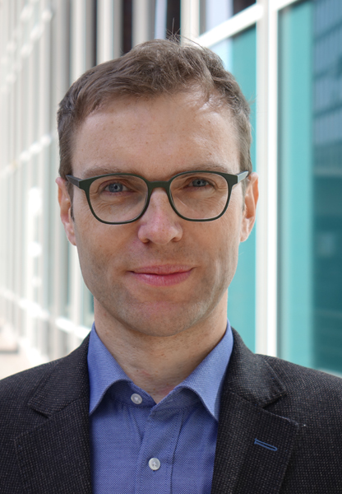
2023 Class A1 – Humanities Section – Musicology & Art History
Clemens Wöllner Hochschule für Musik Freiburg Germany | Motor and perceptual expertise Sociocultural foundations of musical conducting Working memory and attention Timing and time perception in the performing arts Movement analysis Multimodal perception of musical performances Music psychology Musical expressiveness

Slide 47
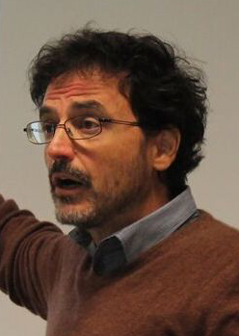
2023 Class A1 – Humanities Section – Philosophy, Theology & Religious Studies
Vincenzo Crupi Università di Torino Italy | Judgment and decision making Logic and philosophy of science Conditionals Probability theory Formal epistemology Confirmation

Slide 48
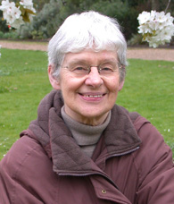
2023 Class A1 – Humanities Section – Philosophy, Theology & Religious Studies
Dorothy Edgington Birkbeck College London United Kingdom | Vagueness and indeterminacy Philosophy of language Reasoning under suppositions Metaphysics Epistemology Probabilistic reasoning Philosophy of logic

Slide 49

2023 Class A1 – Humanities Section – Philosophy, Theology & Religious Studies
Cécile Fabre All Souls College, Oxford United Kingdom | Ethics of foreign policy Just war theory Theories of distributive justice Theories of democracy Political philosophy Moral philosophy Applied ethics

Slide 50
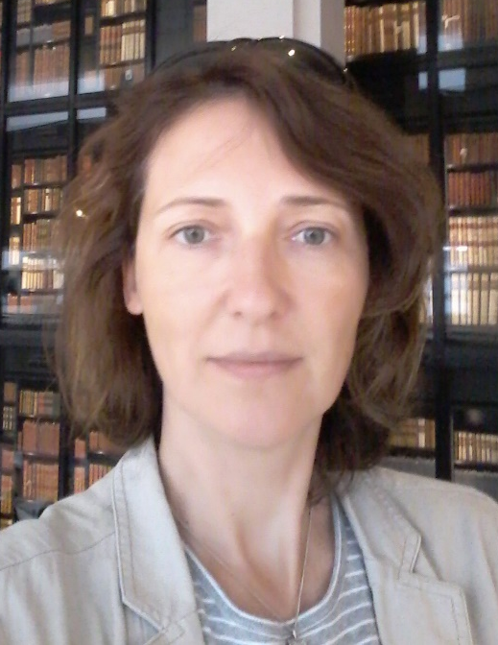
2023 Class A1 – Humanities Section – Philosophy, Theology & Religious Studies
Daniela Jalobeanu University of Bucharest Romania | Francis Bacon Emergence of experimental philosophy Isaac Newton Early modern philosophy and the sciences Philosophy of scientific experimentation

Slide 51

2023 Class A1 – Humanities Section – Philosophy, Theology & Religious Studies
Pauline Kleingeld University of Groningen The Netherlands | Ethics History of Western philosophy Political philosophy Immanuel Kant

Slide 52
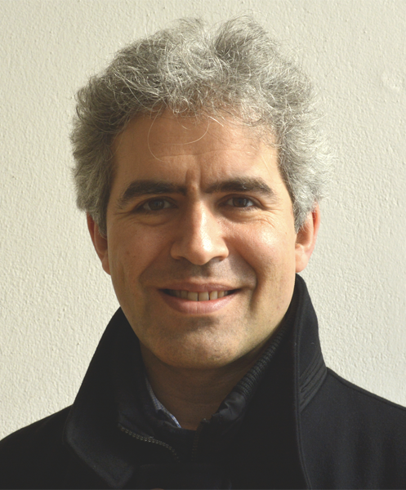
2023 Class A1 – Humanities Section – Philosophy, Theology & Religious Studies
Christian List Ludwig Maximilian University (LMU) Munich Germany | Theories of individual and collective decision making, especially social choice theory Philosophical foundations of the social sciences Mental causation Free will Theories of democracy Theories of group agency and social epistemology

Slide 53
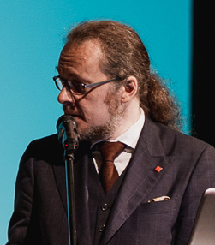
2023 Class A1 – Humanities Section – Philosophy, Theology & Religious Studies
Benedikt Löwe Churchill College, Cambridge United Kingdom | Foundations of mathematics Transfinite computation Philosophical logic Set theory Mathematical logic Applications of logic in narratology Philosophy of mathematics Applications of logic in artificial intelligence Methodology of science

Slide 54
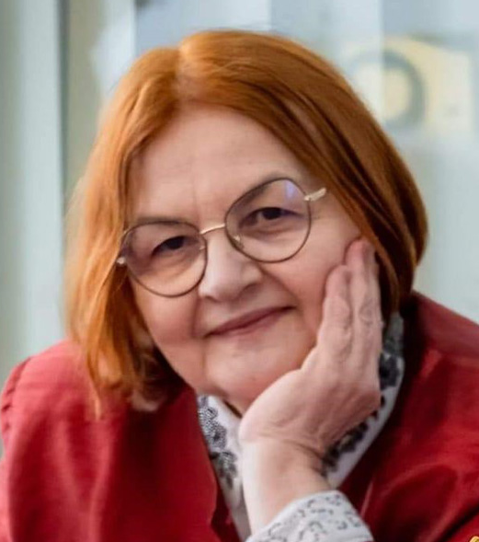
2023 Class A1 – Humanities Section – Philosophy, Theology & Religious Studies
Mihaela Miroiu National School of Political and Administrative Studies Bucharest Romania | Feminist philosophy Feminist political Theory Applied ethics Political philosophy Political ethics

Slide 55
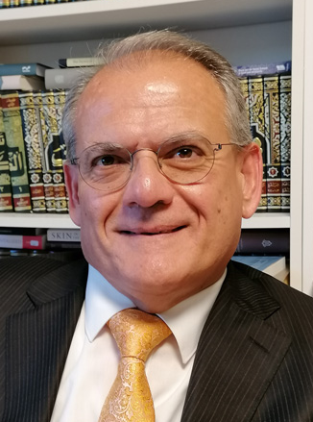
2023 Class A1 – Humanities Section – Philosophy, Theology & Religious Studies
Georges Tamer Friedrich-Alexander-Universität Erlangen-Nürnberg Germany | Judeo-Arabic thought Philosophy in the Islamic world Jewish-Christian-Islamic discourses Christian-Arabic thought Hermeneutics of the Qur’ān Arab-Islamic history of Ideas

Slide 56
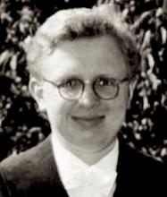
2023 Class A1 – Humanities Section – Philosophy, Theology & Religious Studies
Jens Timmermann University of St Andrews United Kingdom | Moral, legal and political philosophy Kant Ancient philosophy

Slide 57
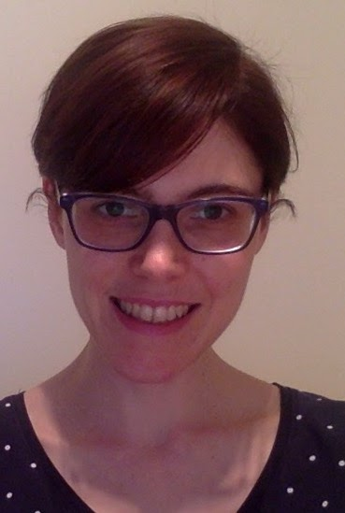
2023 Class A1 – Humanities Section – Philosophy, Theology & Religious Studies
Laura Valentini Ludwig Maximilian University Munich Germany | Social ontology Philosophy of rights and human rights Methodology of political philosophy Political authority Contemporary political, legal, and social philosophy Global justice Democratic theory

Slide 58
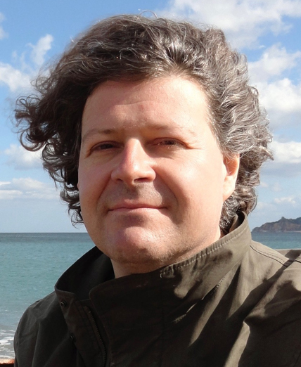
2023 Class A1 – Humanities Section – Philosophy, Theology & Religious Studies
Marcel Weber University of Geneva Switzerland | Philosophy of the biological and biomedical sciences Philosophy of evolutionary linguistics General philosophy of science

Slide 59
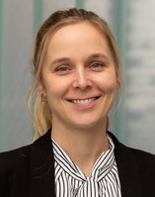
2023 Class A1 – Humanities Section – Film, Theatre and Visual Studies
Kathleen Beullens KU Leuven Belgium | Children’s and adolescents’ psychosocial well-being Social media use Effects of media use Media effects on health and risk-related outcomes

Slide 60

2023 Class A1 – Humanities Section – Film, Theatre and Visual Studies
Leen d'Haenens KU Leuven Belgium | Youth digital engagement and wellbeing Media, migration and refugee experiences News, post-truth and political communication Framing the European crisis Media and telecommunications policy Media literacy, competence and skills

Slide 61

2023 Class A1 – Humanities Section – Film, Theatre and Visual Studies
Helen Kennedy University of Sheffield United Kingdom | Digital media and society Data and everyday life

Slide 62
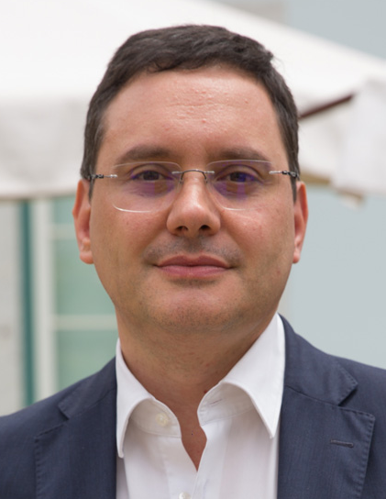
2023 Class A1 – Humanities Section – Film, Theatre and Visual Studies
Nelson Ribeiro Universidade Católica Portuguesa Portugal | Propaganda history Journalism studies Political economy of the media Media history

Slide 63

2023 Class A1 – Humanities Section – Film, Theatre and Visual Studies
Anda Rožukalne Riga Stradins University Latvia | Children’s and adolescents’ psychosocial well-being Social media use Effects of media use Media effects on health and risk-related outcomes

Slide 64
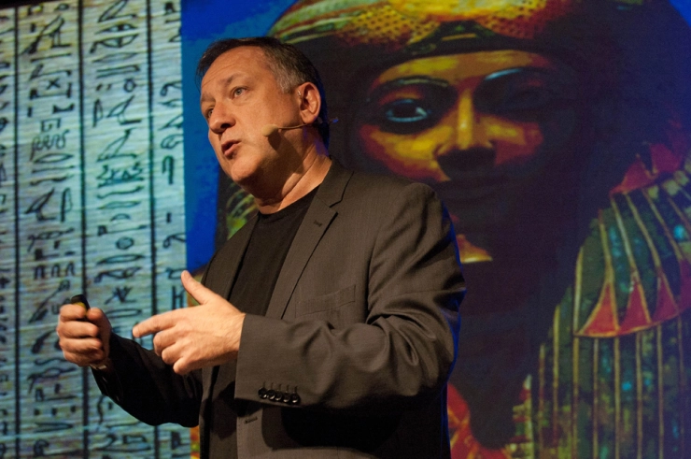
2023 Class A1 – Humanities Section – Film, Theatre and Visual Studies
Carlos A. Scolari Universitat Pompeu Fabra Barcelona Spain | Semiotics Mediatization theory Digital interactive media Media evolution Transmedia literay Communication theory Media ecology Transmedia storytelling

