Slide 1
2024 Class A1 – Humanities Section – History & Archaeology
Overall section members: 319 Overall foreign members: 15 Overall female members: 72

Slide 2
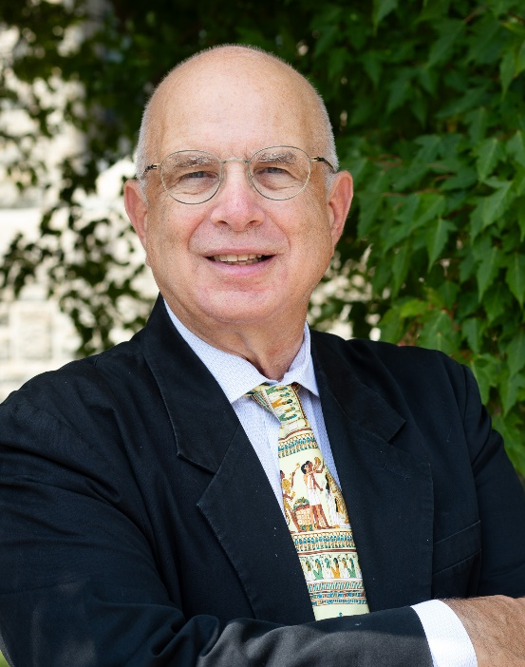
2024 Class A1 – Humanities Section – History & Archaeology
Haskel Greenfield University of Manitoba Winnipeg Canada | Evolution of food producing and farming societies Evolution of metallurgical technology Evolution of early complex and urban societies Origins of pastoralism Origins of food production Old World archaeology Origins of metallurgy Zooarchaeology Archaeology of Europe, Near East and Africa Origins of animal domestication

Slide 3
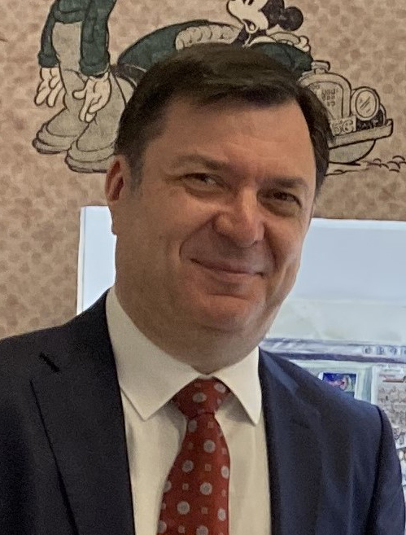
2024 Class A1 – Humanities Section – History & Archaeology
Slobodan Markovich University of Belgrade Serbia | History of European pessimism Psychoanalytic anthropology Western perceptions of the Balkans Cultural transfer Europe – the Balkans History of psychoanalysis British-Balkan relations since the Napoleonic Wars

Slide 4
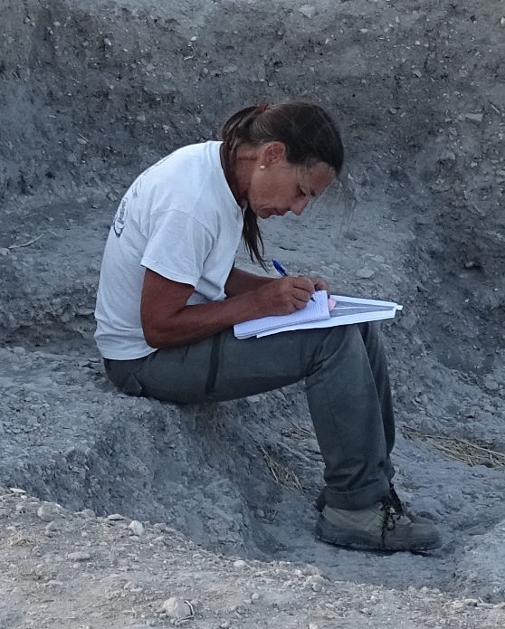
2024 Class A1 – Humanities Section – History & Archaeology
Luisa Migliorati Sapienza Università di Roma Italy | Heritage buildings Mexico colonial urbanism Ancient topography Ancient cartography Ancient urbanism Ancient architecture

Slide 5

2024 Class A1 – Humanities Section – History & Archaeology
Felicitas Schmieder FernUniversität in Hagen Germany | Europe and the Mongols in the Middle Ages Medieval Europe Medieval cultural contacts Medieval prophecy Medieval German urban history Medieval/ early modern cartography

Slide 6
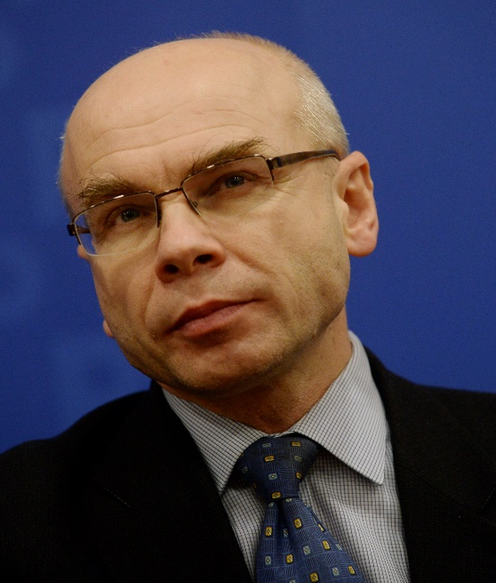
2024 Class A1 – Humanities Section – History & Archaeology
Dariusz Stola Polish Academy of Sciences Warsaw Poland | History of transnational migrations Contemporary history of Poland History of Polish-Jewish relations Holocaust History of communist regimes

Slide 7
2024 Class A1 – Humanities Section – Classics & Oriental Studies
Overall section members: 171 Overall foreign members: 9 Overall female members: 45

Slide 8

2024 Class A1 – Humanities Section – Classics & Oriental Studies
Arlene Holmes Henderson Durham University United Kingdom | Public policy Social mobility Classics education Languages in education Public engagement Employability Rhetoric Critical skills Humanities in education

Slide 9
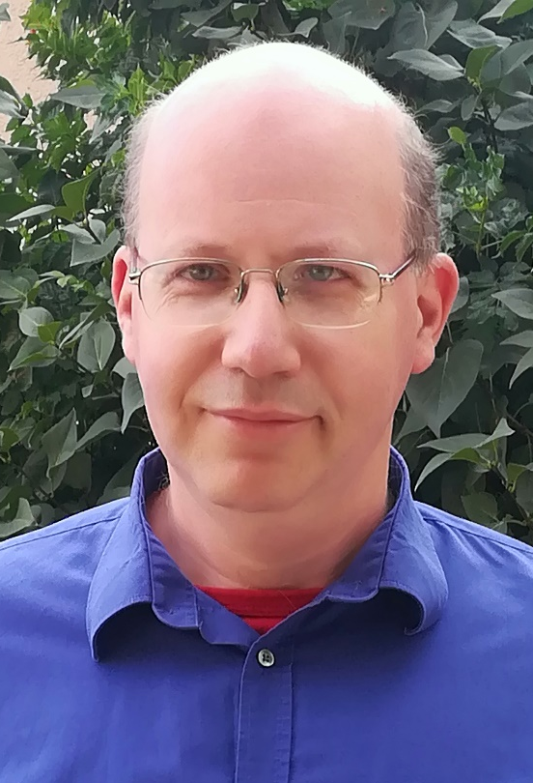
2024 Class A1 – Humanities Section – Classics & Oriental Studies
Gábor Kósa Eötvös Loránd University Budapest Hungary | Manichaeism Cosmogonic myths Shamanism Chinese religions

Slide 10

2024 Class A1 – Humanities Section – Classics & Oriental Studies
Enrico Morano Turin Italy | Manichaeism Middle Iranian languages Iranian epigraphy Old Iranian languages Classics

Slide 11
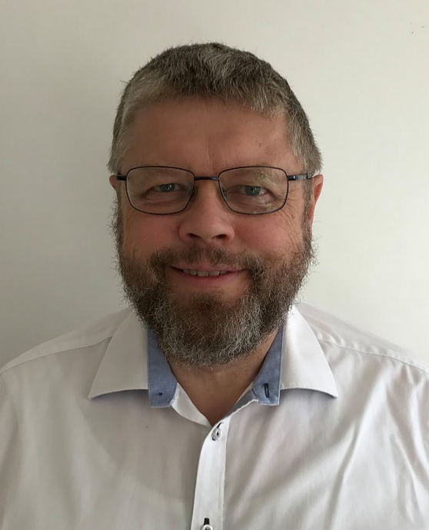
2024 Class A1 – Humanities Section – Classics & Oriental Studies
Nils Arne Pedersen Aarhus University Denmark | Patristics Christian Orient Manichaeism Church history Reception of Bible

Slide 12
2024 Class A1 – Humanities Section – Classics & Oriental Studies
Danuta Shanzer University of Vienna Austria | Christian Latin literature Religion and social changes in the Late Roman period Reception of classical literature in the Middle Ages Classical and medieval philology Later Roman and Early Medieval history Textual criticism and editorial technique Latin literature of the Late Roman and the Early Medieval periods

Slide 13

2024 Class A1 – Humanities Section – Classics & Oriental Studies
Sophia Xenophontos Aristotle University of Thessaloniki Greece | Reception of the classical tradition in Byzantium and the Modern Greek Enlightenment Greek literature of the 1st and 2nd century CE Plutarch: biography, popular philosophy, moralising techniques History of medical deontology in antiquity Intellectual history and history of ideas in antiquity and the medieval period History of emotions and psychotherapy Commentary tradition especially on Aristotle’s works Edition, textual criticism and translation of ancient and Byzantine texts Galen: interplay between medicine and practical philosophy, the social role of philosophy

Slide 14
2024 Class A1 – Humanities Section – Linguistic Studies
Overall section members: 235 Overall foreign members: 8 Overall female members: 15

Slide 15
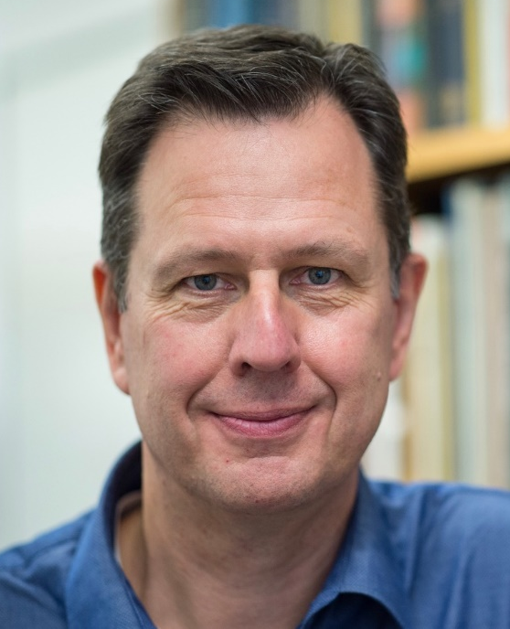
2024 Class A1 – Humanities Section – Linguistic Studies
Bas Aarts University College London United Kingdom | Corpus linguistics Syntax Linguistic usage Language change English grammar Language teaching and pedagogy

Slide 16
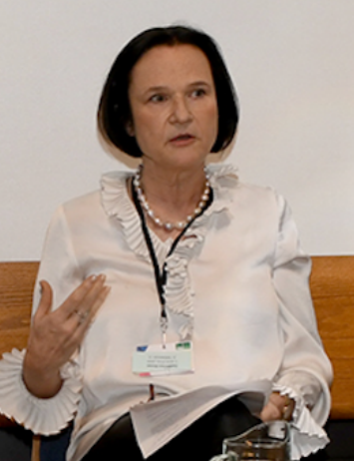
2024 Class A1 – Humanities Section – Linguistic Studies
Anna Carlier Sorbonne Université Paris France | Theories of linguistic change Nominal determination Historical linguistics of French Corpus linguistics Comparative linguistics of the Romance languages Aspect, voice, and auxiliaries Morphosyntax Grammatical semantics

Slide 17

2024 Class A1 – Humanities Section – Linguistic Studies
Hamida Demirdache Nantes University/CNRS France | Syntax of Logical-Form (LF Syntax) Limits of linguistic diversity Semitic Syntax - Semantics - Acquisition Interfaces Experimental methodology for probing linguistic knowledge at the syntax semantics interface Under-represented languages Temporal and nominal anaphora Salish A'-dependencies (questions, relatives, resumption)

Slide 18
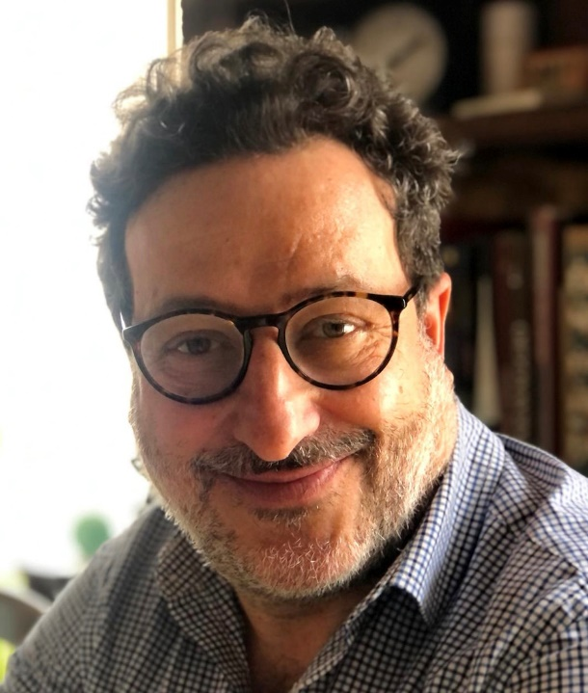
2024 Class A1 – Humanities Section – Linguistic Studies
Livio Gaeta University of Turin Italy | Contrastive linguistics Linguistic minorities German and Germanic linguistics Theoretical linguistics: morphology and word-formation Language contact Language change and grammaticalization Cognitive linguistics Italian and Romance linguistics

Slide 19

2024 Class A1 – Humanities Section – Linguistic Studies
Aylin Küntay Koç University Istanbul Turkey | Communicative development Gestures Bilingualism and heritage languages Social robots in educational use Psycholinguistics Child language development

Slide 20
2024 Class A1 – Humanities Section – Linguistic Studies
Janet Pierrehumbert University of Oxford United Kingdom | Speech technology Phonology Language processing Morphology Sound change Computational linguistics Language modeling

Slide 21
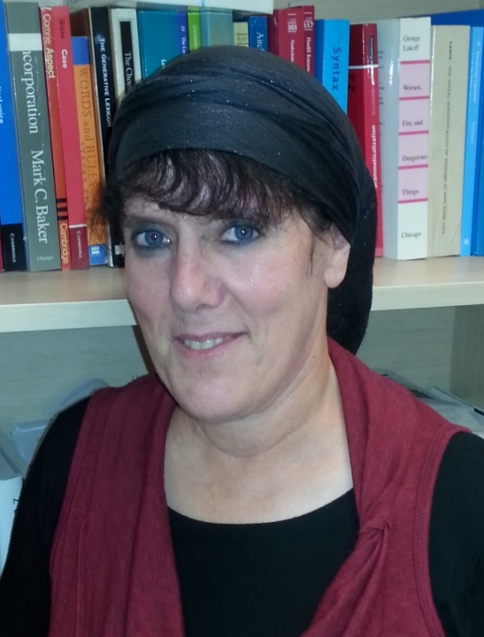
2024 Class A1 – Humanities Section – Linguistic Studies
Malka Rappaport Hovav The Hebrew University of Jerusalem Israel | Polysemy Argument structure Syntax Event semantics Lexical semantics Lexical and grammatical aspect Semantics-cognition interface Morphology

Slide 22
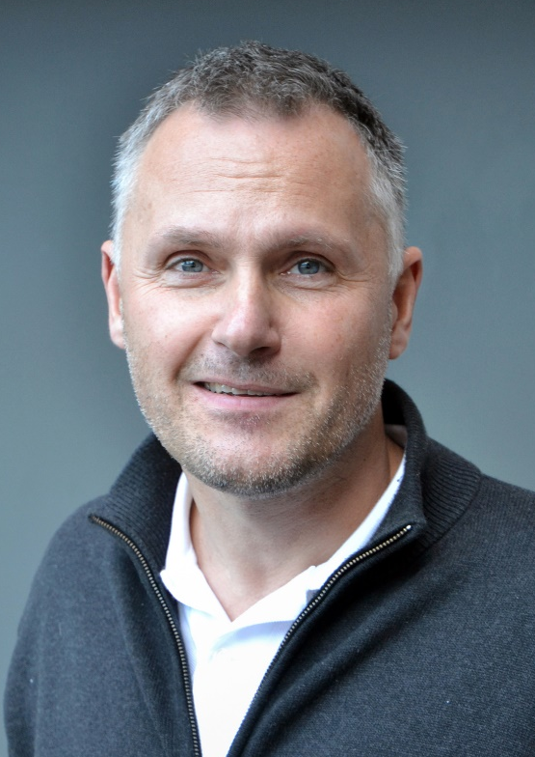
2024 Class A1 – Humanities Section – Linguistic Studies
Michael Schulte University of Agder Kristiansand Norway | Comparative linguistics Writing system research (Runes) Formulaic language (Runic inscriptions) Runic inscriptions (Runology) Language history (Nordic) Metrical studies of Old Germanic Sociocultural history (Nordic) Proto-Norse Germanic philology Old Norse

Slide 23
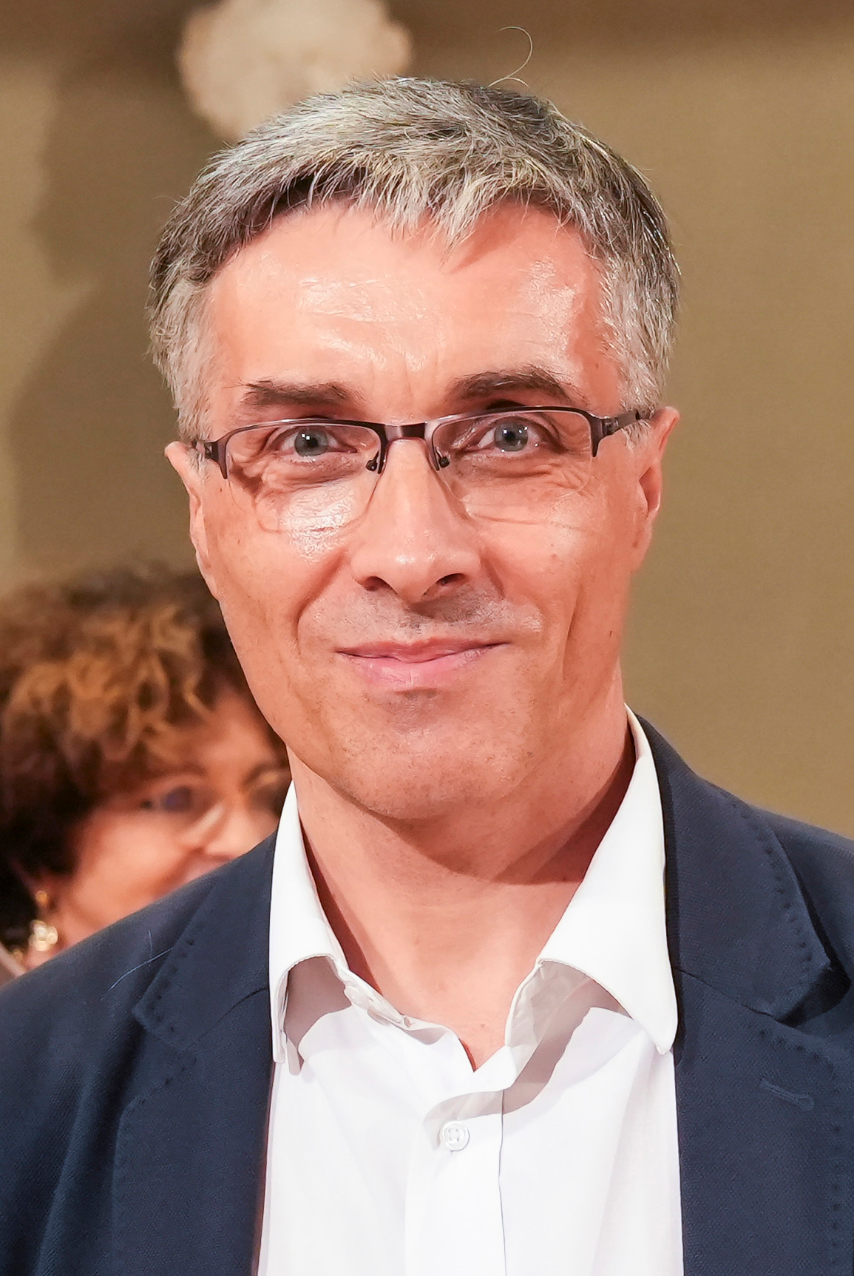
2024 Class A1 – Humanities Section – Linguistic Studies
Daniel Petit École Normale Supérieure Paris France | Latvian linguistics and philology Lithuanian linguistics and philology History of comparative linguistics Historical syntax Comparative grammar of the Indo-European languages Baltic linguistics and philology Old Prussian linguistics and philology Ancient Greek linguistics and philology

Slide 24
2024 Class A1 – Humanities Section – Literary & Theatrical Studies
Overall section members: 230 Overall foreign members: 22 Overall female members: 80

Slide 25

2024 Class A1 – Humanities Section – Literary & Theatrical Studies
Helena Duffy University of Wrocław Poland | Postmodernism Holocaust literature and cinema French and comparative literature Posthumanism (ecocriticism and human-animal studies)

Slide 26
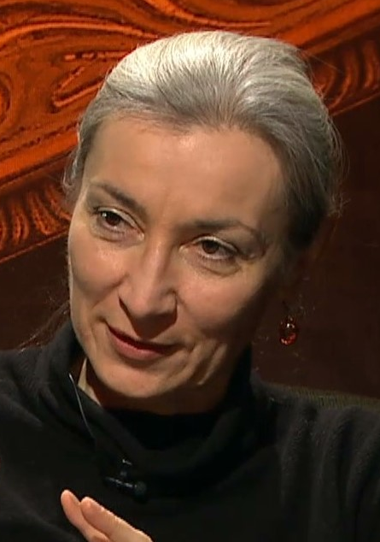
2024 Class A1 – Humanities Section – Literary & Theatrical Studies
Tatjana Jukić University of Zagreb Croatia | English literature (19th and 20th centuries) Semiotics Comparative literature Film and visual arts European cultural history Social philosophy

Slide 27
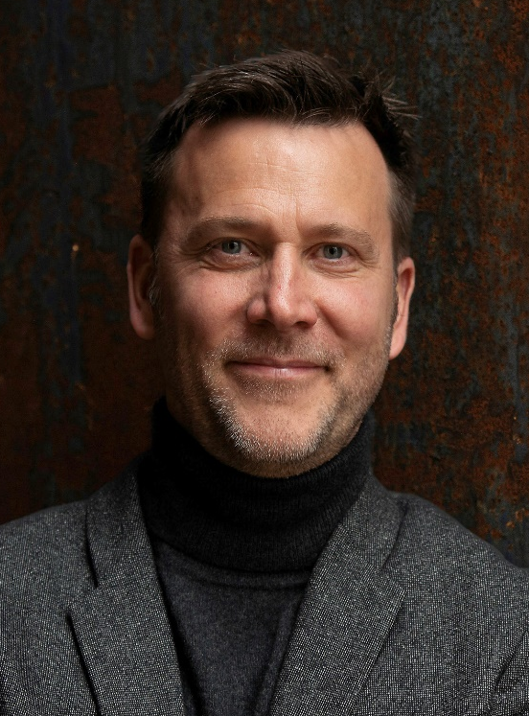
2024 Class A1 – Humanities Section – Literary & Theatrical Studies
Markus Messling Universität des Saarlandes Saarbrucken Germany | Comparative literature and cultural philosophy French and Francophone literatures Epistemology and history of the modern humanities Historical anthropology Narration and historiography Aesthetics Mediterranianism Universalism/relativism The irreparable and theories of reparation/repair

Slide 28

2024 Class A1 – Humanities Section – Literary & Theatrical Studies
Martin Procházka Charles University Prague Czech Republic | Intercultural communication American colonial literature Comparative literature Scottish literature Romanticism

Slide 29

2024 Class A1 – Humanities Section – Literary & Theatrical Studies
Eva von Contzen Albert-Ludwigs-Universität Freiburg Germany | Narratology Hagiography History of reception Re-telling Medieval English studies

Slide 30
2024 Class A1 – Humanities Section – Musicology & Art History
Overall section members: 152 Overall foreign members: 9 Overall female members: 38

Slide 31

2024 Class A1 – Humanities Section – Musicology & Art History
Wojciech Bałus Jagiellonian University Kraków Poland | History of modern art and architecture History of art theory Methodology of art history and Bildwissenschaft Theory and history of stained-glass

Slide 32
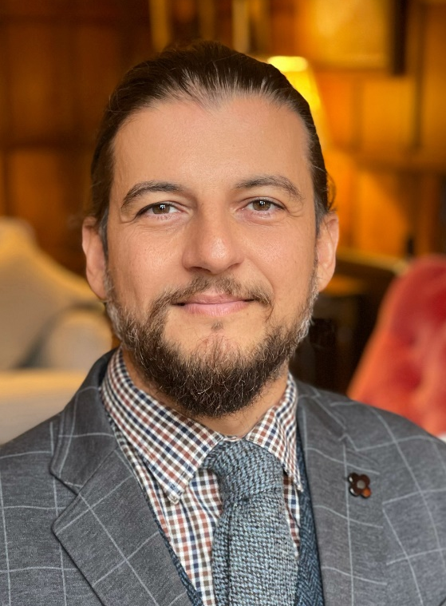
2024 Class A1 – Humanities Section – Musicology & Art History
Massimo Leone Università di Torino Turin Italy | Theoretical frameworks for modeling cultural change in semiotic terms Art history Digital evolution of visual cultures

Slide 33
2024 Class A1 – Humanities Section – Philosophy, Theology & Religious Studies
Overall section members: 155 Overall foreign members: 5 Overall female members: 45

Slide 34
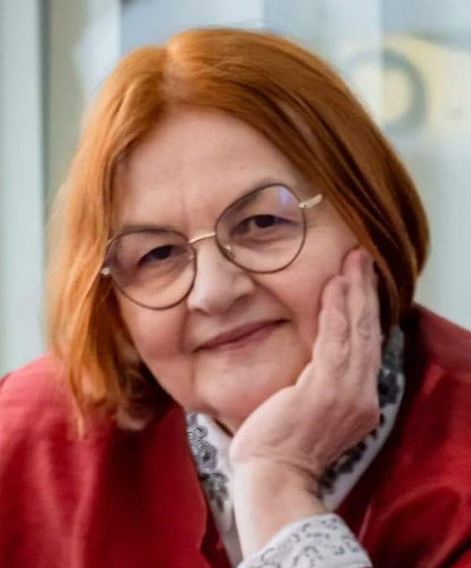
2024 Class A1 – Humanities Section – Musicology & Art History
Mihaela Miroiu National University of Political Studies and Public Administration Sibiu Romania | Feminist philosophy Feminist political Theory Applied ethics Political philosophy Political ethics

Slide 35
2024 Class A1 – Humanities Section – Film, Media & Visual Studies
Overall section members: 116 Overall foreign members: 7 Overall female members: 54

Slide 36
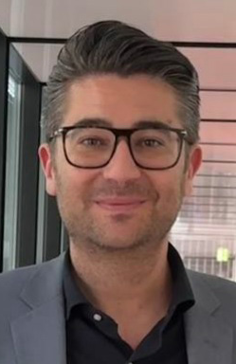
2024 Class A1 – Humanities Section – Film, Media & Visual Studies
Gabriele Balbi USI Università della Svizzera italiana Lugano Switzerland | Political economy of communication Media history Science and technology studies Media archaeology Communication history

Slide 37
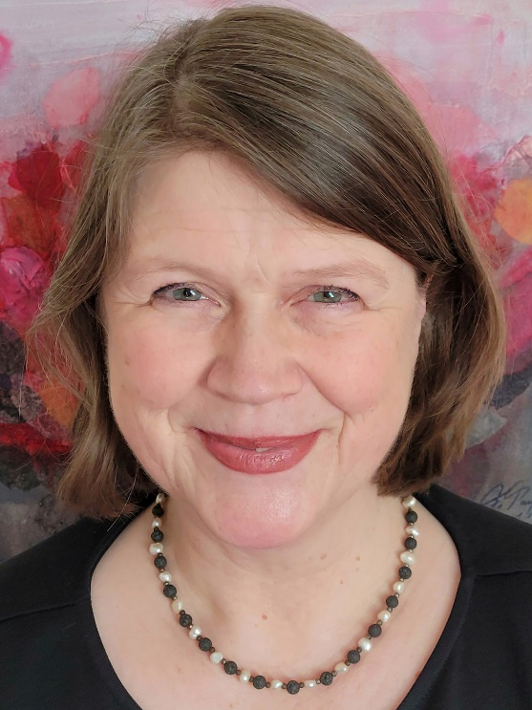
2024 Class A1 – Humanities Section – Film, Media & Visual Studies
Susanne Kinnebrock Augsburg University Germany | Media change and transformations of the Public Sphere (since the 19th Century) Journalism (narrative journalism, convergent journalism) Gender media studies European communication history Health and science communication

Slide 38

2024 Class A1 – Humanities Section – Film, Media & Visual Studies
Margreth Lünenborg Freie Universität Berlin Germany | Affect studies Journalism studies Migration and media Gender media studies Public sphere theory Cultural studies and media research

Slide 39
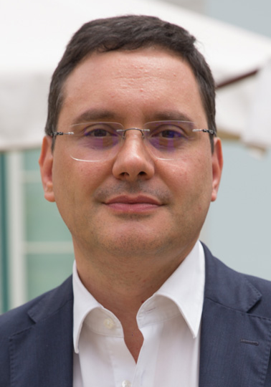
2024 Class A1 – Humanities Section – Film, Media & Visual Studies
Nelson Ribeiro Universidade Católica Portuguesa Lissabon Portugal | Propaganda history Journalism studies Political economy of the media Media history

Slide 40

2024 Class A1 – Humanities Section – Film, Media & Visual Studies
Ramón Salaverría University of Navarra Pamplona Spain | Journalism Digital journalism Disinformation

Slide 41
2024 Class A1 – Humanities Section – Film, Media & Visual Studies
Monika Taddicken Pamplona Spain | Methodology for media and communication research Environmental communication Science communication Online communication Audience and media effects research

Slide 42

2024 Class A1 – Humanities Section – Film, Media & Visual Studies
Barbie Zelizer University of Pennsylvania Philadelphia USA | Memory studies Holocaust War and conflict Visual studies Journalism studies

Slide 43
2024 Class A2 – Social and related sciences Section – Governance, Institutions & Policies
Overall section members: 74 Overall foreign members: 1 Overall female members: 25

Slide 44
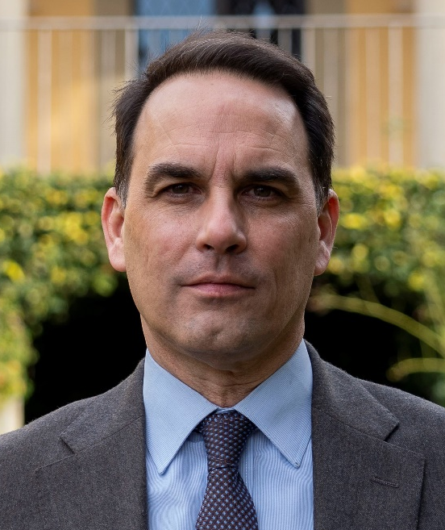
2024 Class A2 – Social and Related Sciences Section – Governance, Institutions & Policies
Daniele Caramani University of Zurich Switzerland | Parties and party systems Electoral systems and behaviour Democracy and democratization Populism and technocracy Historical analysis Comparative politics and methods Globalization Political representation Nationalism, state formation, and nation-building European integration

Slide 45

2024 Class A2 – Social and Related Sciences Section – Governance, Institutions & Policies
Maurizio Ferrera University of Milan Italy | EU studies Political theory Comparative social policies

Slide 46
2024 Class A2 – Social and related sciences Section – Human Mobility, Governance, Environment & Space
Overall section members: 154 Overall foreign members: 15 Overall female members: 32

Slide 47

2024 Class A2 – Social and Related Sciences Section – Human Mobility, Governance, Environment & Space
Harriet Bulkeley Durham University United Kingdom | Politics and governance of environmental issues Climate change Roles of cities and other non-state actors in responding to this global challenge Social and environmental justice Urban sustainability focusing energy, smart grids, infrastructure, housing, mobility & waste

Slide 48

2024 Class A2 – Social and Related Sciences Section – Human Mobility, Governance, Environment & Space
Iñaki Alday Sanz Tulane University Barcelona Spain | Sustainable design Urbanism and urban ecology Architecture Urban public spaces Landscape studies: cities, riverfronts and water parks Environmental studies

Slide 49
2024 Class A2 – Social and related sciences Section – Law
Overall section members: 140 Overall foreign members: 7 Overall female members: 36

Slide 50

2024 Class A2 – Social and Related Sciences Section – Law
Randall Lesaffer KU Leuven Belgium | History of international law Diplomatic history Laws of war Legal history Constitutional history

Slide 51

2024 Class A2 – Social and Related Sciences Section – Law
Antonello Miranda University of Palermo Italy | Comparative law Legal systems English law European private law Legal history Family law

Slide 52
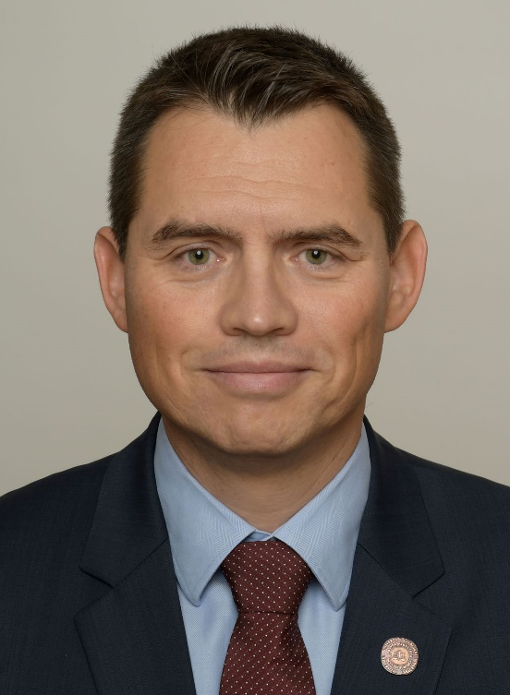
2024 Class A2 – Social and Related Sciences Section – Law
Grega Strban University of Ljubljana Slovenia | Labour law Comparative legal studies International social law Law European Union law Social law Legal terminology

Slide 53
2024 Class A2 – Social and related sciences Section – The Human Mind and its Complexity
Overall section members: 177 Overall foreign members: 5 Overall female members: 54

Slide 54
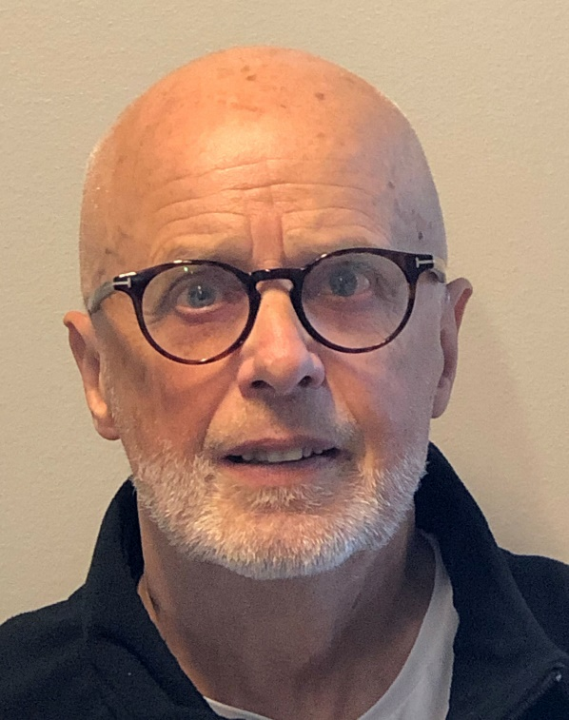
2024 Class A2 – Social and Related Sciences Section – The Human Mind and its Complexity
Kenneth Hugdahl University of Bergen Norway | Cognitive neuroscience Neuroimaging, functional magnetic resonance imaging (fMRI) Hemispheric asymmetry and auditory processing Neuroscience of mental disorders, schizophrenia and auditory hallucinations Experimental psychology, attention and language

Slide 55
2024 Class B – Exact Sciences Section – Mathematics
Overall section members: 239 Overall foreign members: 33 Overall female members: 28

Slide 56

2024 Class B – Exact Sciences Section – Mathematics
Andrew Kresch University of Zurich Switzerland | Rationality problems Algebraic geometry Brauer groups

Slide 57
2024 Class B – Exact Sciences Section – Informatics
Overall section members: 383 Overall foreign members: 86 Overall female members: 33

Slide 58
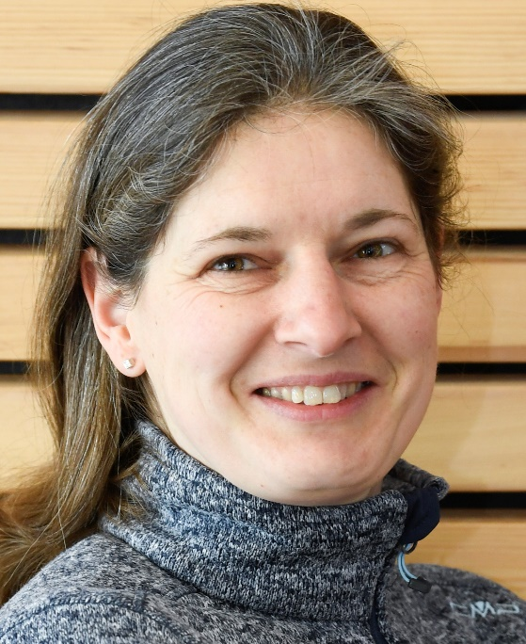
2024 Class B – Exact Sciences Section – Informatics
Barbara Hammer University of Bielefeld Germany | Artificial intelligence applications for social good Human-centered machine learning Learning for data streams Neural networks for structured data Neuro-symbolic systems Explainable artificial intelligence Machine learning Nonlinear dimensionality reduction and self-organization

Slide 59

2024 Class B – Exact Sciences Section – Informatics
Mira Mezini Technische Universität Darmstadt Germany | AI programming systems Automated software engineering Software security Programming languages design and implementation

Slide 60
2024 Class B – Exact Sciences Section – Informatics
Stefanie Rinderle-Ma Technical University of Munich Germany | Workflow automation Information systems Collaborative and distributed processes Business process management AI-driven compliance management Process intelligence Flexible process technologies

Slide 61
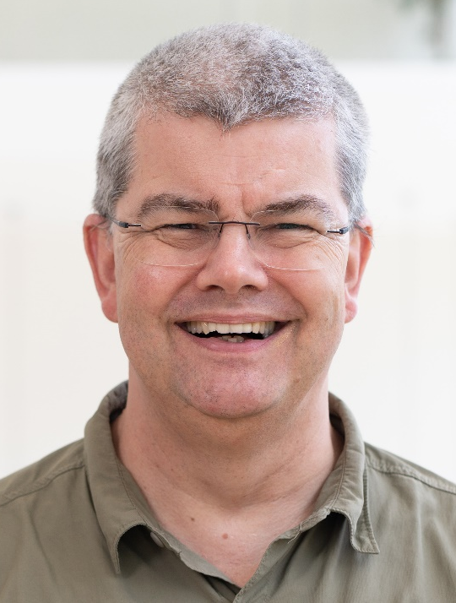
2024 Class B – Exact Sciences Section – Informatics
Andreas Zeller CISPA Helmholtz Center for Information Security Saarbrucken Germany | Software security Automated software debugging Software testing and analysis Mining software archives Mining software specifications Generating software tests

Slide 62
2024 Class B – Exact Sciences Section – Physics & Engineering Sciences
Overall section members: 511 Overall foreign members: 80 Overall female members: 45

Slide 63
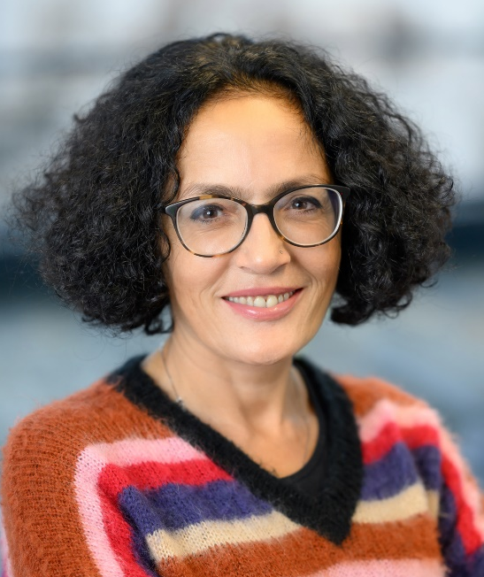
2024 Class B – Exact Sciences Section – Physics & Engineering Sciences
Tiziana Di Matteo King’s College London United Kingdom | Granular materials Numerical simulations of diffusive processes for the analysis of the magnetic properties in new materials Magnetic properties of high-Tc superconductors Econophysics Network science Josephson Junction networks Data science Strongly correlated electronic systems and high-Tc superconductivity Complex systems Superconducting technological devices

Slide 64
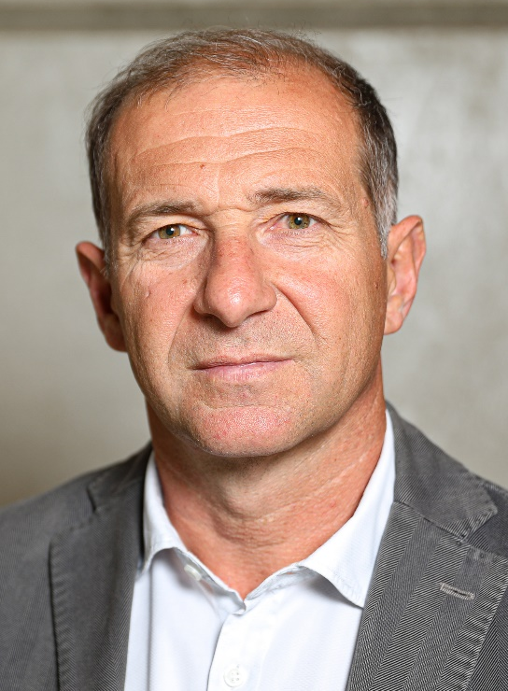
2024 Class B – Exact Sciences Section – Physics & Engineering Sciences
Ambrogio Fasoli Swiss Federal Institute of Technology- Lausanne (EPFL) Switzerland | Plasma magnetic confinement Magnetic reconnection Physics of burning plasmas Suprathermal particle physics Plasma physics Fusion energy Plasma waves Turbulence

Slide 65

2024 Class B – Exact Sciences Section – Physics & Engineering Sciences
Despo Fatta-Kassinos University of Cyprus Cyprus | Contaminants of emerging concern in the environment and technical systems Reclaimed water reuse Advanced processes for wastewater treatment Antimicrobial resistance determinants in natural and engineered systems

Slide 66

2024 Class B – Exact Sciences Section – Physics & Engineering Sciences
Martin Ostoja-Starzewski University of Illinois at Urbana-Champaign USA | Sensor networks Wireless communication systems (4G,5G,6G) Machine learning Molecular communications Statistical learning and inference Underwater networking Information theory Communication theory Signal processing

Slide 67
2024 Class B – Exact Sciences Section – Chemical Sciences
Overall section members: 328 Overall foreign members: 41 Overall female members: 54

Slide 68
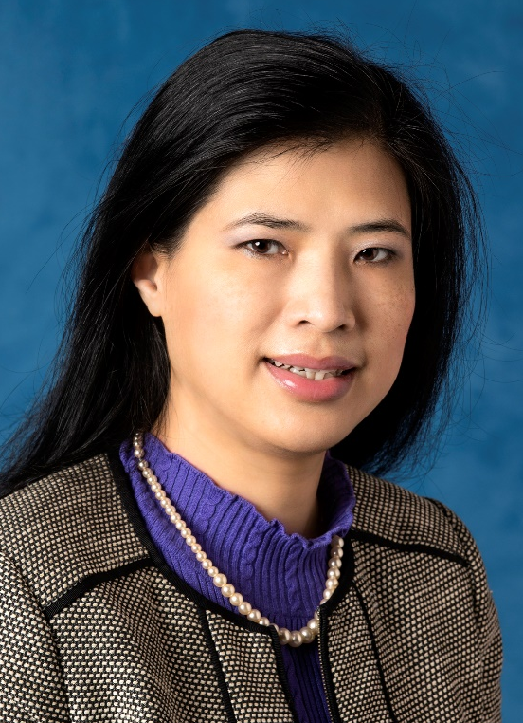
2024 Class B – Exact Sciences Section – Chemical Sciences
Thanh Thi Kim Nguyen University College London United Kingdom | Chemical synthesis of nanomaterials Physical characterisation of nanomaterials Biofunctionalisation of nanomaterials for biomedical applications

Slide 69
2024 Class B – Exact Sciences Section – Earth & Cosmic Sciences
Overall section members: 455 Overall foreign members: 48 Overall female members: 57

Slide 70
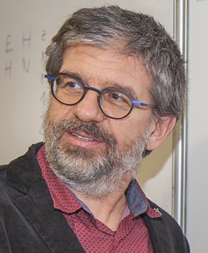
2024 Class B – Exact Sciences Section – Earth & Cosmic Sciences
Razvan Caracas CNRS, UNIVERSITE PARIS CITE France | Spectroscopy Geochemistry Mineral phyiscs Ab initio simulations Geophysics Planetary formation Extreme conditions Impacts Computational mineralogy Accretion

Slide 71
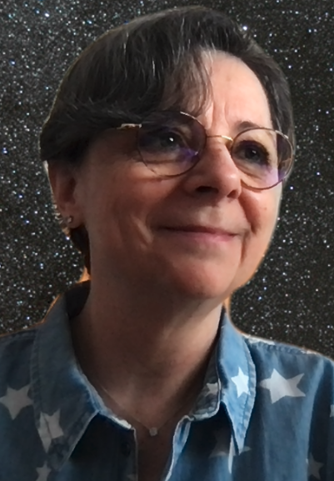
2024 Class B – Exact Sciences Section – Earth & Cosmic Sciences
Cecilia Ceccarelli Université Grenoble Alpes France | Interstellar medium Solar system history Astrophysics Molecular physics Star formation Astrochemistry

Slide 72
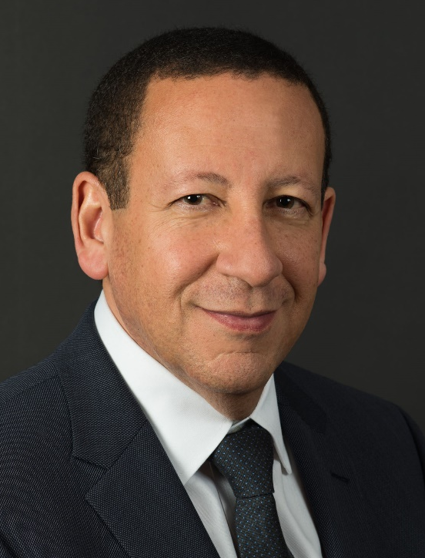
2024 Class B – Exact Sciences Section – Earth & Cosmic Sciences
Lyesse Laloui EPFL – Swiss Federal Institute of Technology Lausanne Switzerland | Energy geostructures Biomediated soils and grouting Smart urban design Geotechnical engineering Soil mechanics Geothermal energy Climate change mitigation and adaptation

Slide 73

2024 Class B – Exact Sciences Section – Earth & Cosmic Sciences
Stephen Mojzsis MTA Hungarian Academy of Sciences Budapest Hungary | Biogeodynamics Planetary geochemistry Geoastronomy Nuclear cosmochemistry Solid-state physics Radiogenic isotope geochemistry Stable isotope geochemistry Geochronology Metamorphic field petrology Origins of life

Slide 74
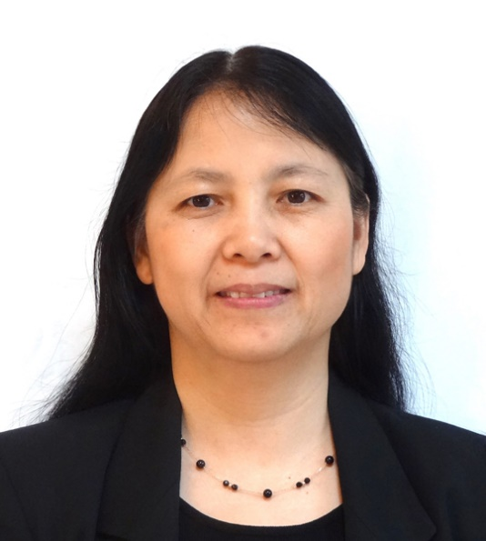
2024 Class B – Exact Sciences Section – Earth & Cosmic Sciences
Yang Zhang Northeastern University Boston United States | Air pollution and air quality Atmospheric chemistry, physics, and transport Aerosol chemistry and microphysics Chemistry-aerosol-cloud-climate interactions Multiscale (global to hyperlocal) atmospheric modeling and forecasting Integrated modeling for meteorological and chemical weather prediction Climate and Earth system modeling Linkages among air pollution, climate change, energy, ecosystem, and health Human-Earth system interactions Health impact assessment

Slide 75
2024 Class C – Life Sciences Section – Biochemistry & Molecular Biology
Overall section members: 428 Overall foreign members: 29 Overall female members: 86

Slide 76
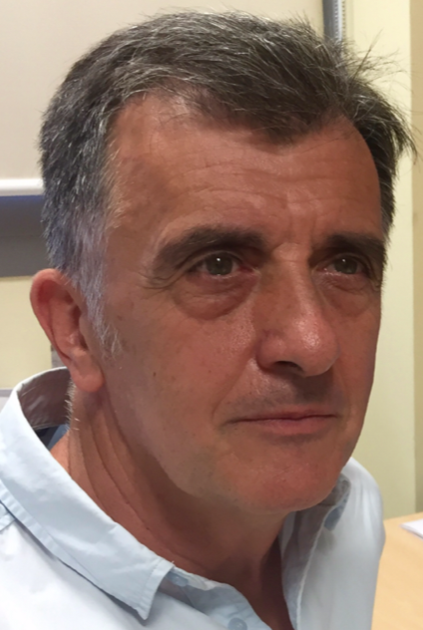
2024 Class C – Life Sciences Section – Biochemistry & Molecular Biology
Luis Blanco Consejo Superior de Investigaciones Cientificas (CSIC) Madrid Spain | Discovery of bacteriophage phi29 DNA polymerase Double strand DNA break repair in bacteria and eukarya Discovery and characterization of human PrimPol Mechanisms of DNA replication DNA amplification methods and their use in biotecnology and genome analysis Discovery of human Pol lambda and human Polmu Terminal proteins as non-conventional primers for DNA replication Engineering of DNA polymerases as improved biotechnological tools DNA polymerases and primases involved in DNA damage tolerance and DNA replication stress

Slide 77

2024 Class C – Life Sciences Section – Biochemistry & Molecular Biology
Emmanuelle Charpentier Max Planck Unit for the Science of Pathogens Berlin Germany | CRISPR-Cas Microbiology Regulatory Proteins Regulatory RNAs Streptococcus pyogenes Bacteriology

Slide 78

2024 Class C – Life Sciences Section – Biochemistry & Molecular Biology
Junbiao Dai Chinese Academy of Agricultural Sciences Shenzhen China | Synthetic biology Yeast genetics Genome engineering Synthetic genomics Genome synthesis and assembly

Slide 79
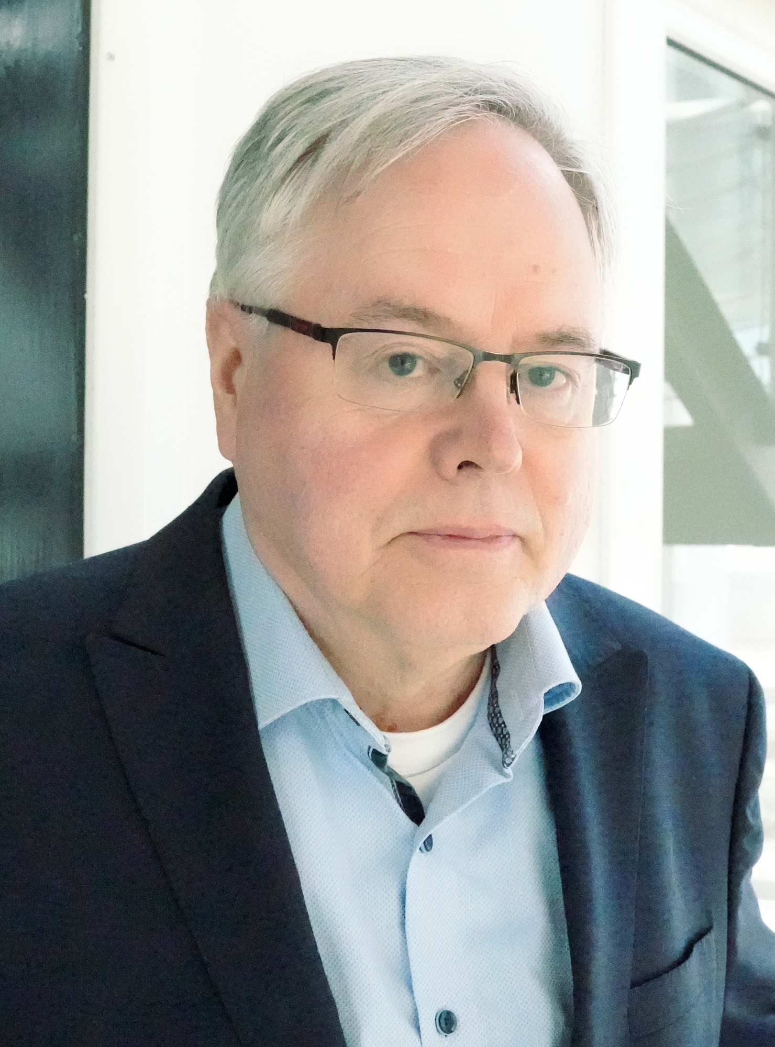
2024 Class C – Life Sciences Section – Biochemistry & Molecular Biology
Jyrki Heino University of Turku Finland | Cell adhesion Matrisome Extracellular matrix Cancer biology Cell biology Structural biology Cell adhesion receptors Biochemistry Cellular signalling

Slide 80
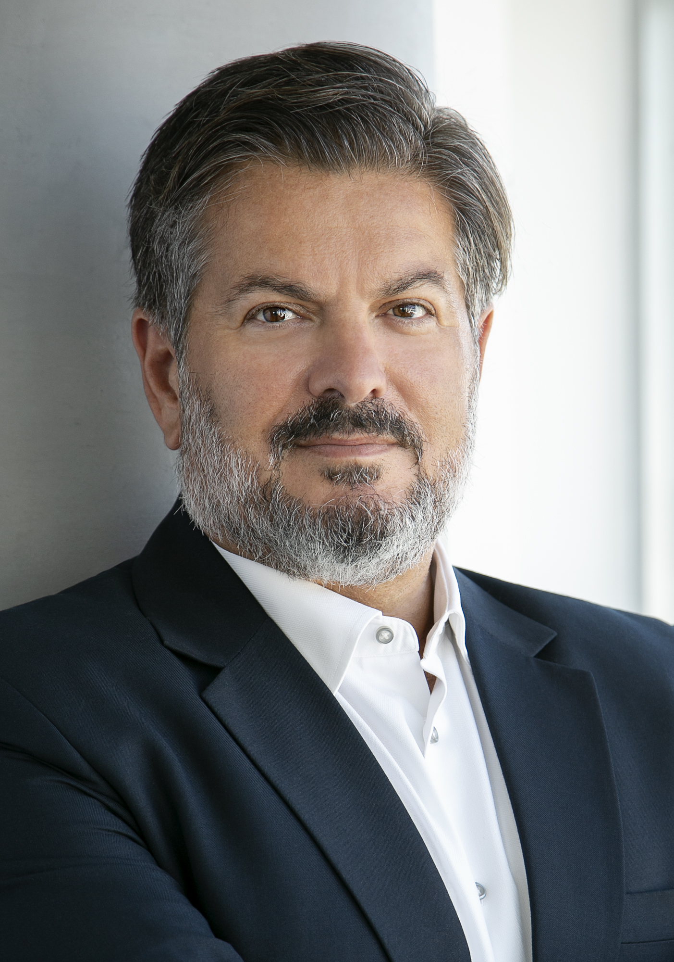
2024 Class C – Life Sciences Section – Biochemistry & Molecular Biology
Leontios Kostrikis University of Cyprus CYPRUS | Human genetics in the transmission of HIV-1 and disease progression Global molecular epidemiology of HIV1 infection Molecular detection of coronaviruses Detection of the SARS coronavirus and other SARS-associated coronaviruses Global transmission drug resistance

Slide 81

2024 Class C – Life Sciences Section – Cell & Developmental Biology
Francisco Martinez Mojica University of Alicante Spain | Microbiology CRISPR Genetics of prokaryotes Bacterial physiology Molecular biology DNA topology Gene expression

Slide 82
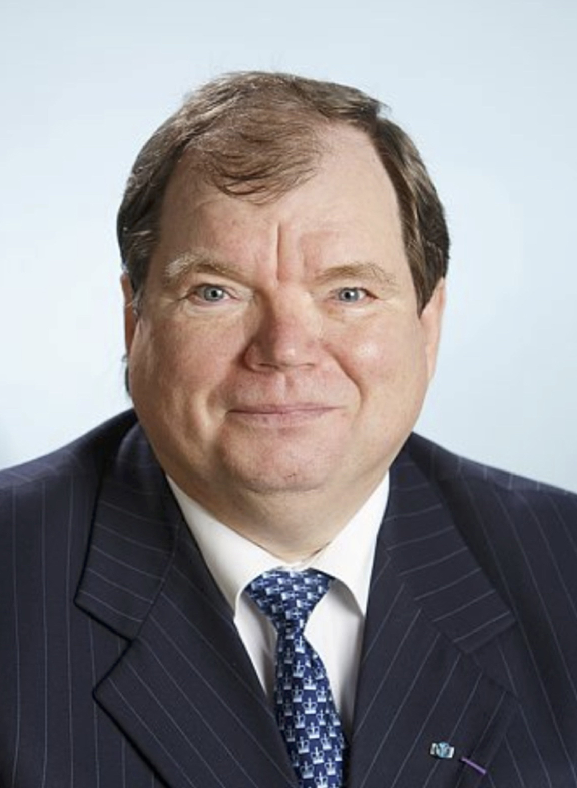
2024 Class C – Life Sciences Section – Biochemistry & Molecular Biology
Andres Metspalu Tartu Estonia | Microarray technology Personalised medicine and prevention Medical genomics DNA diagnostics Human genetics and genomics Biobanking

Slide 83
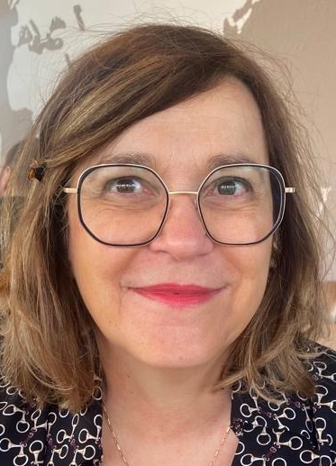
2024 Class C – Life Sciences Section – Biochemistry & Molecular Biology
Michaela Müller-Trutwin Institut Pasteur Paris France | Natural killer cells Virology Antiviral cellular innate immunity Preclinical research (nonhuman primates) Viral persistence Translational research

Slide 84

2024 Class C – Life Sciences Section – Biochemistry & Molecular Biology
Natalia Prevarskaya University de Lille France | Molecular pharmacology Oncochannelopathies Ion channels and cancer Prostate cancer Calcium signaling and cancer

Slide 85
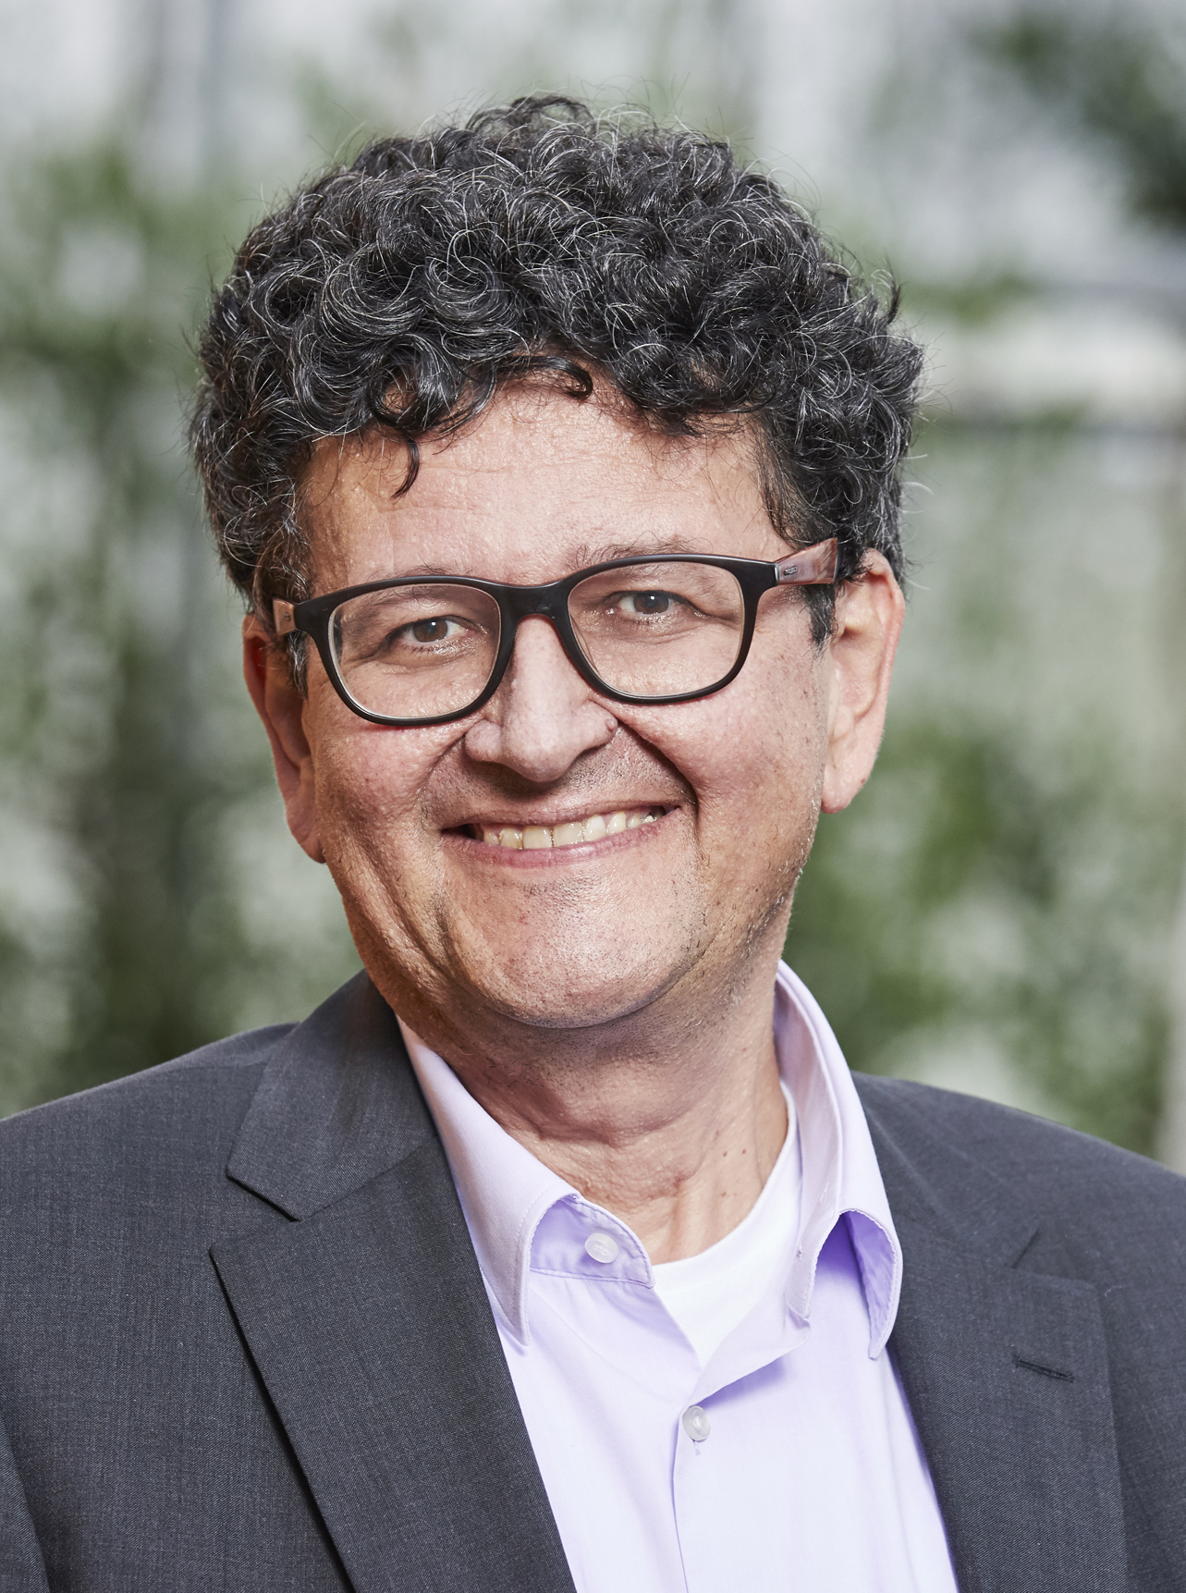
2024 Class C – Life Sciences Section – Biochemistry & Molecular Biology
Holger Puchta Karlsruhe Institute for Technology Germany | Plant genetics Genome engineering DNA recombination DNA repair Gene editing

Slide 86

2024 Class C – Life Sciences Section – Biochemistry & Molecular Biology
Lixin Zhang East China University of Science and Technology Shanghai China | Intelligent bio-manufacturing Chemical biology Microbial drug discovery Synthetic biology

Slide 87
2024 Class C – Life Sciences Section – Cell & Developmental Biology
Overall section members: 264 Overall foreign members: 18 Overall female members: 51

Slide 88

2024 Class C – Life Sciences Section – Cell & Developmental Biology
Thomas Brunner University of Konstanz Germany | Nuclear receptors Immunology TNF family BCL-2 family Glucocorticoids Cell death Inflammation

Slide 89
2024 Class C – Life Sciences Section – Cell & Developmental Biology
Yrjö Helariutta University of Helsinki Finland | Molecular genetics Arabidopsis thaliana Emerging models Tree biology & genomics Plant vascular biology Wood formation Forestry and breeding Developmental biology

Slide 90
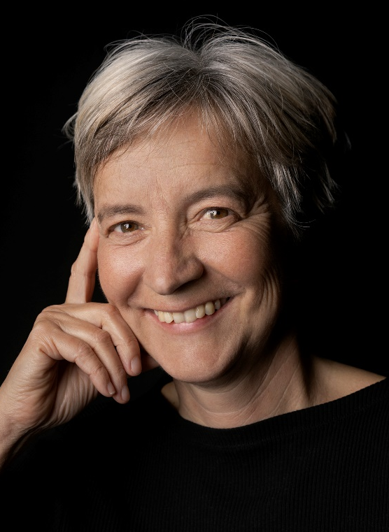
2024 Class C – Life Sciences Section – Cell & Developmental Biology
Anna Katharina Simon Max Delbrück Center Berlin Germany | Autophagy prevents aging immune cells Autophagy inducers in vaccine responses (clinical trials) Mechanisms of immunological tolerance in the thymus Peripheral tolerance in tumour immunity T cell subsets in autoimmunity Cell Death mechanisms in immune cells Autophagy in hematopoiesis (stem cells and mature lineages) Autophagy in immune cells

Slide 91
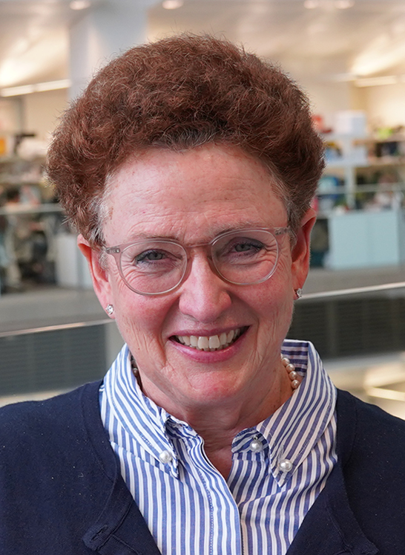
2024 Class C – Life Sciences Section – Cell & Developmental Biology
Sharon A. Tooze The Francis Crick Institute London United Kingdom | Vesicular trafficking Autophagy Molecular cell biology Organelle biogenesis Protein trafficking Secretory pathway

Slide 92
2024 Class C – Life Sciences Section – Physiology & Neuroscience
Overall section members: 477 Overall foreign members: 78 Overall female members: 51

Slide 93
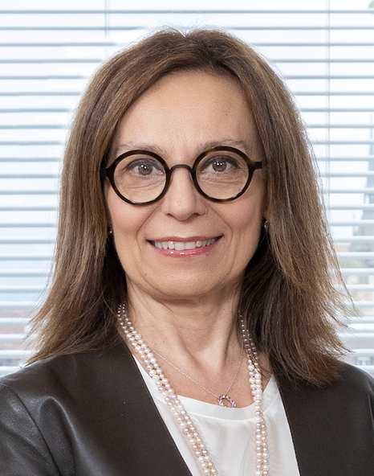
2024 Class C – Life Sciences Section – Physiology & Neuroscience
Claudia Bagni University of Lausanne Switzerland | Molecular mechanisms of synaptic plasticity Neuronal development mRNA metabolism Molecular mechanisms of cancer in the context of Fragile X syndrome Intellectual disabilities Brain wiring Fragile X Syndrome ASD and SCZ-like behaviours Autism

Slide 94

2024 Class C – Life Sciences Section – Physiology & Neuroscience
Zsuzsanna Helyes University of Pécs Hungary | Transient Receptor Potential Ion Channels (TRPV1, TRPA1) Sensory-vascular-immune interactions Neuropeptides Trigeminovascular activation, migraine Analgesic, anti-inflammatory and antidepressant drug discovery and development Complex Regional Pain Syndrome Somatostatin sst4 receptor Capsaicin-sensitive sensory nerves Neurogenic inflammation Neuropathic pain

Slide 95
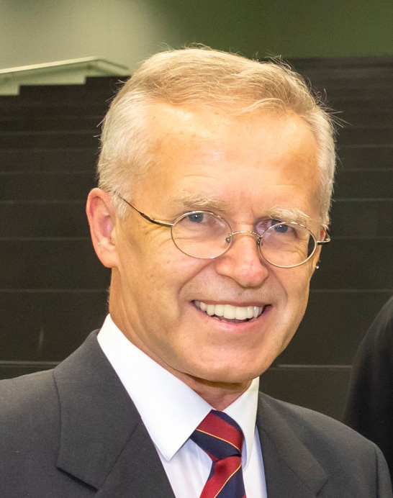
2024 Class C – Life Sciences Section – Physiology & Neuroscience
Peter Holzer Medical University of Graz Austria | Potential role of the gastrointestinal microbiota in nutrition-related brain dysfunction Neurogenic inflammation and its mediators Translational models in pharmacology and neuroscience Communication between gastrointestinal tract and brain via neuronal, endocrine and immune pathways Analysis of the opioid system in the gastrointestinal tract Capsaicin-sensitive neurons in gastric mucosal blood flow and protection of the gastric mucosa Neuropeptides Gastric acid induced signalling to the brain mediated by vagal afferent neurons Neuropharmacological analysis of the effect of peripheral immune activation

Slide 96

2024 Class C – Life Sciences Section – Physiology & Neuroscience
Gemma Modinos King’s College London United Kingdom | Multimodal neuroimaging Cross-species neuroimaging Psychosis Neuropsychopharmacology Social neuroscience Schizotypy Schizophrenia

Slide 97

2024 Class C – Life Sciences Section – Physiology & Neuroscience
Fu-Dong Shi Beijing Tiantan Hospital China | Immunology Clinical neuroscience Neuroinflammatory diseases Stroke Neurology Multiple sclerosis

Slide 98
2024 Class C – Life Sciences Section – Physiology & Neuroscience
Liliane Schoofs KU Leuven Belgium | Comparative endocrinoogy Biochemistry Physiology Neurobiology Role of brain neuropeptides in behaviour and physiology

Slide 99
2024 Class C – Life Sciences Section – Physiology & Neuroscience
Pawel Swietach University of Oxford United Kingdom | Hypoxia Cardiac Red blood cells Acid/base Mathematical modelling Physiology Metabolism Cancer biology pH regulation

Slide 100
2024 Class C – Life Sciences Section – Ecology & Evolution
Overall section members: 163 Overall foreign members: 11 Overall female members: 23

Slide 101
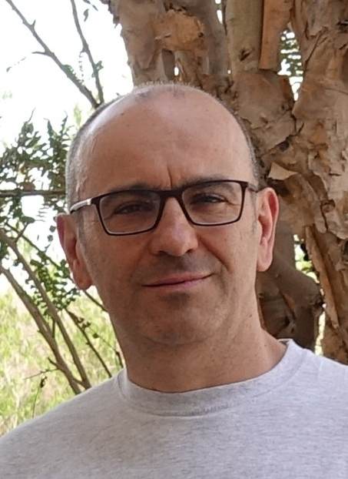
2024 Class C – Life Sciences Section – Ecology & Evolution
Alessandro Chiarucci Alma Mater University of Bologna Italy | Biogeography Conservation biology Macroecology Biodiversity assessment Community ecology Vegetation science

Slide 102
2024 Class C – Life Sciences Section – Ecology & Evolution
Richard Primack Boston University United States | Using community science in climate change research Conservation biology Using herbarium species in ecological research Plant population biology Writing conservation textbooks and producing translations Managing a conservation biology journal Ecological and conservation impacts of the COVID-19 pandemic Climate change biology and phenology Tropical ecology and conservation Using networks of botanical gardens in climate change research

Slide 103
2024 Class C – Life Sciences Section – Ecology & Evolution
Carlo Rondinini Sapienza University of Rome Italy | Mammal extinction risk Spatial conservation prioritization Conservation biology Scenarios of biodiversity change

Slide 104
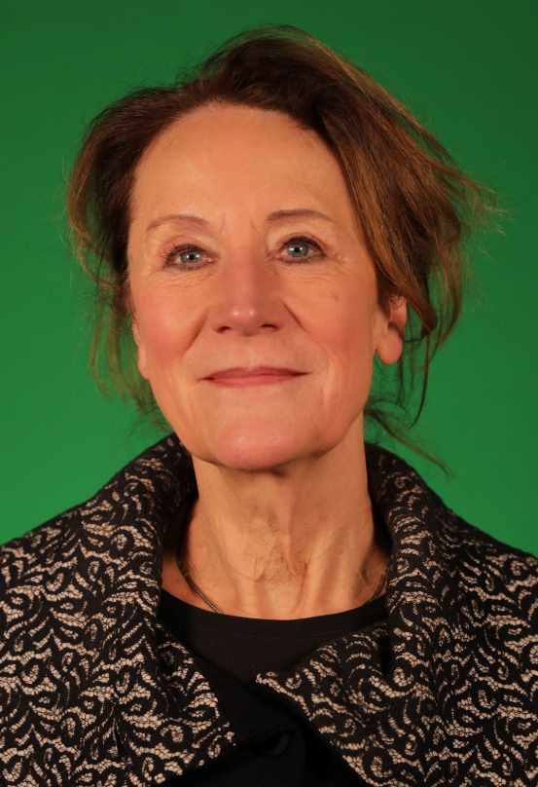
2024 Class C – Life Sciences Section – Ecology & Evolution
Louise Vet Netherlands Institute of Ecology (NIOO-KNAW) Wageningen The Netherlands | Ecosystem services Biodiversity Above-belowground interactions Biological control Community ecology Behavioural ecology Multitrophic interactions Evolutionary ecology Sustainable agriculture

Slide 105
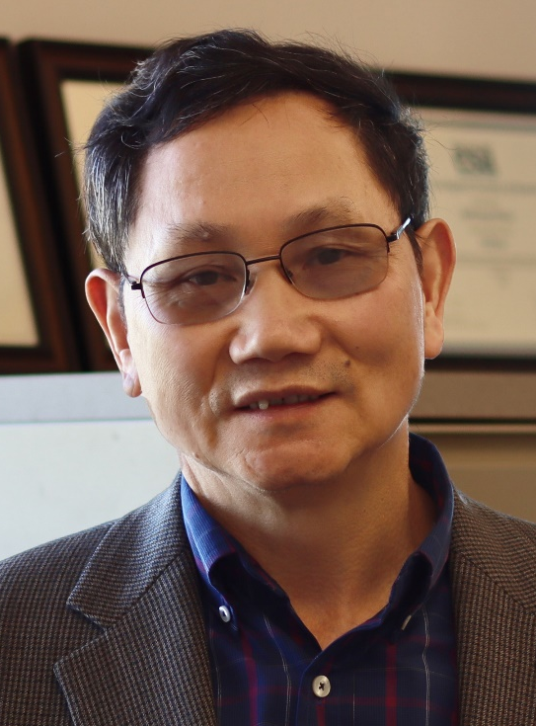
2024 Class C – Life Sciences Section – Ecology & Evolution
Jizhong Zhou University of Oklahoma Norman, OK United States | Experimental evolution Microbial genomics Bioinformatics Environmental remediation Climate change Microbiome sciences Metagenomics Microbial ecology Genomic technologies Theoretical ecology

Slide 106
2024 Class C – Life Sciences Section – Clinical & Veterinary Science
Overall section members: 366 Overall foreign members: 29 Overall female members: 58

Slide 107
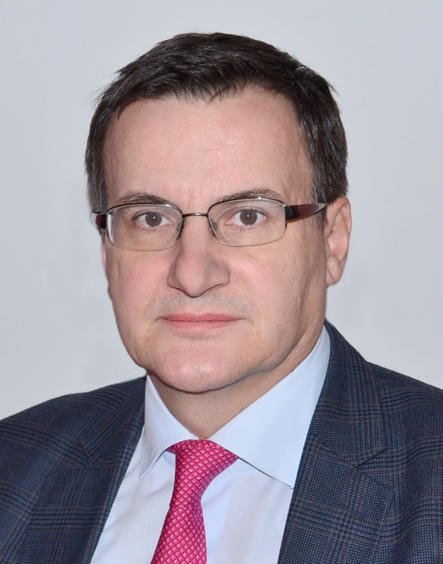
2024 Class C – Life Sciences Section – Clinical & Veterinary Science
Boris Brkljačić University of Zagreb School of Medicine Croatia | Radiation protection Vascular imaging Breast imaging Urogenital imaging

Slide 108
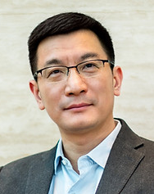
2024 Class C – Life Sciences Section – Clinical & Veterinary Science
Xiaoyuan Chen National University of Singapore Singapore | Nanomedicine mRNA vaccine Theranostics Gene and drug delivery Biomaterials Radiopharmaceuticals Molecular imaging Cancer

Slide 109

2024 Class C – Life Sciences Section – Clinical & Veterinary Science
Maria Dorobantu University of Medicine and Pharmacy "Carol Davila“ Bucharest Romania | Cell biology Echocardiograpy Heart failure Coronary microcirculation Arterial hypertension Coronary artery disease

Slide 110
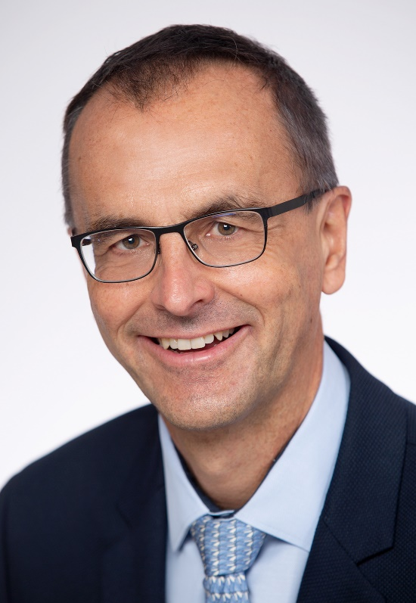
2024 Class C – Life Sciences Section – Clinical & Veterinary Science
Martin Fromm Friedrich-Alexander-University Erlangen-Nuremberg Erlangen Germany | Biomarkers for transporter-mediated drug-drug interactions Medication safety (oncology, geriatrics) Mass spectrometry and metabolomics Drug transporters and drug metabolism Mechanisms underlying drug-drug interactions

Slide 111
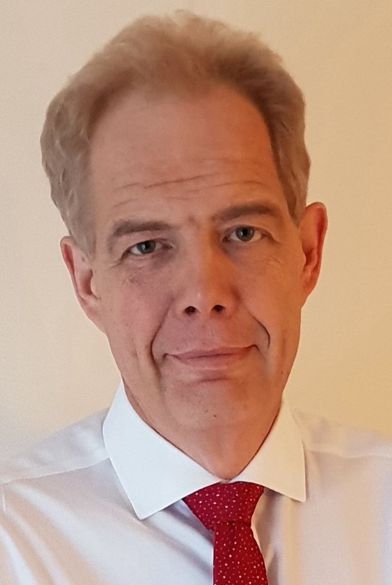
2024 Class C – Life Sciences Section – Clinical & Veterinary Science
Martin Koltzenburg University College London United Kingdom | Experimental medicine Clinical trials Translational neurophysiological biomarker Experimental neurophysiology Sensorimotor control Clinical neurophysiology Sensory neurons Somatosensation Pain and nociception Neurology

Slide 112
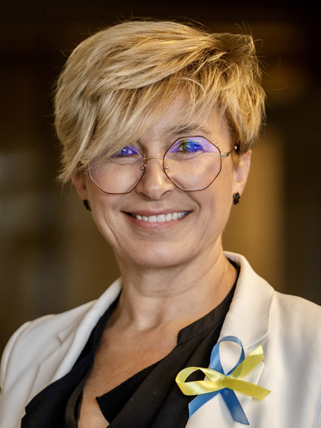
2024 Class C – Life Sciences Section – Clinical & Veterinary Science
Joanna Rymaszewska Wroclaw University of Science and Technology Poland | Dementia Deep brain stimulation in mental disorders Consultation-liaison psychiatry (psychiatry in somatic medicine) Functional disorders and body stress disorder Old age psychiatry Neuromodulation in psychiatry Psychosocial interventions Social psychiatry Transcranial magnetic stimulation in mental disorders Whole-body cryotherapy in mental disorders

Slide 113
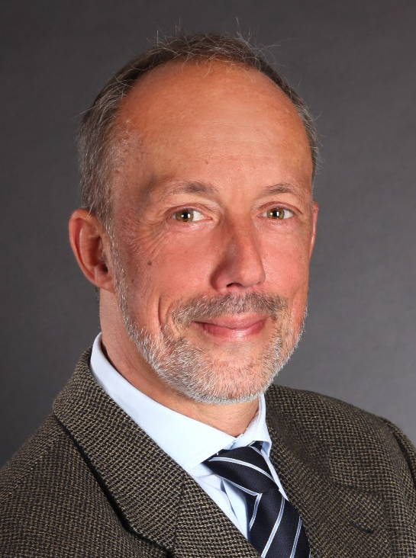
2024 Class C – Life Sciences Section – Clinical & Veterinary Science
Rainer Schulz Justus Liebig University Giessen Germany | Cardioprotection Ischemia Mitochondria Pulmonary hypertension Reperfusion

Slide 114

2024 Class C – Life Sciences Section – Clinical & Veterinary Science
Michel Wensing Heidelberg University Germany | Patients' perspectives and self-management Evidence-based healthcare Implementation science in health Primary healthcare Organisation of healthcare

Slide 115

2024 Class C – Life Sciences Section – Clinical & Veterinary Science
Mone Zaidi Icahn School of Medicine at Mount Sinai New York United States | Endocrinology Translational medicine Pharmacology Neurodegeneration Skeletal medicine Obesity Metabolism

