Slide 1
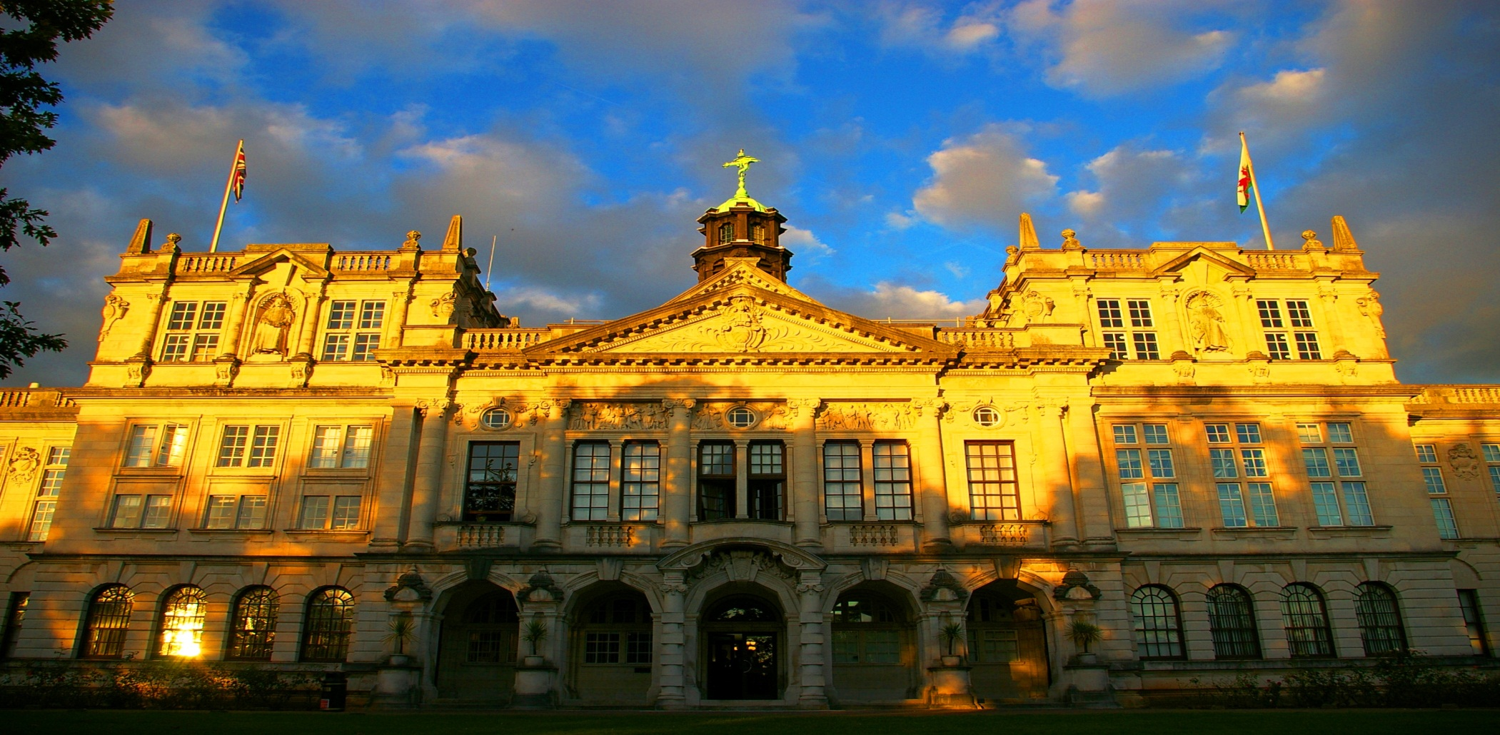
Potential Impact of Plan S from a Researcher’s Perspective
Professor Nora de Leeuw
Pro Vice-Chancellor International & Europe
The future of research, Assessing the impact of Plan S
Leuven 2019

Slide 2
Opportunities
1
Research available to wider audience beyond academic disciplines
2
Researchers in developing countries gain full access to up-to-date literature
3
Make SME’s and policy units aware of pertinent expertise and experience
4
Assists justification of public funding of research

Slide 3
Challenges
Financial implications for Universities, particularly in transition period
1
2
3
Experienced hybrid journals not compliant
Barriers for (early-career) scientists to publish in ‘prestigious journals’
4
Publishing not readily accessible to researchers in developing countries
5
Potential financial drawbacks for learned societies which may affect charitable activities

