Slide 1

  Professor Jeff Haywood, Vice Principal Digital Education
  University of Edinburgh, UK
  jeff.haywood@ed.ac.uk
  http://homepages.ed.ac.uk/jhaywood
Learning from MOOCs – lessons for the future

Slide 2
“Learning Technology and Groundhog Day”
Terry Mayes, 1995
Seen it all before
It will blow over
“a faculty encamped just north of armageddon”
Robert Zemsky, “Checklist for Change”

Slide 3
Lessons from learning at scale:
learners, technologies & directions
Educational data from MOOCs – pro’s & con’s
What have we learned?
Some technology gaps
Some new areas to explore

Slide 4
Two types of MOOC research are most common
“Who studies on MOOCs?“
  e.g. University of Edinburgh
  Items: Demographics, MOOC intentions, satisfaction, prior experiences, future intentions
  Survey sources: incomplete (often <20% response rates)
  Ethics: explicit
“What do MOOC learners actually do on course?”
  e.g. MIT, EPFL
  Items: Groups of learner types, stop-out points, use of online tools, mastery, discussion forum behaviours
  System data: 100% but only records on-system study
  Ethics: ambiguous

Slide 5
“Who studies on MOOCs?“
What have we learned about…. ????
Age
Gender
Country of residence
Prior educational attainment & subject
Prior MOOC experience
Intentions for MOOC study
Actual MOOC outcomes
Behaviour on course
All our analyses are openly available at: http://moocs.is.ed.ac.uk
5

Slide 6
1.4 million sign ups - over 1 million unique people enrolled
10.5 million video views
1.9 million quizzes submitted
667,967 active learners
353,934 forum posts made
88,845 completion certificates awarded
745+ videos made
218 countries represented
85 academics + 109 TAs involved
38 live course iterations
24 courses
15 academic schools
6 core staff
2 platforms
2.5 years
DATA….

Slide 7
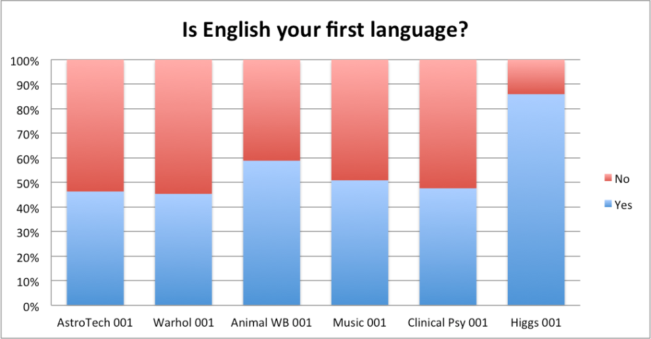
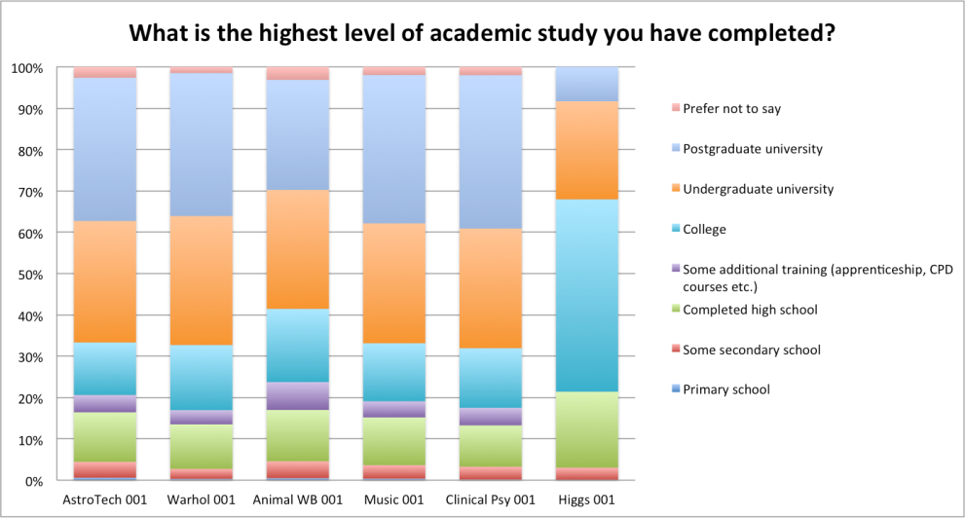
Futurelearn vs Coursera MOOC data
MOOC platform audiences differ appreciably…..it may be both design and the ‘maturity stage’ of the platform

Slide 8
Forum users per course vs. number of posts per forum user
Coursera
FutureLearn

Slide 9
13 courses 28 iterations 1.1 million sign ups 633,521 active learners

Slide 10
Certificate attainment

Slide 11
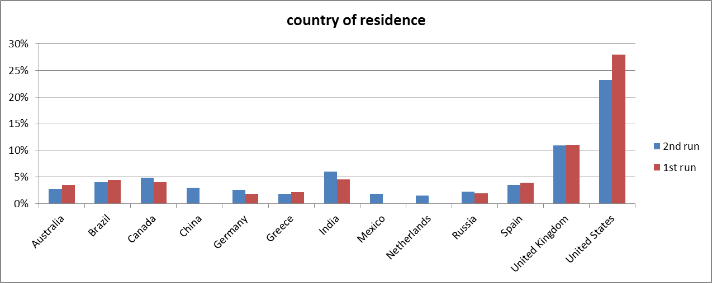
Top countries supplying learners on 6 Edinburgh MOOCs

Slide 13
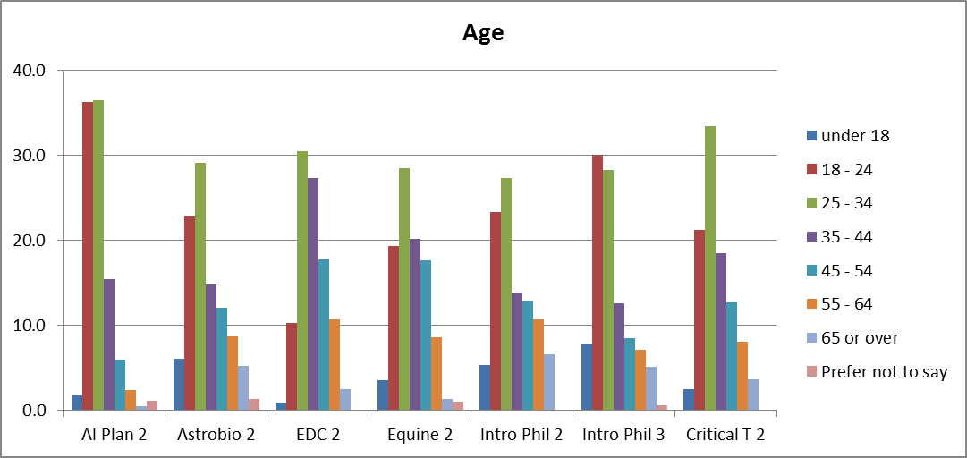
Age profiles of learners on 6 Edinburgh MOOCs

Slide 15
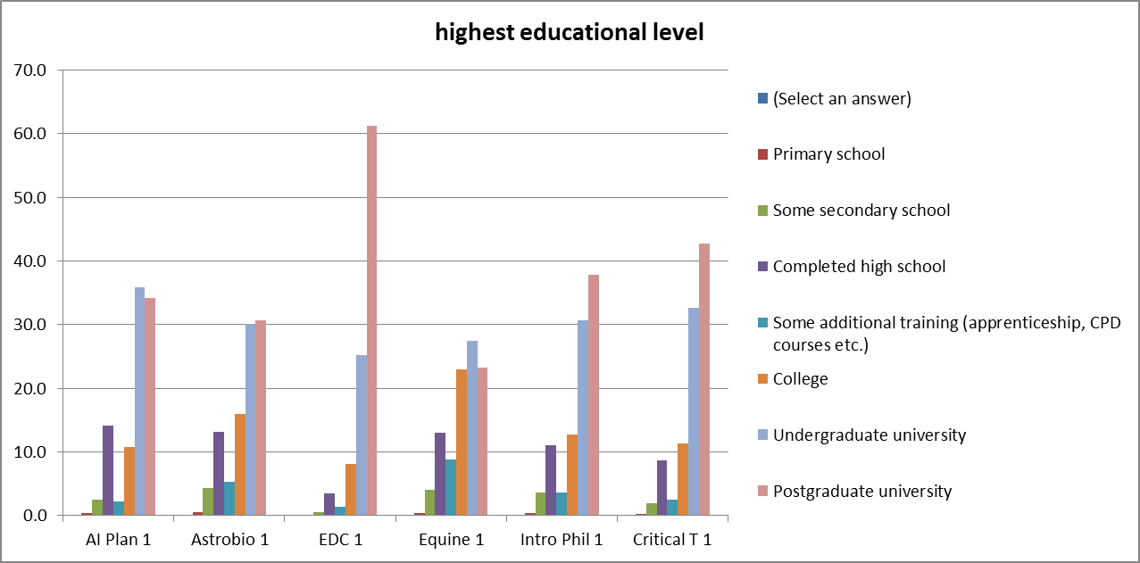
Educational profiles of learners on 6 Edinburgh MOOCs

Slide 16
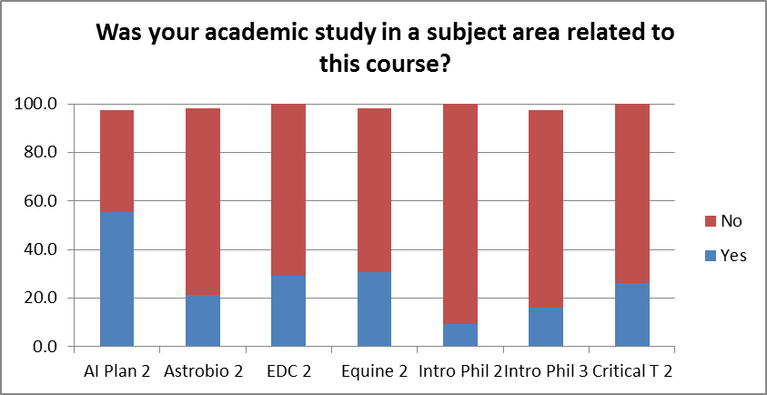
Prior study subject of learners on 6 Edinburgh MOOCs

Slide 17
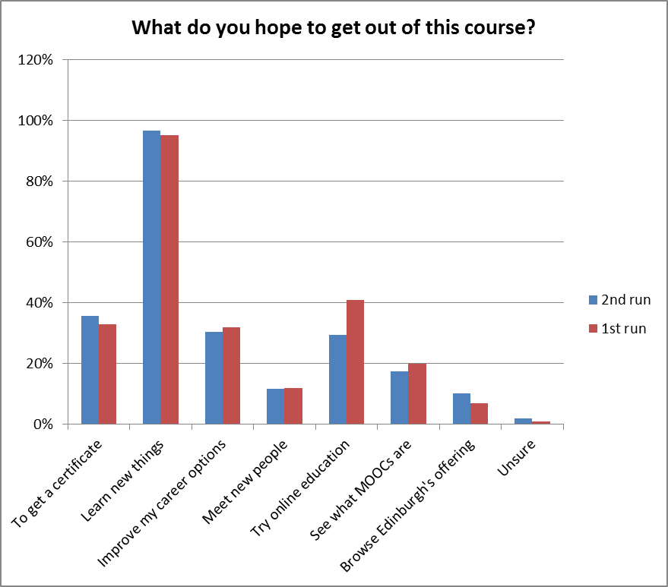
Reasons for learners to study on 6 Edinburgh MOOCs

Slide 18
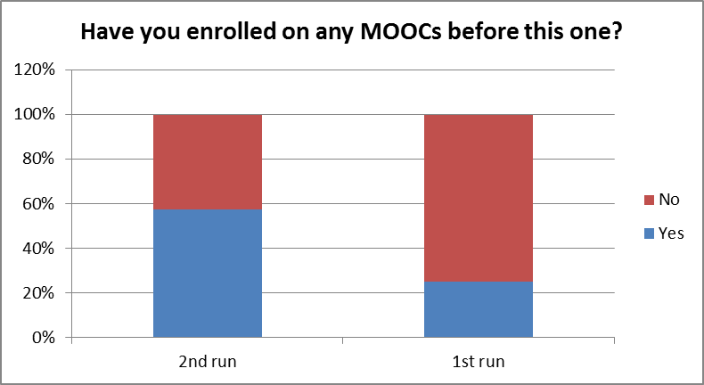
Increasing repeat study of learners on 6 Edinburgh MOOCs

Slide 19
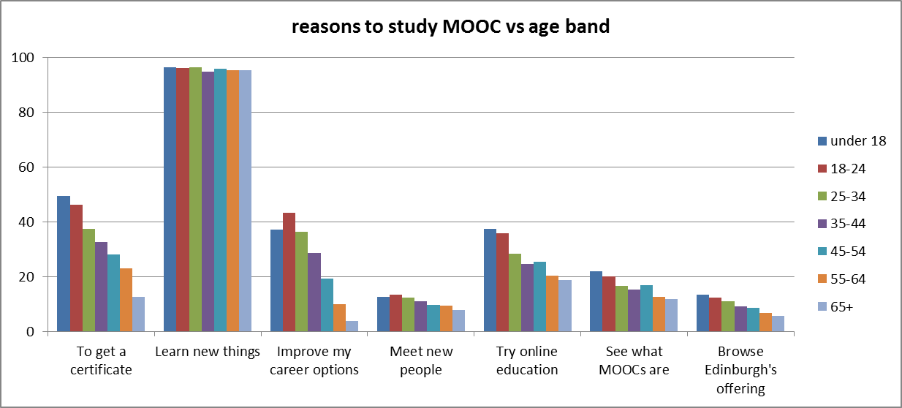
Reasons for studying on a MOOC vs age profiles

Slide 21
In summary:
Mostly adults of working age, well-educated, global with concentrations in developed countries, learning for interest
Demographics changing slowly, can be influenced
Large numbers of learners in the minority groups
Interest in study for career etc rising
As with all online education, continuous study hard to sustain against external pressures

Slide 22
Where next?

Slide 23
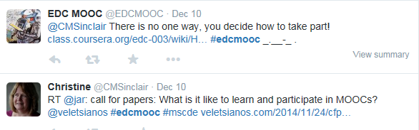
Teacherbots:
addressing mass communications with intelligent answers
Sian Bayne (2015) ‘Teacherbot: interventions in automated teaching’, Teaching in Higher Education 20(4): 455-467
Scanning the MOOC twitterspace for key words and phrases – deadline, assignment, lost, unsure…..and giving a teacher pre-prepared response

Slide 24
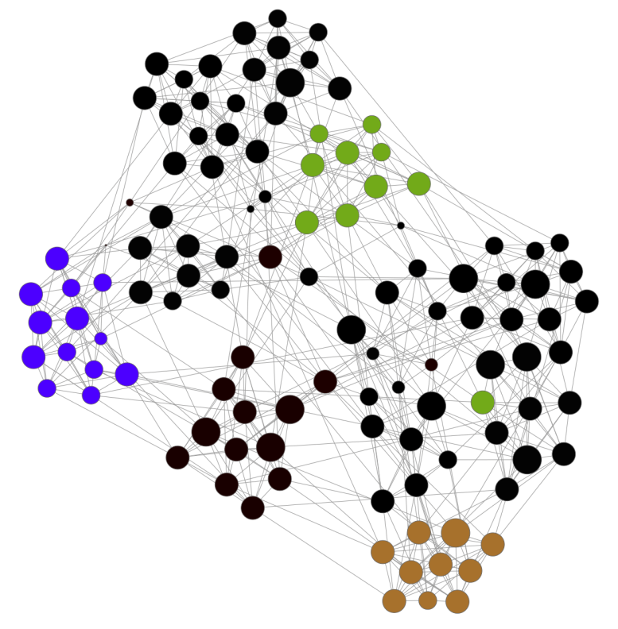
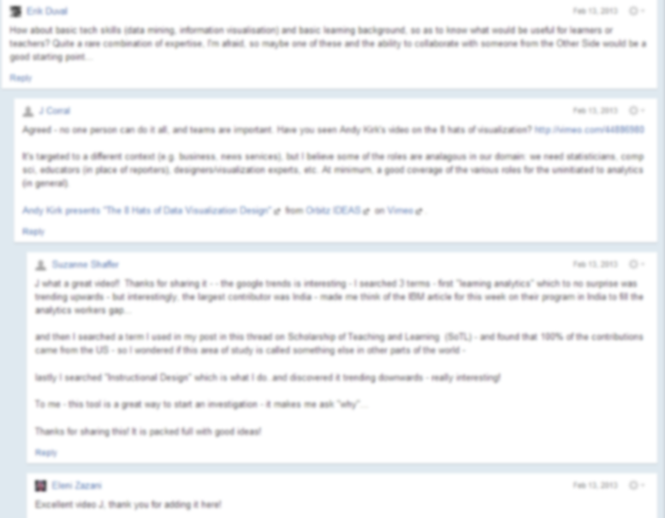

Dashboard for quality of online discussion groups

Slide 25







MOOCs & cultural backgrounds of learners
  Coursera = 45% non-US
  edX = 33% non-US
  F/L = 18% non-UK
http://www.rwaq.org/
http://www.xuetangx.com/

Slide 26
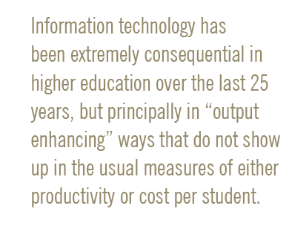
Potential for scaling up with technology??
William G Bowen, Tanner Lecture, Stanford University, October 2012

Slide 27
Potential for scaling up thru technology
Content
(video,
readings,
Etc)
Text-based interaction
(discourse, questions, tweets,
posts etc)
Assessment
(MCQ,
short text,
essay,
peer grading,
competence testing)
Bespoke
academic
Input
(career advice,
high stakes assessment etc)
Scalable to massive
Human only (1: small)

Slide 28
So, where does all this fit with a traditional university re-positioning itself for 2025?

Slide 29
An educational portfolio with technology: 2013
Open studies
Extension
~17,000 learners enrolled
LITTLE/NO TECHNOLOGY
TECHNOLOGY
On-campus
30,000 students
all courses
since ~1990
Off-campus
2000 students
50 Masters
since ~2005
14 MOOCs
750k learners
since 2012
~15 MOOCs under construction
open

Slide 30
An educational portfolio with technology: c2025
On-campus AND off-campus
40,000 students, all with at least one fully online course
RICH
TECHNOLOGY
Open studies
Extension
~17,000 learners enrolled
Off-campus
10,000 students
100 Masters
10s of PGRs
Open
100s MOOCs
1000s OERs
10,000,000 learners
since 2012
open
30

Slide 31

Thank you for listening
© MSc Digital Education
University of Edinburgh
http://online.education.ed.ac.uk/

